Slide 1
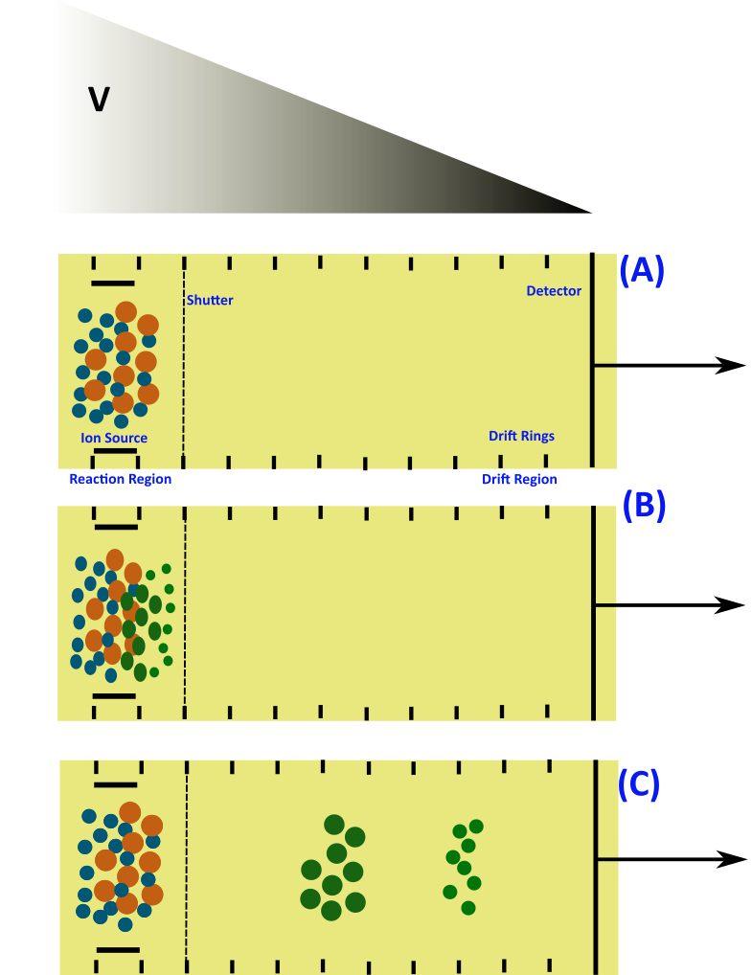
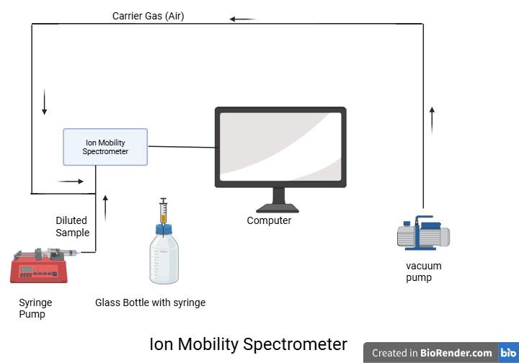
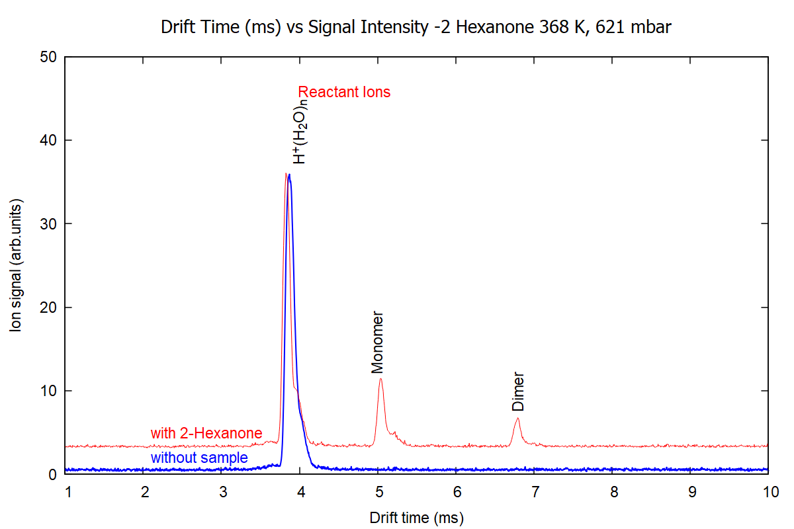

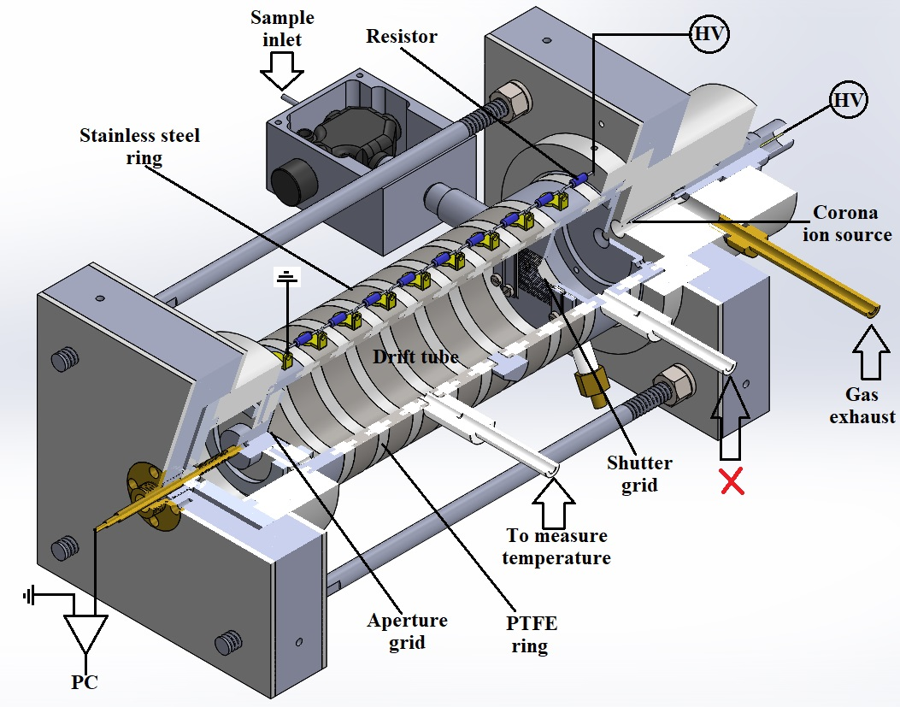
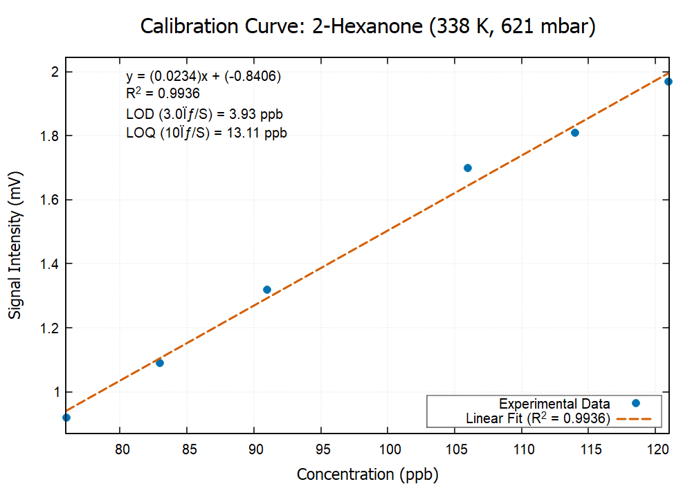
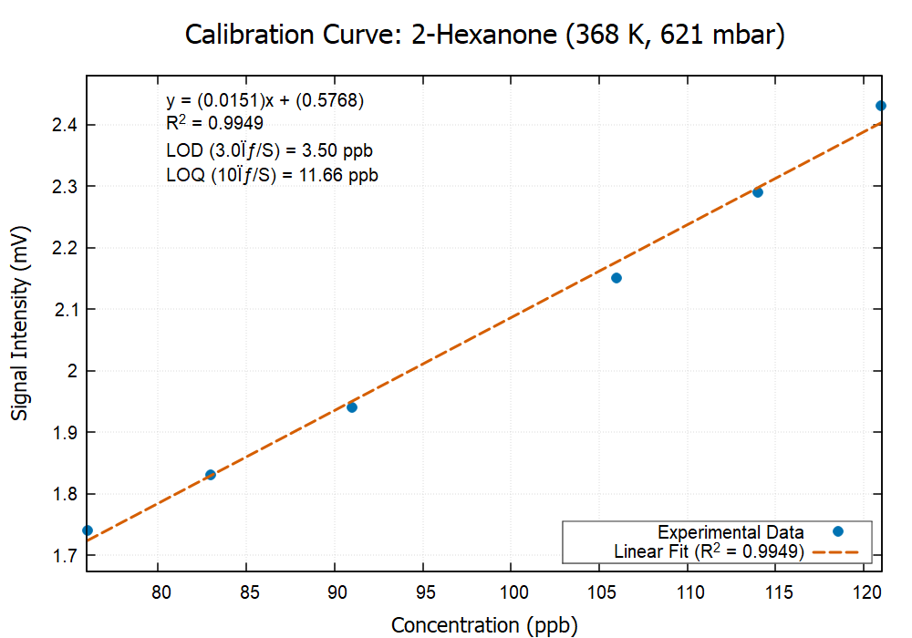
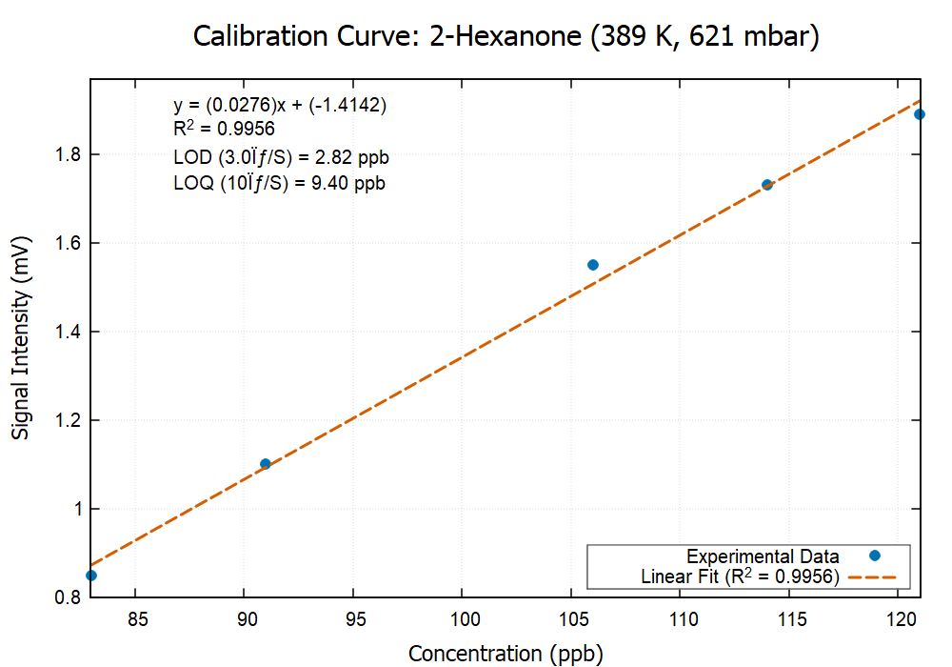
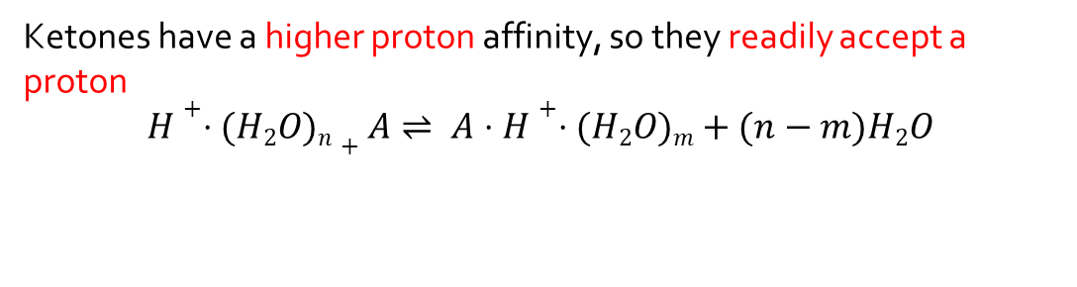
Detection of Ketones using Ion Mobility Spectrometry
Introduction
Principle
Experimental Setup
Volatile organic compound (VOC) detection is increasingly important for monitoring environmental quality, ensuring workplace safety, and supporting medical diagnostics.
This study focuses on how varying temperatures affect ketone detection using ion mobility spectrometry (IMS) equipped with corona discharge ionization (CDI) in positive mode.
Ion-Molecule Reactions
Ketones have a higher proton affinity, so they readily accept a proton
$$H+⋅(H2​O)n​+A⇌ A⋅H+⋅(H2​O)m​+(n−m)H2​O$$
Source: Internet
Ion Mobility Spectrometry
Detector Response vs Drift Time
Parameters
Operating parameter | Unit
IMS drift tube length | 11.93 cm
Electric field intensity | 670.6 V.cm⁻¹
IMS operating pressure | 621 mbar
IMS operating temperature | 370 K
Drift gas flow | 600 mL.min⁻¹
CD current | 10 μA
Shutter grid pulse width | 80 μs
Shutter grid frequency | 16 Hz
Carrier Gas Flow rate | 100 ml/min
Moravský et al., 2021, Rapid Commun Mass Spectrom. 2021;35(17):e9145
Calibration Curve
Temperature is used as a tunable parameter
As we increase the temperature, the Limit of Detection improves.
References:
[1] Michalczuk, B., Moravský, L., Hrdá, J., & Matejčík, Š. (2020). Atmospheric Pressure Chemical Ionisation study of selected Volatile Organic Compounds (VOCs) by Ion Mobility Spectrometry coupled with orthogonal acceleration Time Of Flight Mass Spectrometry. International Journal of Mass Spectrometry, 449. https://doi.org/10.1016/j.ijms.2019.116275
[2] An, X., Eiceman, G. A., Räsänen, R.-M., Rodriguez, J. E., & Stone, J. A. (2013). Dissociation of Proton Bound Ketone Dimers in Asymmetric Electric Fields with Differential Mobility Spectrometry and in Uniform Electric Fields with Linear Ion Mobility Spectrometry. The Journal of Physical Chemistry A, 117(30), 6389–6401. https://doi.org/10.1021/jp401640t
This work was supported by the Slovak Research and Development Agency under the Contract no. APVV-23-0522 and the Slovak Grant Agency for Science (contract no. VEGA 1/0553/22).
Ashish Kumar, Priyanka Kumari, Vahideh Ilbeigi, Štefan Matejčík
Department of Experimental Physics, Faculty of Mathematics, Physics, and Informatics,
Comenius University Bratislava,
Mlynská dolina F2, 84248 Bratislava, Slovakia

