Slide 1
Dating of artefacts using radioactive carbon ¹⁴C and determination of the elemental composition of pigments using the PIXE method
Karol Sučák, Miroslav Ješkovský , Boris Bobáľ, Jakub Kaizer, Ivan Kontuľ, Jakub Zeman, Pavel P. Povinec
Comenius University in Bratislava, Slovakia

Slide 2
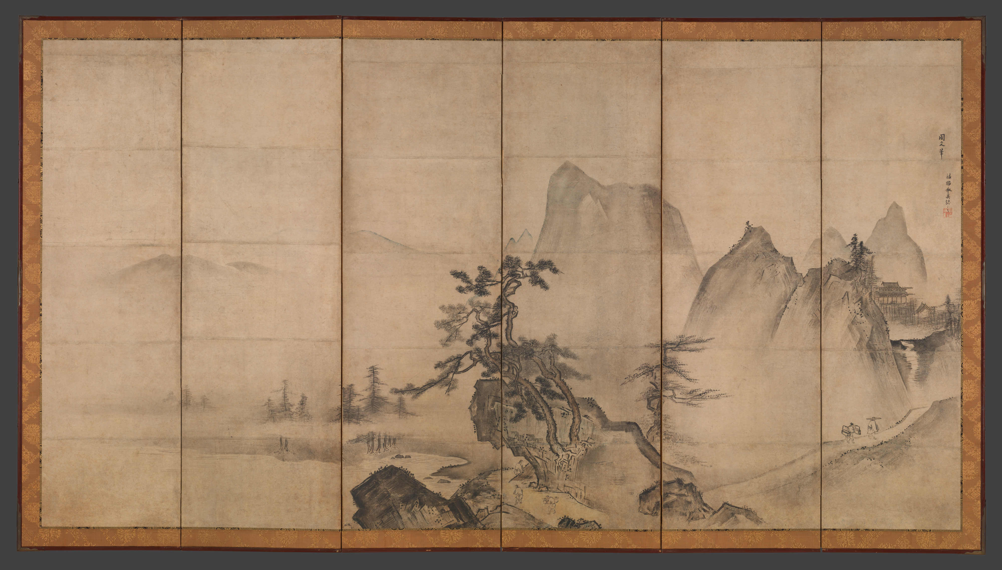
Paintings

Slide 3
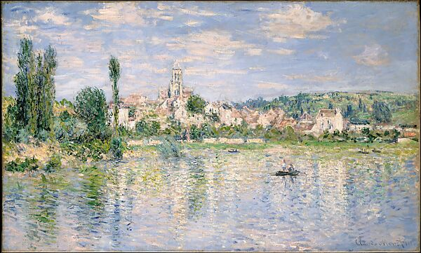
Paintings

Slide 4
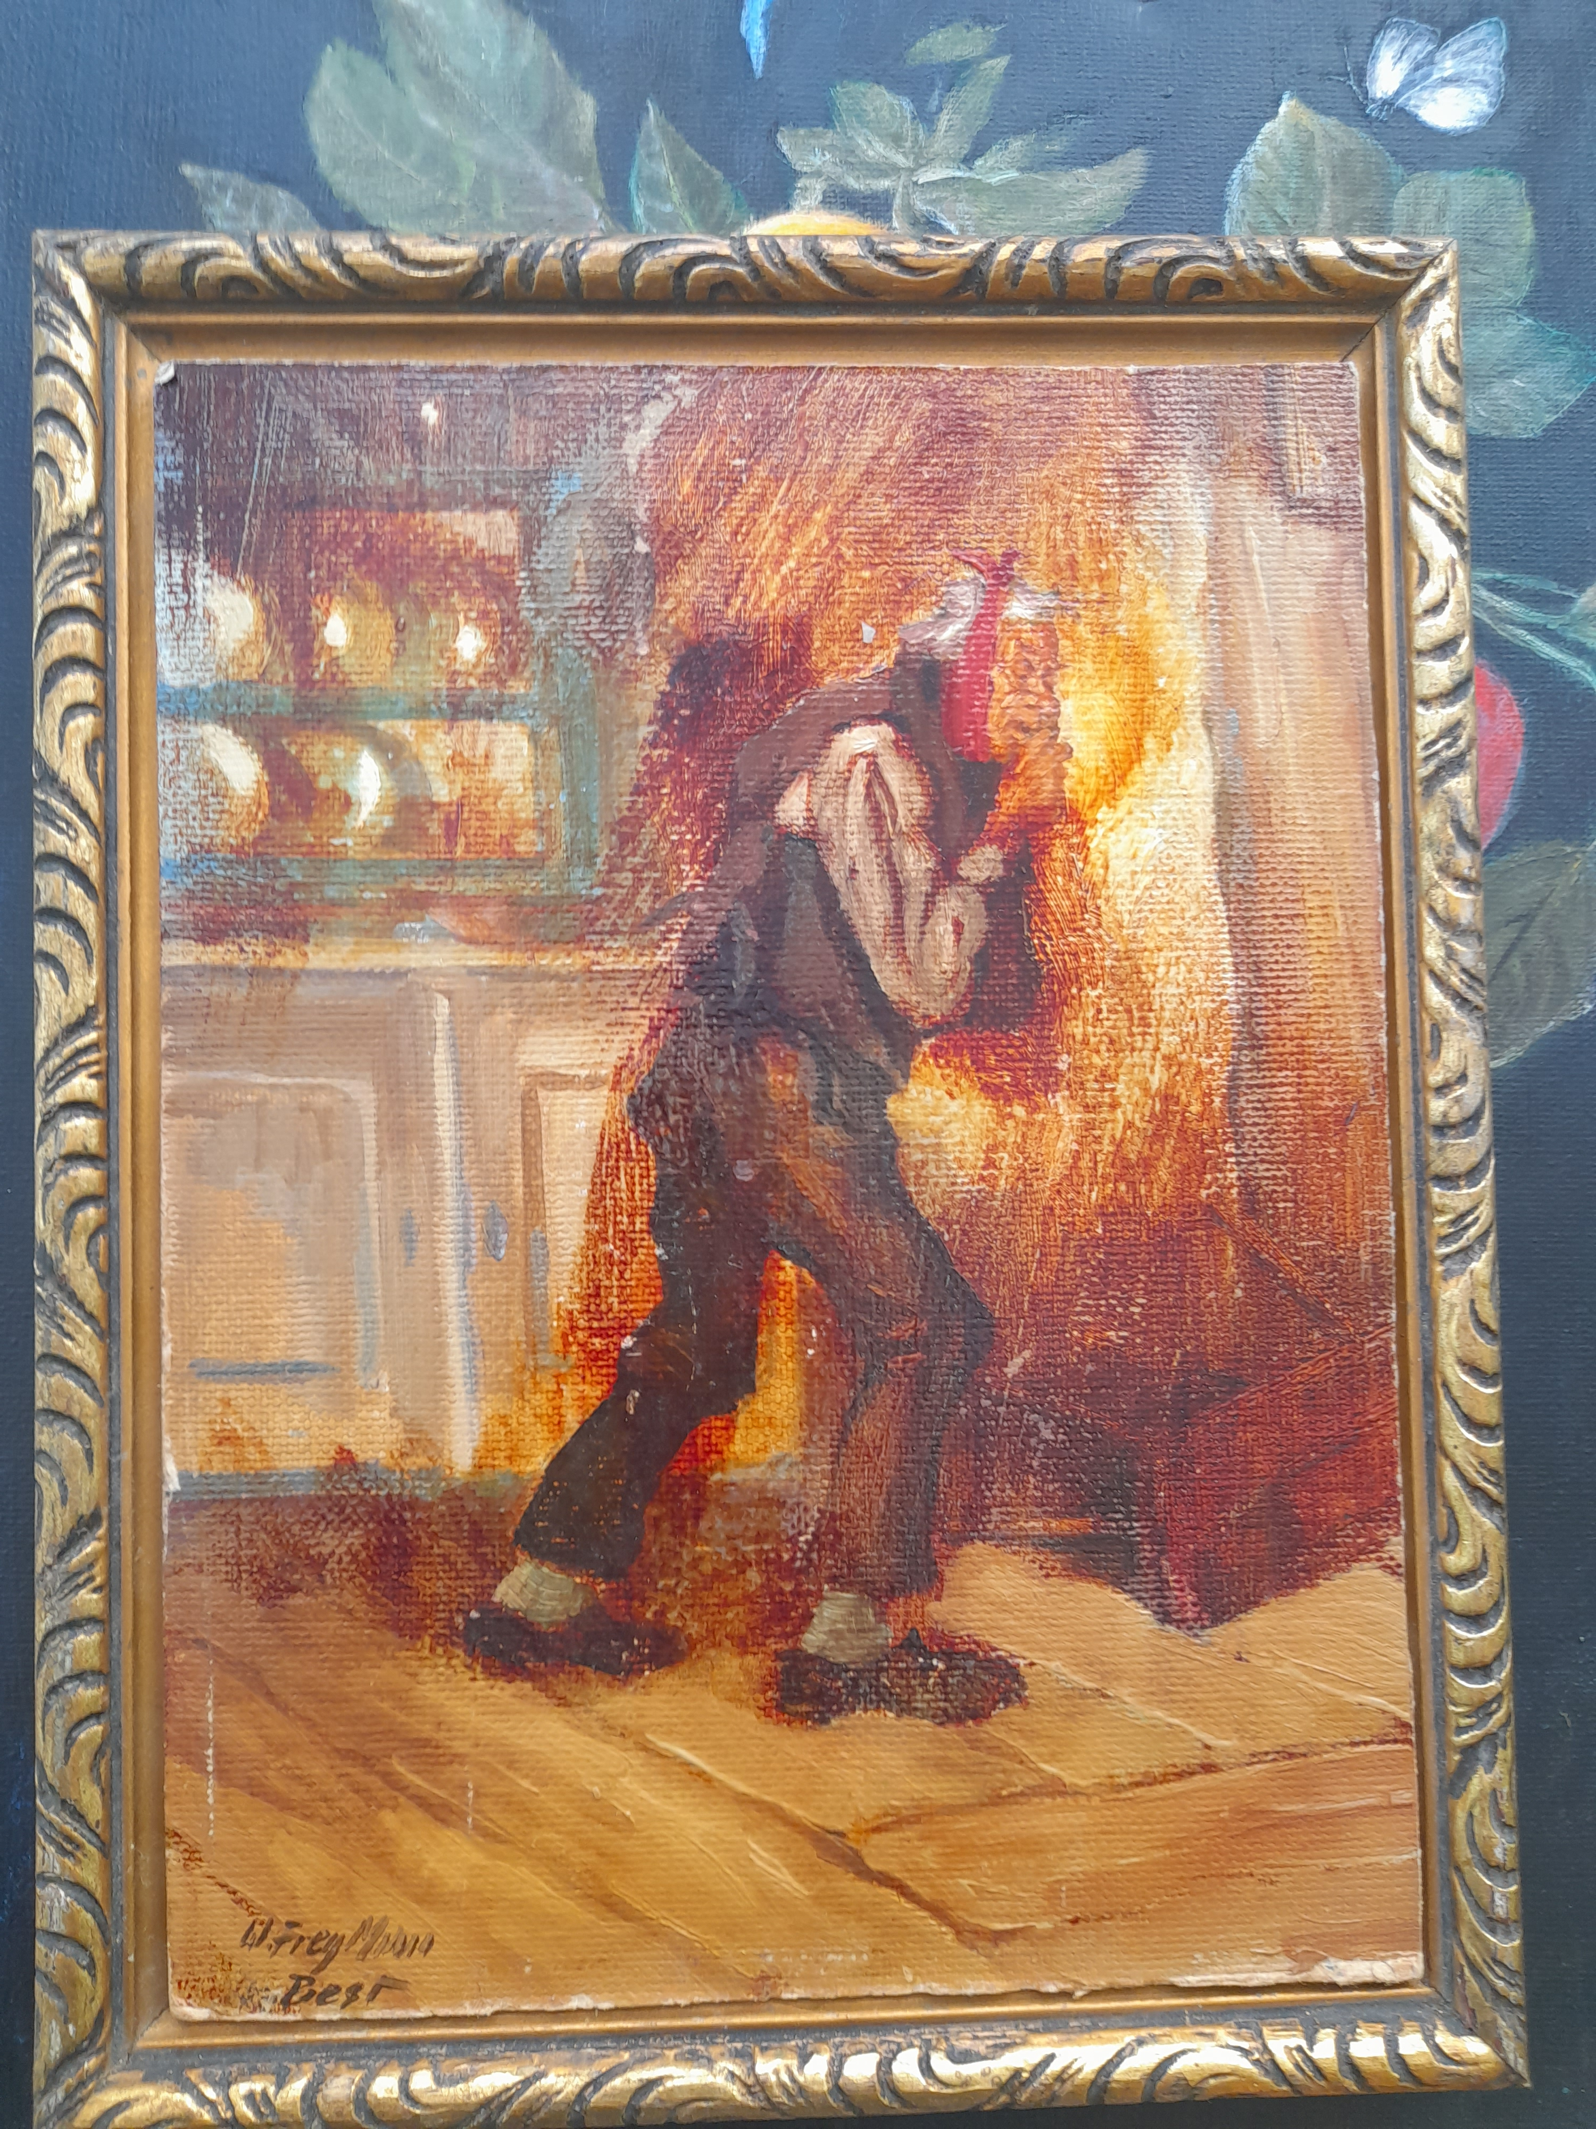
Paintings

Slide 5
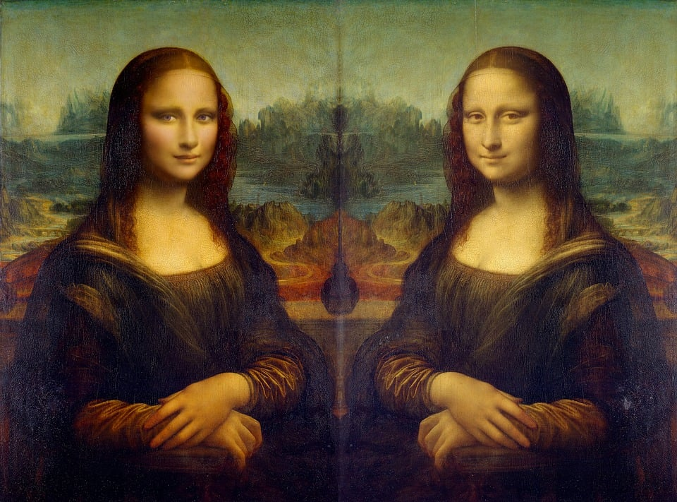
Paintings

Slide 6
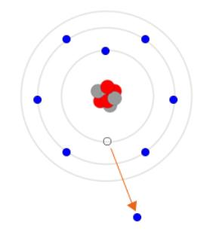
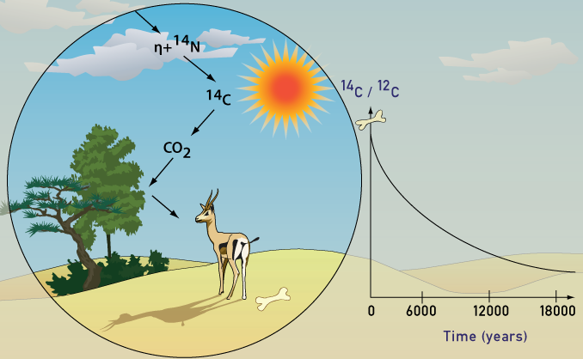
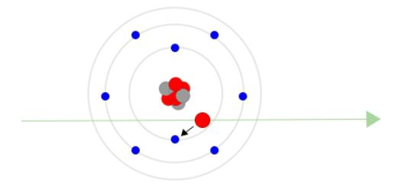
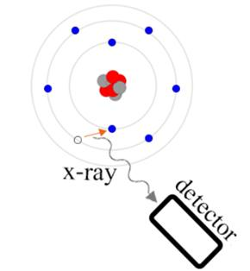
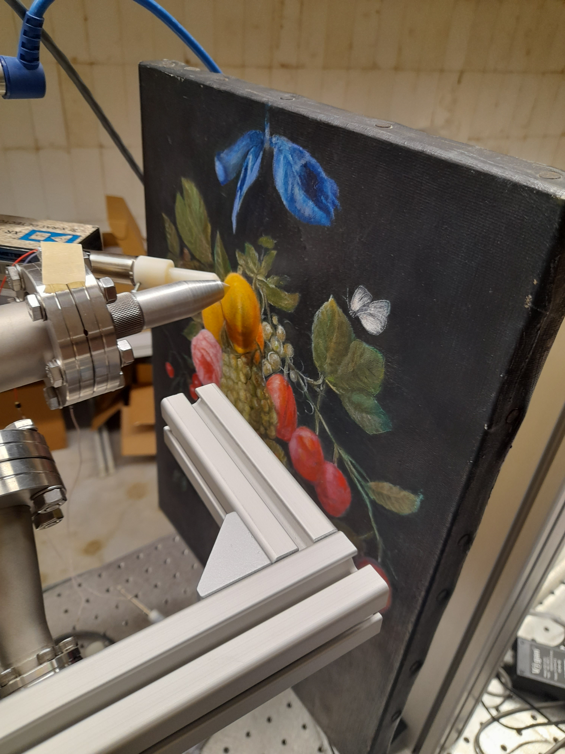
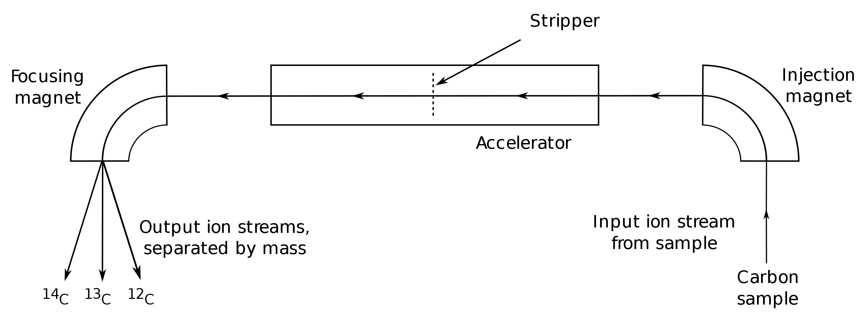
Methods
Radiocarbon dating
PIXE method
2.
1.
3.
Accelerator mass spectrometry (AMS) system diagram

Slide 7
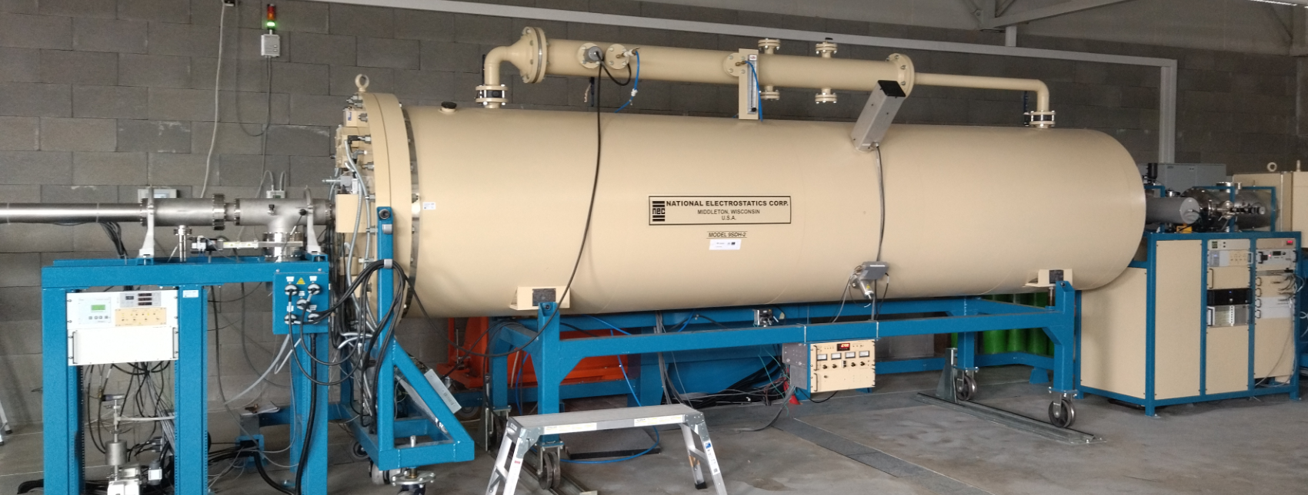
Methods
Radiocarbon dating
PIXE method
2.
1.
3.
Accelerator mass spectrometry (AMS) system diagram

Slide 8
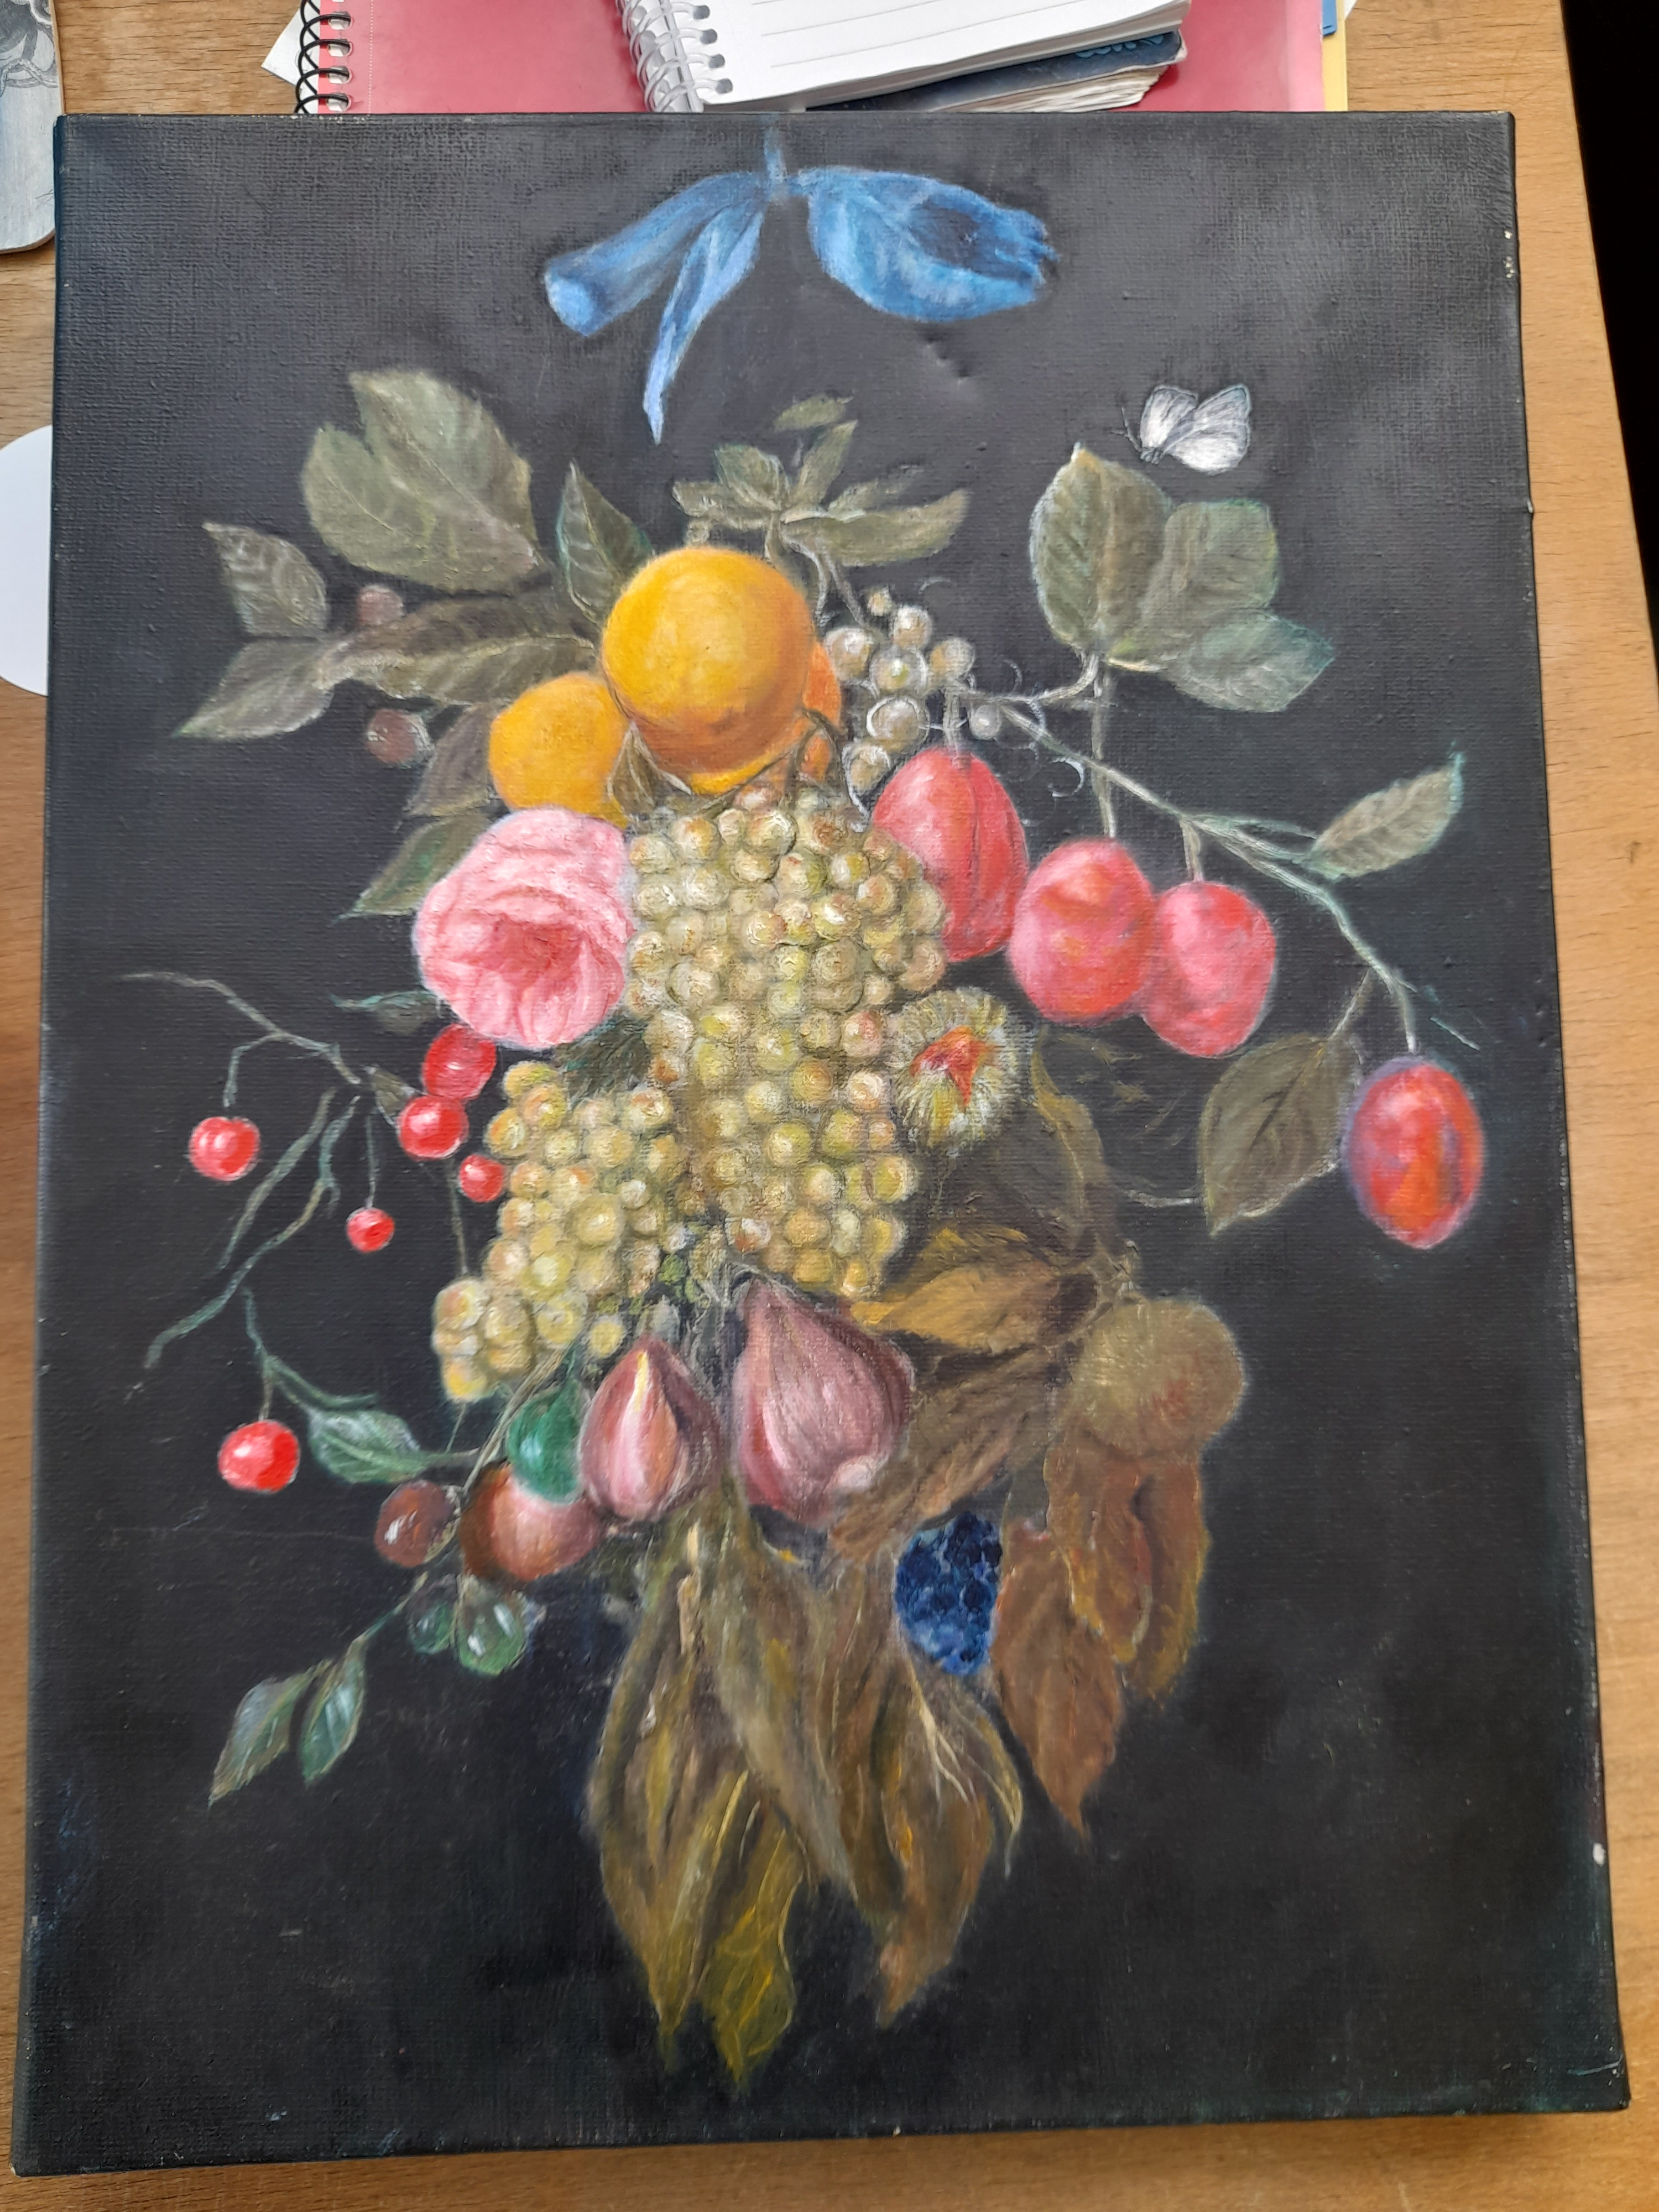
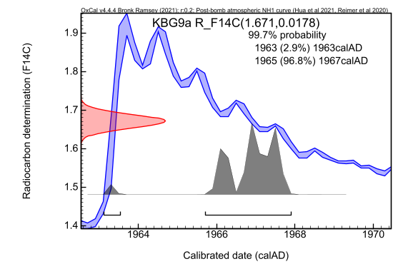
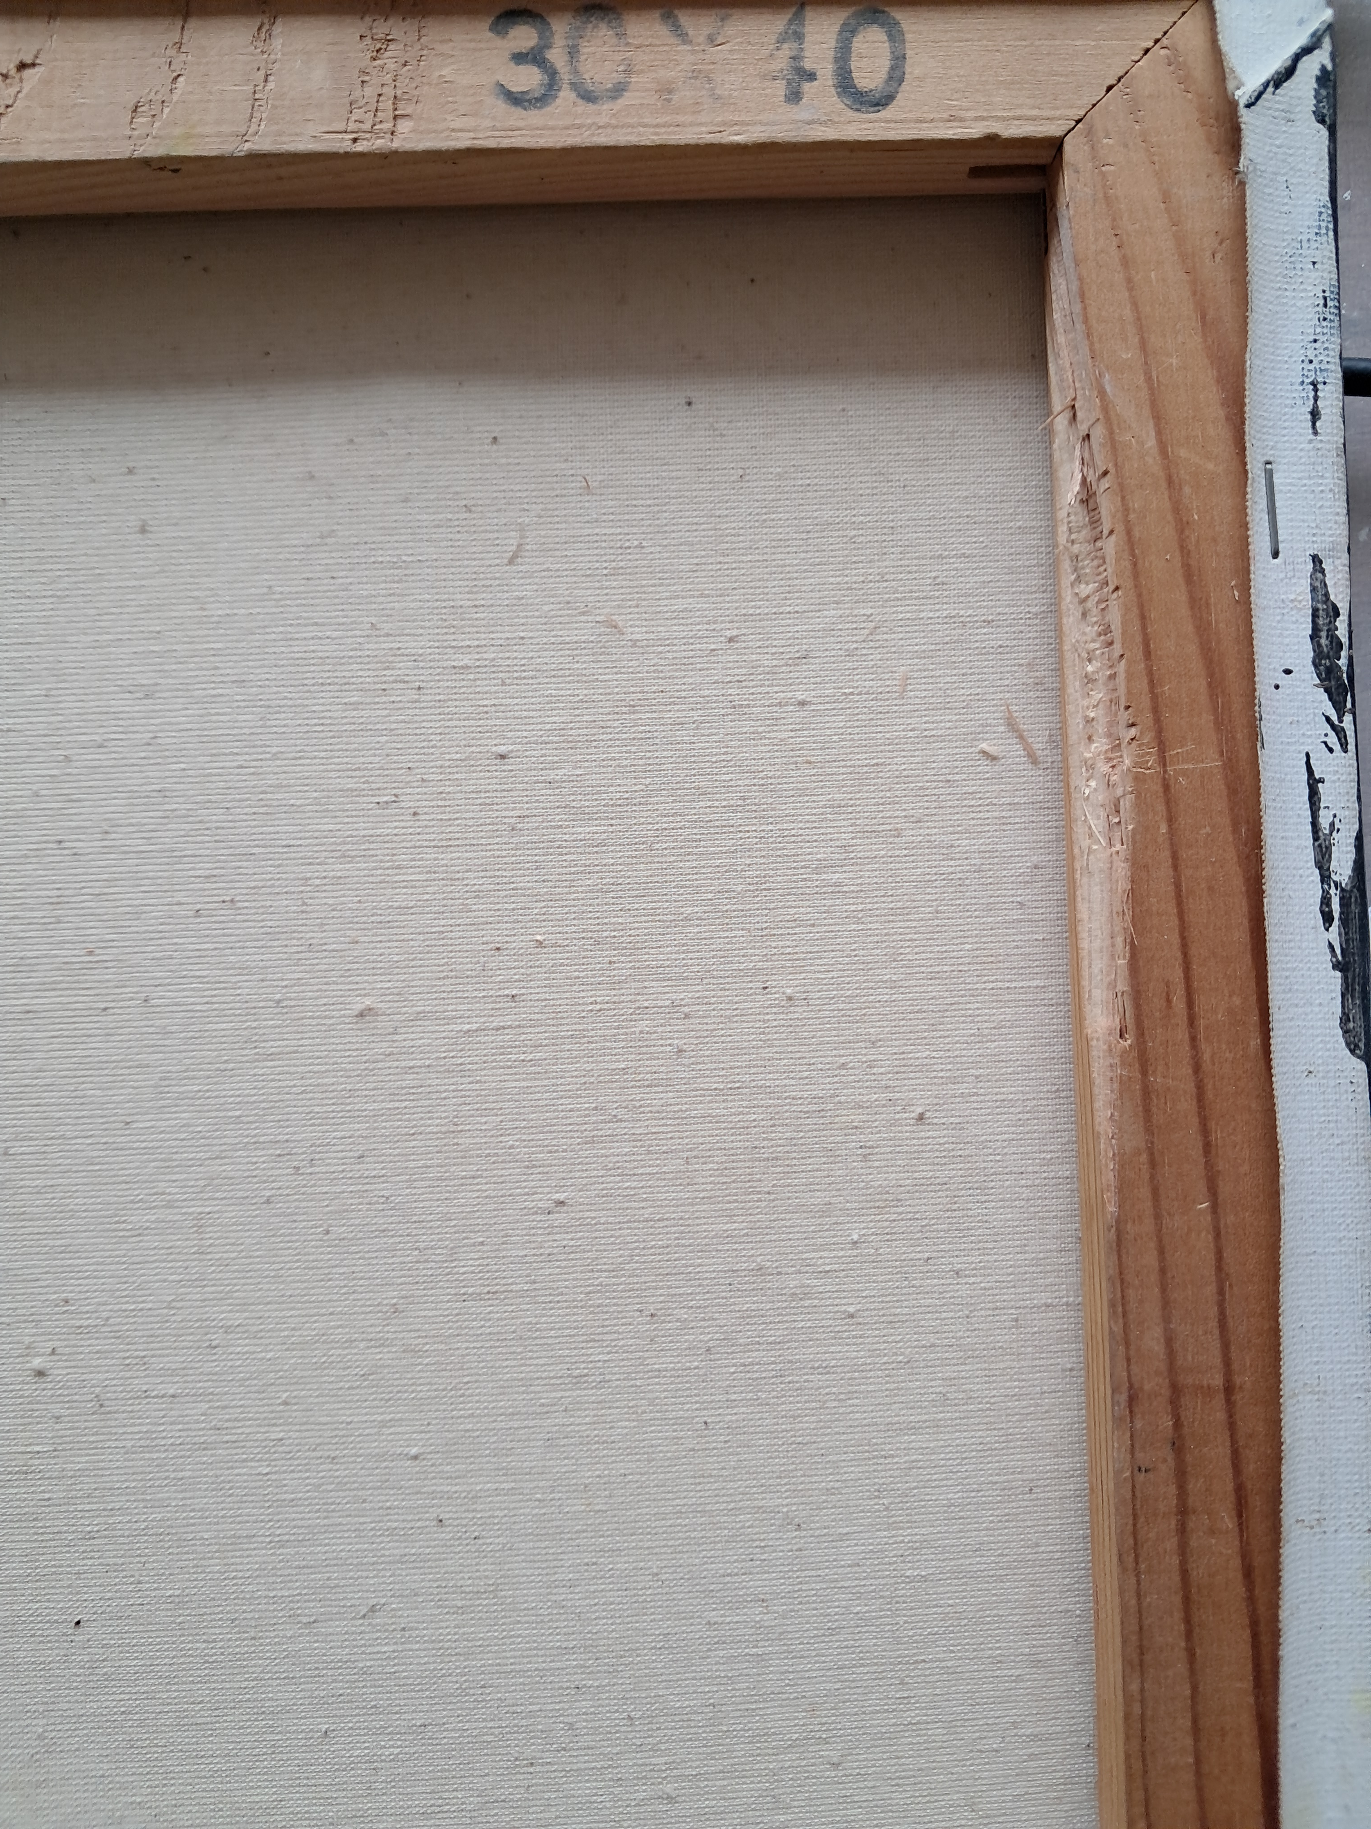
“Flowers and Fruits”
no Pb
¹⁴C/¹²C
A piece of the wooden frame on which the canvas was stretched.
Results from the radiocarbon age calibration of the painting, determined from the ¹⁴C / ¹²C ratio.

Slide 9
“Flowers and Fruits”
no Pb
¹⁴C/¹²C
Measured element concentrations of “Flowers and fruits“ in ppm for individual colours.
 | 1 | 2 | 3 | 4 | 5
Si | (62 ± 18)×10³ | <5×10³ | (22 ± 10)×10³ | (76 ± 23)×10³ | (55 ± 17)×10³
S | (22 ± 2)×10³ | (2.8 ± 0.6)×10³ | (9 ± 1)×10³ | (53 ± 6)×10³ | (33 ± 3)×10³
Cl | (3.8 ± 0.6)×10³ | 740 ± 220 | <288 | (9 ± 2)×10³ | (7.3 ± 0.9)×10³
Ca | (70 ± 5)×10³ | (36 ± 2)×10³ | (15 ± 1)×10³ | (37 ± 4)×10³ | (16 ± 1)×10³
Ti | (38 ± 3)×10³ | (4.1 ± 0.4)×10³ | (20 ± 1)×10³ | (81 ± 8)×10³ | (16 ± 1)×10³
Fe | (6.9 ± 0.6)×10³ | 530 ± 140 | (18 ± 1)×10³ | (4.3 ± 0.6)×10³ | (1.3 ± 0.2)×10³
Zn | (100 ± 7)×10³ | <127 | (21 ± 2)×10³ | (68 ± 7)×10³ | (217 ± 15)×10³
Ba | (16 ± 4)×10³ | (3 ± 1)×10³ | (36 ± 4)×10³ | (105 ± 13)×10³ | (75 ± 6)×10³

Slide 10
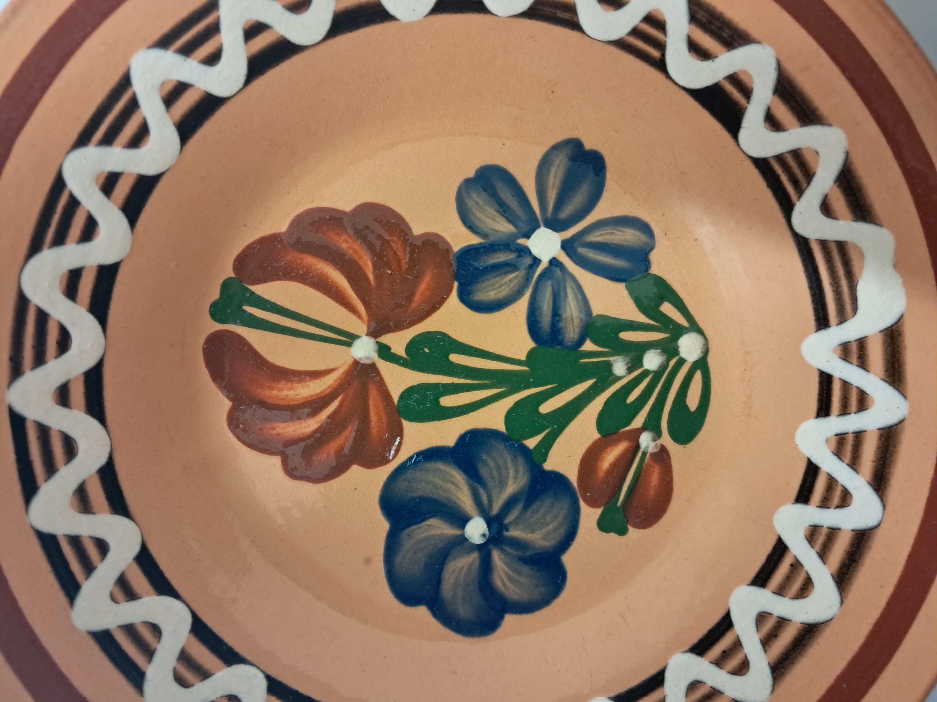
Conclusion
Radiocarbon dating (AMS) applied to determine painting age.
PIXE method identified several elements in different pigments.
These methods were also used for two more samples (more during poster session).

Slide 11
THANK YOU FOR YOUR ATTENTION!
Acknowledgment:
This work was supported by Comenius University in Bratislava through the Young Researchers Grant (project UK/3172/2024) and by the Slovak Research and Development Agency (project APVV-21-0059).

