Slide 1





Slide 2
Misconceptions in Probability Learning
Misconceptions occur even in basic probability concepts at low levels of abstraction (Batanero & Sánchez, 2005).
Probabilistic reasoning often leads to counterintuitive results already at an elementary level (Borovcnik & Peard, 1996).
In most areas of mathematics, counterintuitive results appear only at high levels of abstraction.
This special nature of probability explains why misconceptions and difficulties persist even in secondary school (Shaughnessy, 1992; Fischbein, Nello, & Marino, 1991).
Batanero, C., & Sánchez, E. (2005). What is the nature of high school students’ conceptions and misconceptions about probability?
Borovcnik, M., & Peard, R. (1996). Probability.
Shaughnessy, J. M. (1992). Research in probability and statistics.
Fischbein, E., Nello, M. S., & Marino, M. S. (1991). Factors affecting probabilistic judgments in children and adolescents.
Notes:
In the teaching of probability, we often encounter misconceptions even within the basic concepts at lower levels of abstraction (Batanero & Sánchez, 2005).
As Borovcnik and Peard (1996) point out, probabilistic reasoning is characterized by the fact that counterintuitive results appear already at a very elementary level. In other areas of mathematics, such results—those that contradict intuitive expectations—typically emerge only when working with a high degree of abstraction.
This distinctive feature of probability helps explain the existence of misconceptions and difficulties in understanding, which persist even at the secondary-school level (Shaughnessy, 1992; Fischbein, Nello, & Marino, 1991).

Slide 3
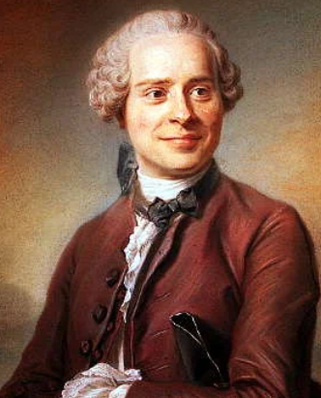
Historical Misconception: d’Alembert’s Error
Even great mathematicians can make mistakes in probability (Gorroochurn, 2014).
Jean le Rond d’Alembert (1717–1783) analyzed the problem:
“What is the probability that at least one head appears in two tosses of a fair coin?”
He rejected the correct answer 3/4 and reasoned incorrectly:
  If the first toss is heads, no second toss is needed.
  Considered only outcomes: H, TH, TT.
  Concluded probability = 2/3.
His reasoning was flawed because these outcomes are not equally likely.
The incorrect solution was even published in his Encyclopédie article (d’Alembert, 1754, Vol. IV, pp. 512–513).
Gorroochurn, P. (2014). Errors of probability in historical context.
d’Alembert, J. L. R. (1754). Croix ou pile. In D. Diderot & J. L. R. d’Alembert (Eds.), Encyclopédie ou dictionnaire raisonné des sciences, des arts et des métiers
Notes:
For example, even a great thinker such as Jean le Rond d’Alembert (1717–1783) made an error in probabilistic reasoning (Gorroochurn, 2014).
Several years after Leibniz’s death, d’Alembert—one of the most prominent mathematicians of his time—considered the following problem:
“What is the probability that in two tosses of a fair coin, at least one head will appear?”
In this problem, d’Alembert rejected the correct answer of $3/4$.
He reasoned as follows: if a head appears on the first toss, there is no need to toss the coin a second time;
therefore, the possible outcomes are H, TH, and TT, and the desired probability is $2/3$.
Of course, d’Alembert’s argument is incorrect, because he failed to recognize that the outcomes H, TH, and TT are not equally likely.
His incorrect answer was even included in his article Croix ou Pile in the Encyclopédie (d’Alembert, 1754, Volume IV, pp. 512–513).

Slide 4
Addressing Misconceptions in Probability
Effective tools: Experimentation, manipulatives, and visualization (Paliwal, 2018).
Gradual development of concepts aligns with the constructivist approach to teaching.
After the constructivist phase, it is important to:
  Formalize the concepts.
  Introduce correct mathematical symbolism and terminology.
Paliwal, V. (2018). Do manipulatives foster pre-service teachers’ understanding of probability?
Notes:
To uncover and eliminate misconceptions in probability, experimentation, manipulative activities, and visualization have proven to be useful tools (Paliwal, 2018).
For a proper understanding of probabilistic concepts, it is also appropriate to develop them gradually, in accordance with the constructivist approach to teaching.
Naturally, after the constructivist phase of concept building, we consider it important that the instructional process includes subsequent formalization and the introduction of correct mathematical symbolism and terminology.

Slide 5

Innovative approaches to teaching probability
Developed as part of the KEGA 037UK-4/2024 Innovative learning technologies in the preparation of future mathematics teachers and Digital Transformation of Education and Schools (DiTEdu, code ITMS2014+: 401402DVR6).
Aim to foster a deep conceptual understanding of probabilistic concepts through their gradual constructivist development, with an emphasis on visualization, manipulative activities, and experimentation.
The topics covered include geometric probability, conditional probability and expected value.
Notes:
Recognizing these student difficulties and the potential ways to mitigate them, we decided to create a series of instructional materials focused on selected probability topics in the secondary-school curriculum.
We are developing these materials as part of the projects KEGA 037UK-4/2024 Innovative Learning Technologies in the Preparation of Future Mathematics Teachers and DiTEdu 401402DVR6 Digital Transformation of Education and Schools.
Aim of these materials is to foster a deep conceptual understanding of probabilistic concepts through their gradual constructivist development, with an emphasis on visualization, manipulative activities, and experimentation.
The topics covered include geometric probability, conditional probability and expected value.

Slide 6

Notes:
In the following slides, we present selected tasks from these educational materials together with methodological notes on their use in teaching.
We also describe feedback obtained from teachers during workshops held at the professional conferences Two Days with Mathematics Education 2024 and Two Days with Mathematics Education 2025, as well as during the use of these materials in the Innovative Training: Learning to Teach Mathematics that Inspires program.
We conclude with the plans for our future work.

Slide 7


Slide 8
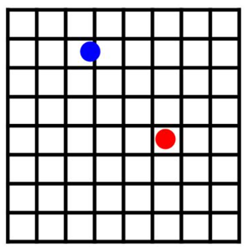
Geometric probability: Franc-carreau (Fair-square)
We toss a coin into the air above a square-grid game board.
We win if the coin lands entirely inside one of the squares. If the coin intersects any side of a square, we lose.
What is the probability that the coin will lie completely inside
a square (i.e., that it will not land on any of the square’s sides)?
(Kubáček, 2010)
Kubáček, Z. (2010). Matematika pre 2. ročník gymnázií, 2. časť. Orbis Pictus Istropolitana.
Notes:
In this task, we make use of experimentation and manipulation with physical artifacts. We divide students into smaller groups. Each group performs the experiment 30 times using a board with square side length 5 cm and a 50-cent coin with a diameter of 24.25 mm. The groups record their results. Then we summarize the data from all groups on the board and use it to determine the value of the experimental probability of winning. The activity continues with the calculation of the theoretical probability.
This task illustrates another situation in which geometric probability must be used. Based on the experiment, students become aware that the set of possible positions of the coin is not discrete, since all positions are possible. Therefore, the size of the set of possible positions is best described as the area of the square of possible center positions of the coin. In the follow-up discussion, we focus on the reasons for the difference between the experimental and theoretical probabilities, as well as on the effect of increasing the number of experimental repetitions on the discrepancy between them.

Slide 9
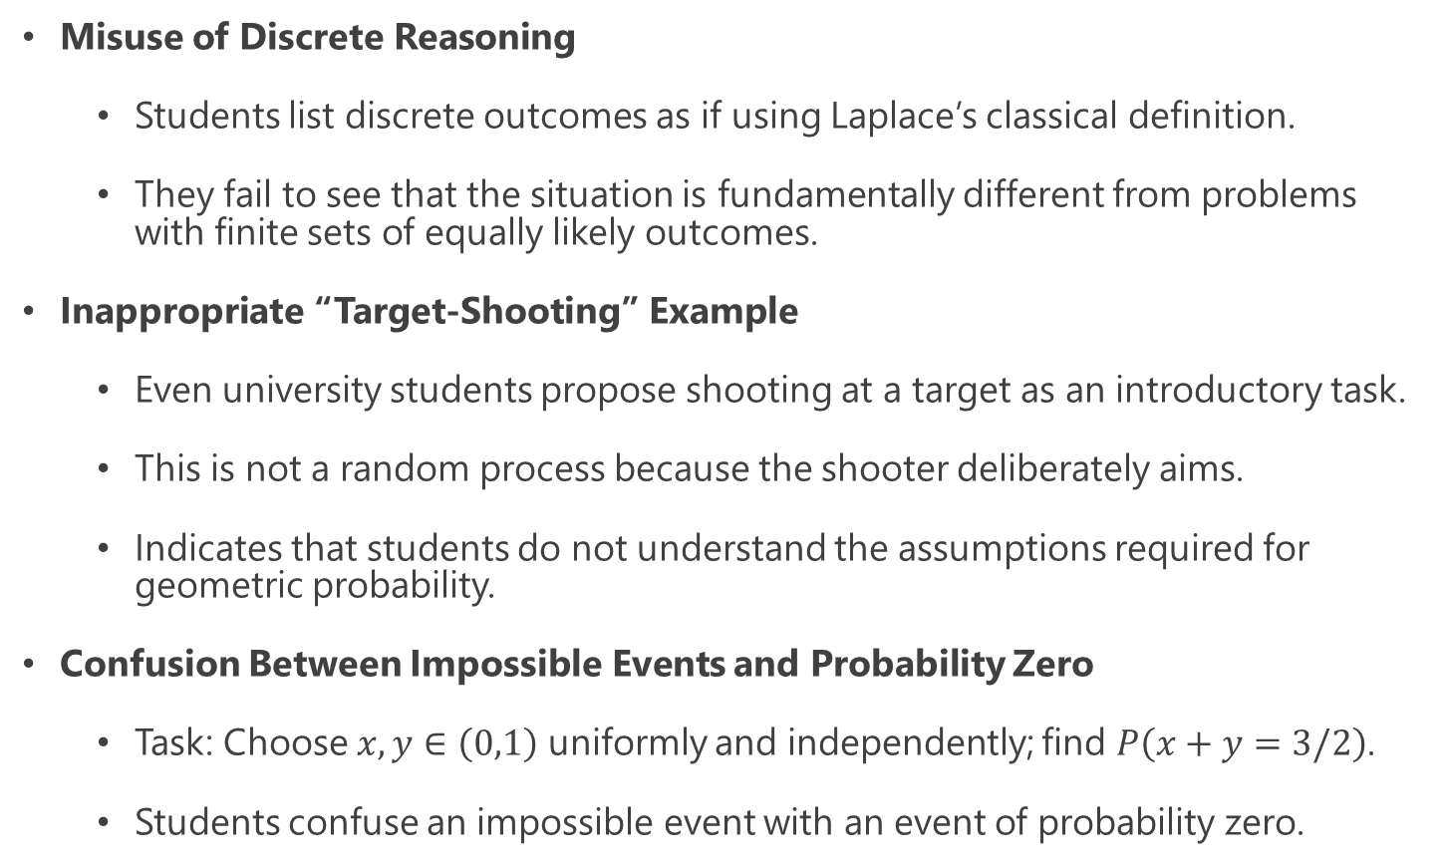
Geometric probability: misconceptions
Misuse of Discrete Reasoning
  Students list discrete outcomes as if using Laplace’s classical definition.
  They fail to see that the situation is fundamentally different from problems with finite sets of equally likely outcomes.
Inappropriate “Target-Shooting” Example
  Even university students propose shooting at a target as an introductory task.
  This is not a random process because the shooter deliberately aims.
  Indicates that students do not understand the assumptions required for geometric probability.
Confusion Between Impossible Events and Probability Zero
  Task: Choose $x,y∈\left(0,1\right)$ uniformly and independently; find $P\left(x+y=3/2\right)$.
  Students confuse an impossible event with an event of probability zero.
Notes:
When designing the sequence of tasks, we focused on eliminating potential misconceptions that we observed among students when teaching this topic.
We present some of them below.
Students often try to solve these problems by listing a discrete set of possibilities, as if they were applying the classical (Laplace) definition of probability. However, they do not realize that this situation differs fundamentally from cases in which one can work with finite sets of equally likely outcomes.
Even university students at our faculty suggest, as a suitable introductory task for geometric probability, a situation in which one computes the probability related to hitting selected parts of a target. This situation is not appropriate, since it does not involve a random process—the shooter is intentionally aiming. This reveals that students do not fully understand all the assumptions that must be met for the concept of geometric probability to be applicable.
We noticed an interesting misconception in the following task: On the interval (0,1), choose two numbers $x$and $y$uniformly at random and independently. Find the probability that their sum equals $3/2$. Students tended to confuse the notions of an impossible event and an event with probability zero.

Slide 10
Conditional probability: Visualisations in Cabs’ Problem
A cab was involved in a hit and run accident at night. Two cab companies, the Green and the Blue, operate in the city. 85% of the cabs in the city are Green and 15% are Blue.
A witness identified the cab as Blue. The court tested the reliability of the witness under the same circumstances that existed on the night of the accident and concluded that the witness correctly identified each one of the two colors 75% of the time and failed 25% of the time.
What is the probability that the cab involved in the accident was Blue rather than Green knowing that this witness identified it as Blue?
(Tversky & Kahneman, 1980)
Tversky, A., & Kahneman, D. (1980). Causal schemas in judgments under uncertainty.
Notes:
In our instructional material, we motivate this topic with the well-known Cabs’ Problem (Tversky & Kahneman, 1980).
The goal of this task is to engage students; the actual solution is addressed only at the end of the sequence of activities, which is designed to gradually build the necessary conceptual framework.
After introducing conditional probability, we guide students through several tasks and subsequently return to solving the motivating Taxi Problem.

Slide 11
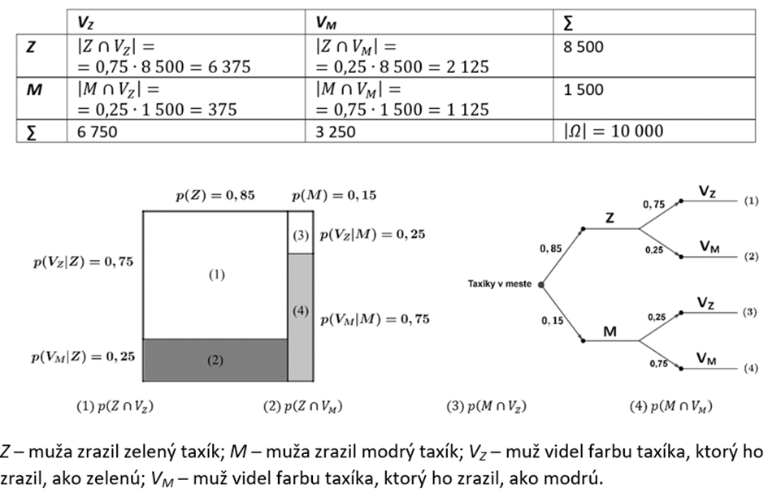
Visualizations in Cabs’ Problem
Vankúš, P., & Vargová, M. (2025). Vizualizácie úlohy z podmienenej pravdepodobnosti.
Notes:
We illustrate the solution using various forms of visualization—specifically table of frequencies, the unit square, and a tree diagram
(Vankúš & Vargová, 2024)

Slide 12
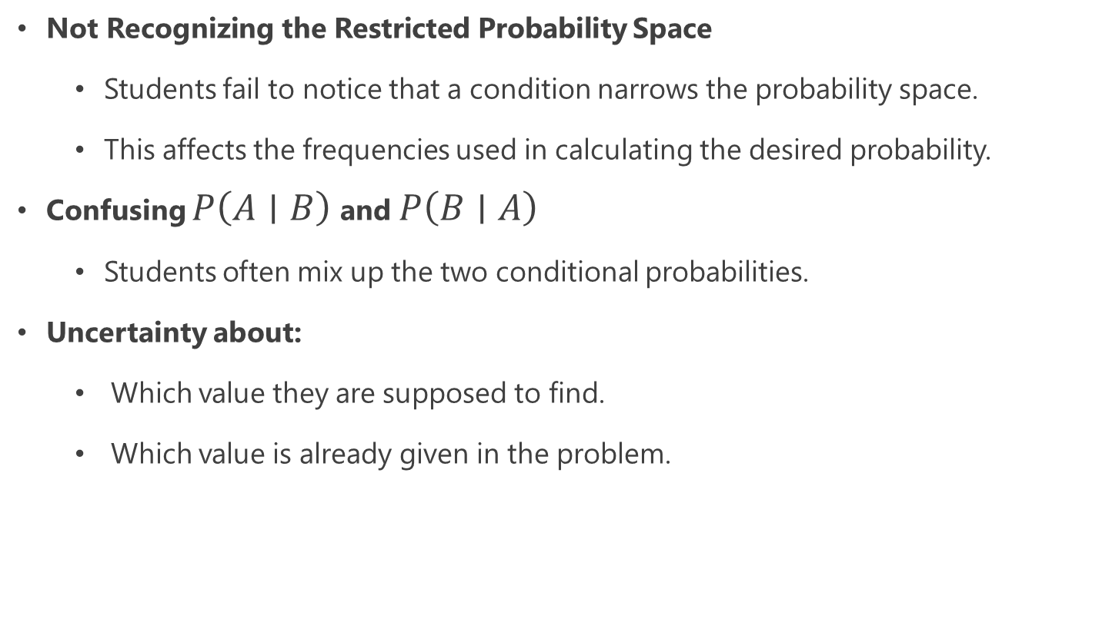
Conditional probability: misconceptions
Not Recognizing the Restricted Probability Space
  Students fail to notice that a condition narrows the probability space.
  This affects the frequencies used in calculating the desired probability.
Confusing $P\left(A∣B\right)$ and $P\left(B∣A\right)$
  Students often mix up the two conditional probabilities.
Uncertainty about:
  Which value they are supposed to find.
  Which value is already given in the problem.
Notes:
When designing and applying this sequence of tasks on conditional probability, we aimed to address the misconceptions we observed among students within this topic.
Students do not realize that the condition restricts the given probability space, which affects the frequencies used in calculating the desired probability.
Students confuse the events $P\left(A∣B\right)$and $P\left(B∣A\right)$, and they are often unclear about which value they are supposed to find and which one is already given in the problem statement.

Slide 13
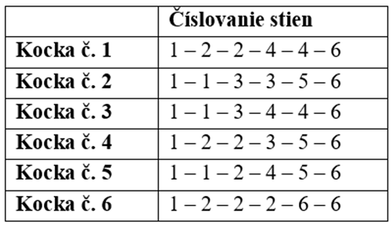
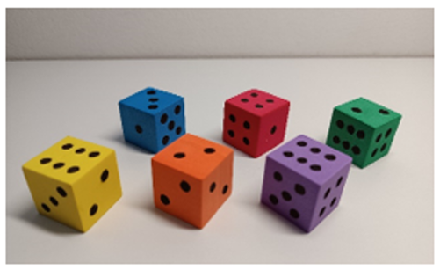
Expected value: Dices with modified numbering
The table below shows six dice and the numbering of their faces.
Try to guess which die will produce the highest total sum after
60 rolls.
Then, try to explain why you think this particular die will have the highest sum.
(Križánková, 2024)
Križánková, M. (2024). Hrové vyučovanie pravdepodobnosti a štatistiky.

Slide 14
Expected value: misconceptions
Misunderstanding the Law of Large Numbers
  Students think the sum cannot be estimated without knowing exact outcomes.
Expected Value Must Be a Possible Outcome
  Students struggle with the idea that the expected value may not appear on the die.
  Example: mean of a standard die is 3.5, which is not a face value
Confusing Expected Value with the Most Probable Value
  Some choose the die with more 6s as “best”.
  Fail to see that dice with the same expected value are equivalent.
Expected Value as a Guaranteed Result
  Students believe a game with positive expected value must always produce a win, or that repeated play cannot lead to losses.
  Corrected through experimentation + reminding them of the Law of Large Numbers.
Notes:
Misunderstanding of the Law of Large Numbers.
Students often incorrectly assume it is impossible to estimate the expected value because the specific outcomes of the events are unknown. When solving the task, it is therefore necessary to strengthen students’ understanding that, with a sufficiently large number of repetitions, the average value of the sum of the dice approaches a certain value. This value corresponds to the mean of the face values of a homogeneous die.
Belief that the expected value must be one of the possible outcomes of the random variable. For example, when calculating the mean of the numbers on the faces of a standard die, students struggle to grasp the fact that this mean value is not one of the numbers actually appearing on the die.
Confusing expected value with the most probable value. When solving the task some students chose as the most advantageous die the one that had the highest number of 6s on its faces. They struggled to understand that the dice were equivalent because they had the same expected value of the numbers on their faces.
Interpreting the expected value as a guaranteed result of a single trial or as an exact prediction of future outcomes (games). This misconception can be addressed through experimental activity. Once again, students need to understand the relevance of the Law of Large Numbers—that is, the need for a sufficiently large number of repetitions so that the experimentally observed average values approach the expected values.

Slide 15


Slide 16
Overview of Collected Teacher Feedback
Feedback on selected instructional materials was gathered through questionnaires.
Conditional probability materials
  Presented during a workshop at Two Days with Mathematics Education 2024.
Expected value materials
  Presented during a workshop at Two Days with Mathematics Education 2025.
All three topics (geometric probability, conditional probability, expected value)
  Included in the program Innovative Training: Learning to Teach Mathematics that Inspires.
Note on Geometric Probability
  Materials used during the online portion of the training.
  No feedback collected for this topic.
Notes:
In this part of the paper, we present the feedback collected through questionnaires during the use of selected instructional materials.
The materials focused on conditional probability were presented to teachers during a workshop held at the Two Days with Mathematics Education 2024 conference.
The materials focused on expected value were introduced to teachers during a workshop at the Two Days with Mathematics Education 2025 conference.
Materials covering all three topics—geometric probability, conditional probability, and expected value—were incorporated into the program Innovative Training: Learning to Teach Mathematics that Inspires. However, the geometric probability materials were used during the online part of the training, and therefore we do not have collected feedback for this topic.

Slide 17
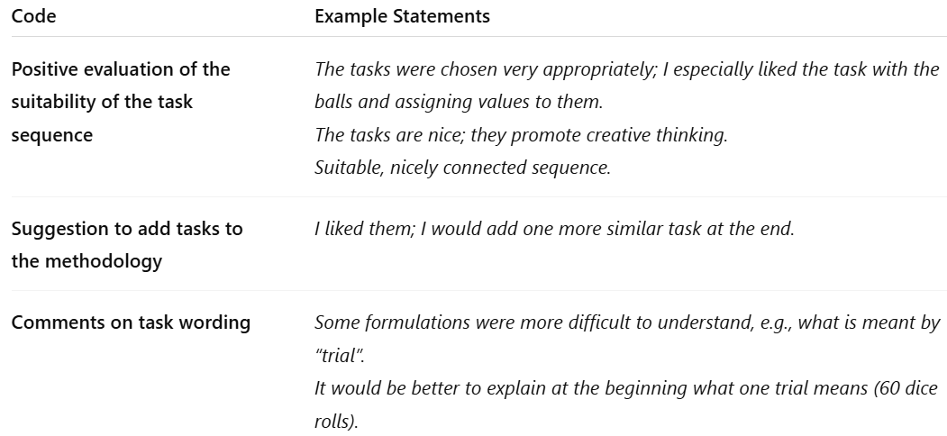
Feedback on the materials on expected value
Teachers' responses were analyzed using thematic analysis (Schreier et al., 2019).
The table shows: Identified codes and example of teacher statements illustrating each code.
Schreier, M, et al. (2019). Qualitative content analysis: Conceptualizations and challenges in research practice.
Notes:
For the instructional materials focused on expected value, teachers evaluated the prepared sequence of tasks.
We then analyzed their responses using thematic analysis (Schreier et al., 2019). The table presents the identified codes together with examples of specific teacher statements.
From Table we can see that the teachers evaluated the task sequence on the topic of expected value positively.
They appreciated the suitability of the selected tasks and their potential for developing creative thinking.
However, some teachers requested more precise wording in some tasks.

Slide 18
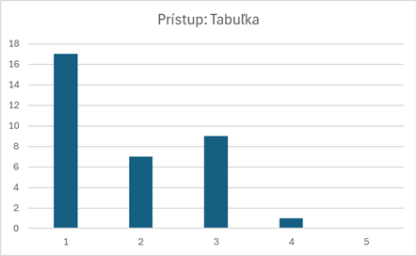
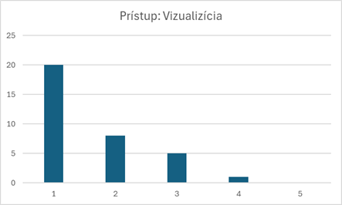
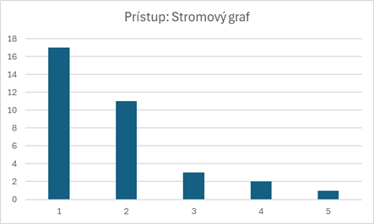
Feedback on the materials on conditional probability 1
How did you like the presented approaches to solving tasks focused on the use of conditional probability?
Approaches: table of frequencies, unit-square visualization, tree diagram; scale: positive 1—2—3—4—5 negative.
Notes:
For the materials related to conditional probability, teachers responded to question:
How did you like the presented approaches to solving tasks focused on the use of conditional probability?
(Possible approaches: table of frequencies, unit-square visualization, tree diagram; scale: positive 1—2—3—4—5 negative).
The results for this item are shown in the figure.
As we can see from the figures, each of the presented visualization approaches for solving conditional probability tasks appealed to enough teachers.

Slide 19
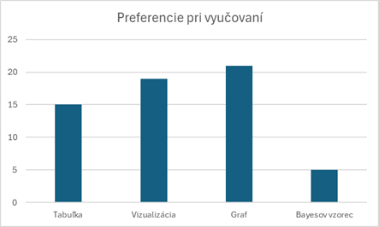
Feedback on the materials on conditional probability 2
Which approach to solving the tasks would you prefer when teaching your students?
Approaches: a) table of frequencies, b) unit-square visualization, c) tree diagram, d) Bayes’ formula; (teachers were allowed to select multiple options).
Notes:
The figure shows that, when teaching this topic in school, teachers most prefer representing the solution with a tree diagram.
This is followed by visualization using the unit square, while the frequency table is the least preferred option.

Slide 20


Slide 21
Future Work
Verification of the proposed materials by in-service teachers within school mathematics teaching.
Revision of the materials based on the collected feedback.
Design and development of additional materials and activities related to introducing probability and statistics concepts in secondary school.
Notes:
Selected aims

Slide 22
Resources
Batanero, C., & Sánchez, E. (2005). What is the nature of high school students’ conceptions and misconceptions about probability? In G. A. Jones (Ed.), Exploring probability in school: Challenges for teaching and learning (pp. 241–266). Springer. https://doi.org/10.1007/0-387-24530-8_11
Borovcnik, M., & Peard, R. (1996). Probability. In A. J. Bishop, K. Clements, C. Keitel, J. Kilpatrick, & C. Laborde (Eds.), International handbook of mathematics education [Part 1] (pp. 239–288). Kluwer.
d’Alembert, J. L. R. (1754). Croix ou pile. In D. Diderot & J. L. R. d’Alembert (Eds.), Encyclopédie ou dictionnaire raisonné des sciences, des arts et des métiers (Vol. 4, p. 250).
Fischbein, E., Nello, M. S., & Marino, M. S. (1991). Factors affecting probabilistic judgments in children and adolescents. Educational Studies in Mathematics, 22, 523–549.
Gorroochurn, P. (2014). Errors of probability in historical context. In M. Pitici (Ed.), The best writing on mathematics 2013 (pp. 191–212). Princeton University Press. https://doi.org/10.1515/9781400847990-020
Notes:
Selected aims

Slide 23
Resources
Križánková, M. (2024). Hrové vyučovanie pravdepodobnosti a štatistiky. In J. Gurican & J. Tekel (Eds.), Študentská vedecká konferencia FMFI UK, Bratislava, 2024. Zborník príspevkov (s. 127–132). Fakulta matematiky, fyziky a informatiky, Univerzita Komenského.
Kubáček, Z. (2010). Matematika pre 2. ročník gymnázií, 2. časť. Orbis Pictus Istropolitana.
Paliwal, V. (2018). Do manipulatives foster pre-service teachers’ understanding of probability? In University of West Georgia (p. 2). https://files.eric.ed.gov/fulltext/EJ1191659.pdf
Schreier, M., Stamann, C., Janssen, M., Dahl, T., & Whittal, A. (2019). Qualitative content analysis: Conceptualizations and challenges in research practice.
Shaughnessy, J. M. (1992). Research in probability and statistics. In D. A. Grouws (Ed.), Handbook of research on mathematics teaching and learning (pp. 465–494). Macmillan.
Tversky, A., & Kahneman, D. (1980). Causal schemas in judgments under uncertainty. In M. Fishbein (Ed.), Progress in social psychology (pp. 49–72). Hillsdale, NJ: Erlbaum.
Vankúš, P., & Vargová, M. (2025). Vizualizácie úlohy z podmienenej pravdepodobnosti. Učitel Matematiky, 32(4), 245–248. https://ojs.cuni.cz/ucitel/article/view/4780
Notes:
Selected aims

Slide 24
Thank you for your attention
michaela.vargova@fmph.uniba.sk
peter.vankus@fmph.uniba.sk

