Slide 1
Research into pedagogical forms to support active learning
Zuzana Kubincová
MatFyz CONNECTIONS 2025

Slide 2
Content
Motivation
Collaborative learning using web tools
Introducing web tools into the learning process
Pedagogical forms to support active learning
Web tools to support active learning
Findings and benefits

Slide 3
Content
Motivation
Collaborative learning using web tools
Introducing web tools into the learning process
Pedagogical forms and tools to support active learning
Findings and benefits

Slide 4
Motivation
Educational theories
Technologies
Students

Slide 5
Motivation
Educational theories
Technologies
Students

Slide 6
Educational theories – 20th and 21st centuries
Constructivism (Piaget, 1954)
Social constructivism (Vygotsky, 1962)
Constructionism (Papert, 1991)
Connectivism (Siemens, 2004)
Technology – a source of learning (networks, databases, etc.)
The ability to learn/find information is essential
A prerequisite for learning: establishing and maintaining contacts
“Active learning is the key to student motivation and teaching effectiveness” (Veselský, 2008)
how teachers should teach
how students should learn
educational theory for the digital age
Piaget, J. The construction of reality in the child. New York: Basic Books, 1954
Vygotsky, L. Thinking and Speech. The M.I.T. Press, 1962
Harel, I.E. and Papert, S.E., 1991. Constructionism. Ablex Publishing.
G. Siemens: Connectivism: A Learning Theory for the Digital Age. Instructional technology and distance education, 2(1), 2004, 3-10
M. Veselský: Pedagogická psychológia 2. Teória a prax. Bratislava, UK, 2008, 168 s

Slide 7
Motivation
Educational theories
Technologies
Students

Slide 8
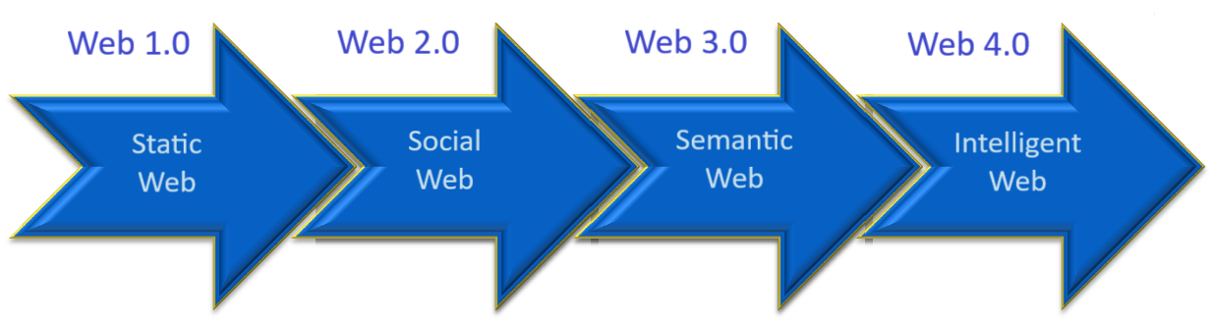
Web technologies
Information web
Limited number of authors
Passive viewing of web content
Collaborative web
Read-write
Interactivity
Sharing content
Web applications
Personalized web
Mobile web
Dynamic web services
Metadata, ontologies,…
Smart search
Autonomous web
Connected to artificial intelligence
Personal assistant of individual user

Slide 9



















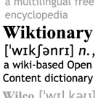



















Slide 10

























Slide 11
Motivation
Educational theories
Technologies
Students

Slide 12



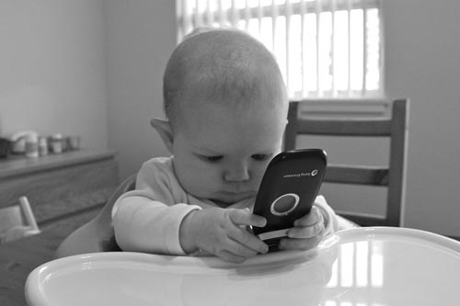






Our students
http://www.123rf.com, http://fall11-eng-02.wikispaces.com
Generation Z

Slide 13
Our students
Generation Z
Their world:
Global networks
Online communities
Instant communication platforms
Different
Experiences
Educational preferences
Collaboration patterns
They prefer
Interactive, technology-oriented VLE
Online discussion forums
Collaboration platforms
Peer-learning

Slide 14
Collaborative learning
using web tools
Introducing web tools into the learning process
Pedagogical forms and tools to support active learning

Slide 15
Collaborative learning
using web tools
Introducing web tools into the learning process
Pedagogical forms and tools to support active learning

Slide 16
Introducing web tools into informatics education
Familiarizing teachers with web tools and their potential
Making the learning process more attractive and effective for students
Specifying methodology
Classifying tools and methods of their use
Designing activities
Identifying support functions
Developing and implementing web tools (design-based research)
VEGA 1/0948/13 Prostriedky webu 2.0 vo vzdelávaní
Homola, M., Kubincová, Z.. Taking Advantage of Web 2.0 in Organized Education (A Survey). In: International Conference ICL 2009: The Challenges of Life Long Learning, Wien : International Assocciation of Online Engineering, s. 741-752

Slide 17
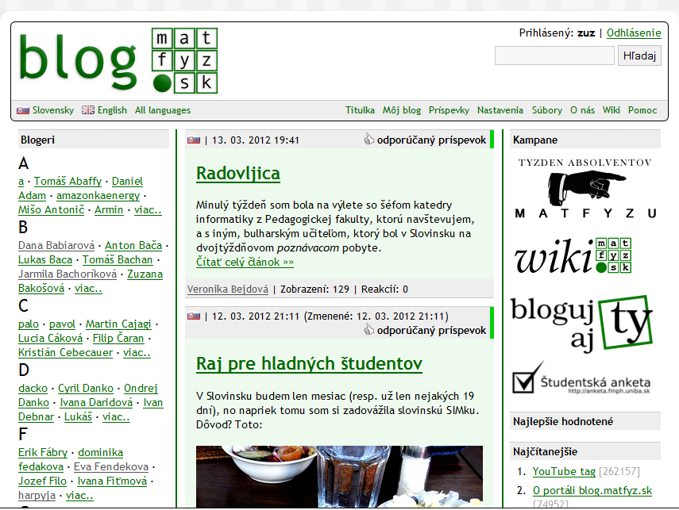
Blog
Reflection on experiences,
organizing knowledge,
informal learning
Comments – exchange of
opinions → social learning
(Mosel, 2005)
Experimental research
Courses: Web design, Algorithms, and Web tools in teaching
Professional blogging, project diaries
Catalog of activities + methods for their use
Mosel, S.: Self directed learning with personal publishing and microcontent. In: Microlearning 2005 Conference (2005)
Popescu, E., Kubincová, Z. and Homola, M., 2015. Blogging activities in higher education: comparing learning scenarios in multiple course experiences. In Advances in Web-Based Learning-ICWL 2015, pp. 197-207. Springer, LNCS 🏆 Best Paper Award

Slide 18
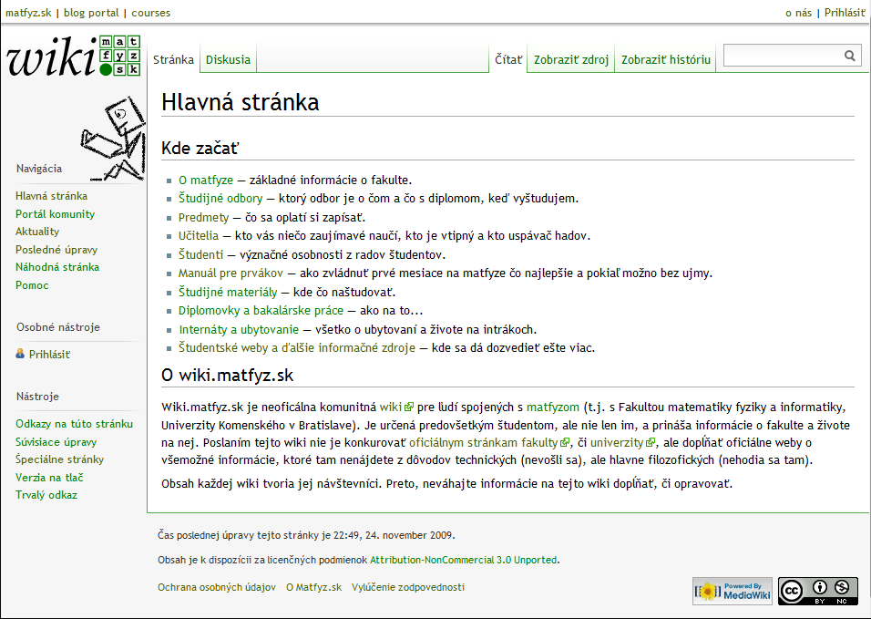
Wiki (technology)
Collaborative creation and
sharing of content (Cunningham, 2001)
Collaborative knowledge building
(Cress & Kimmerle, 2008)
Experimental research
Courses: Web design, Algorithms, Web tools in teaching
Informatics at secondary schools
Integration wiki with matfyz.sk portal
Methodology of use in teaching
Specification of support functions
Leuf, B. and Cunningham, W. The Wiki way: quick collaboration on the Web. Addison-Wesley Longman Publishing Co., 2001.
Cress, U., Kimmerle, J.: A systemic and cognitive view on collaborative knowledge building with wikis. The International Journal of Computer-Supported Collaborative Learning 3(2)(2008)
Kubincová Z, Homola M. How to get around with wikis in teaching. In Advances in Web-Based Learning-ICWL 2012, pp. 21-30, Springer, LNCS.
Kubincová Z, Csicsolová I. Wiki in Informatics Teaching at Secondary School. Information and Communication Technology in Education, 2017, Ostrava, pp. 39-42.

Slide 19
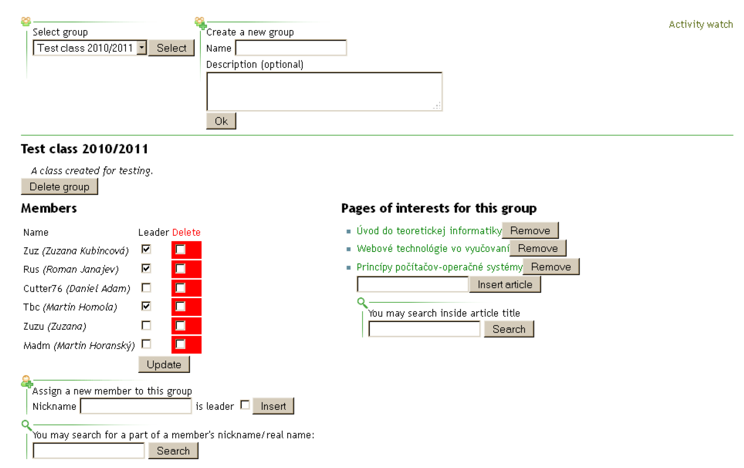
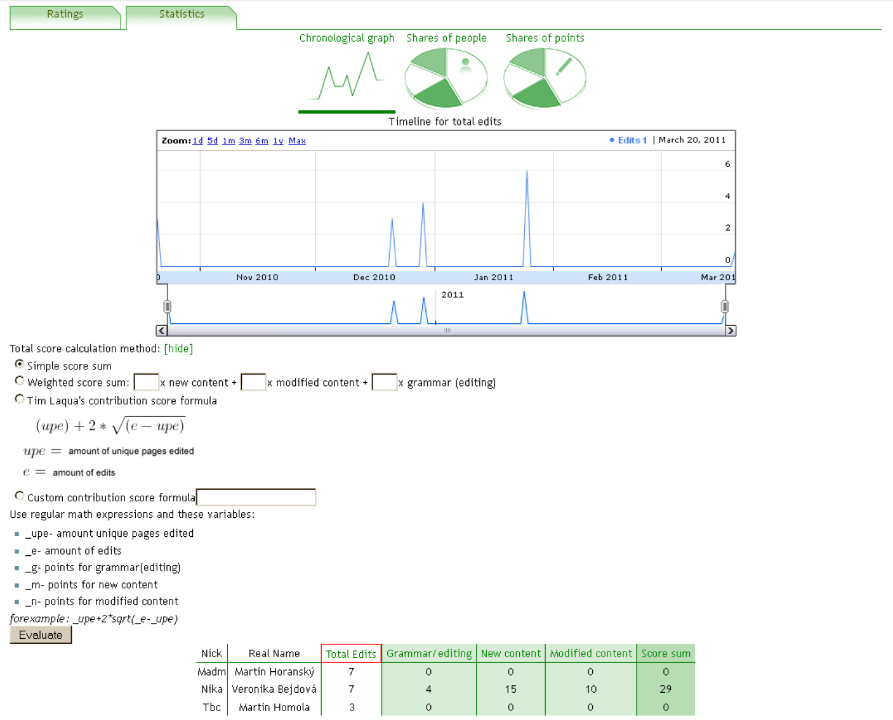
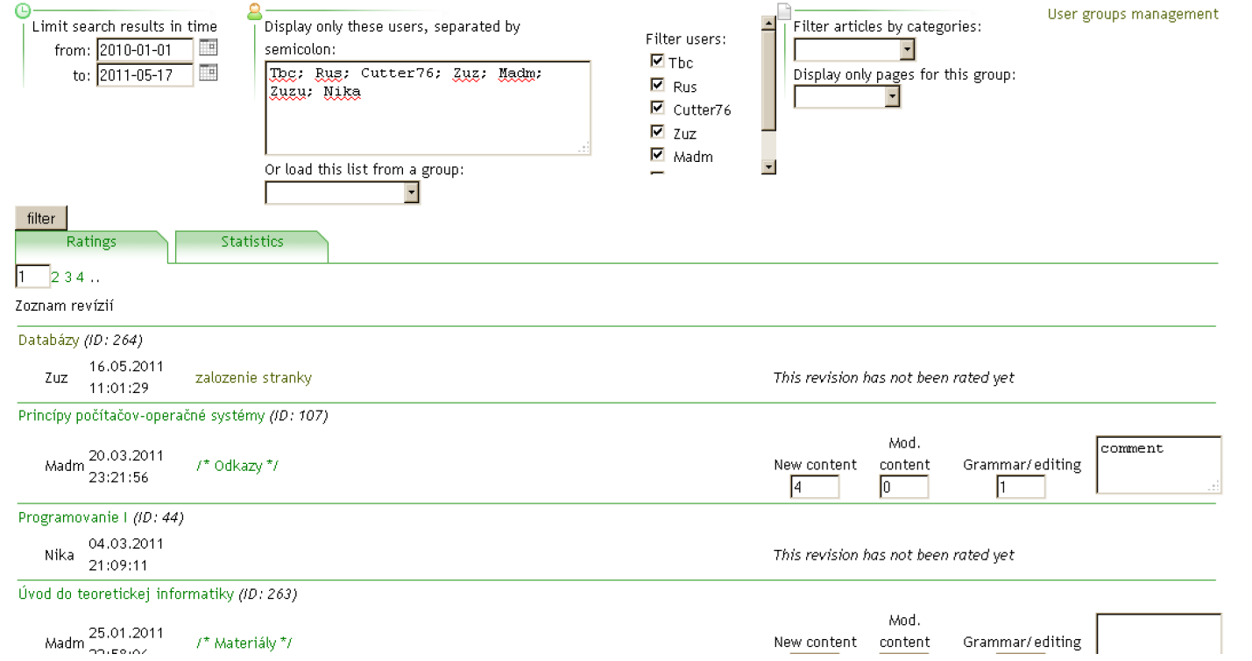
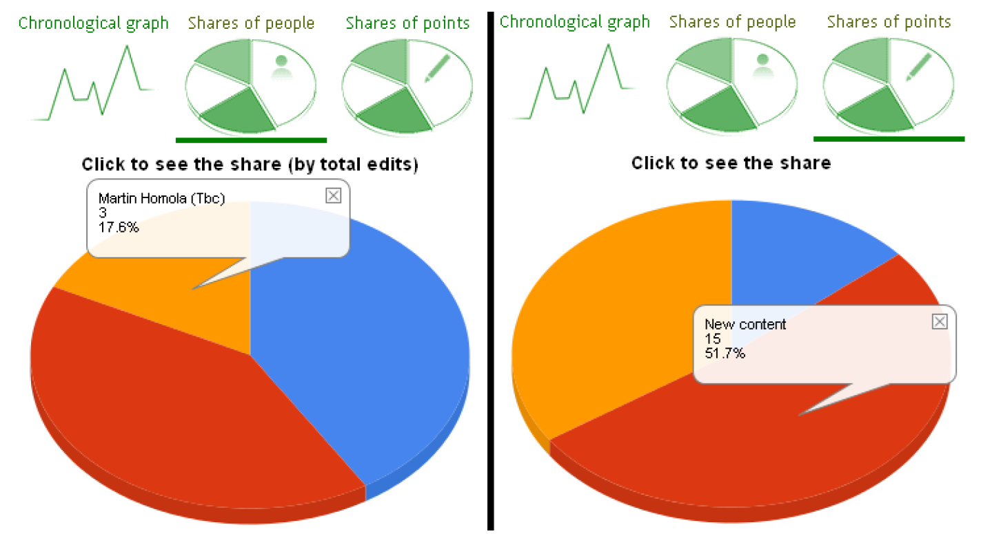
Tracking Bundle
Monitoring and authomatic evaluation of students’ activities in wiki
Creating groups
Assigning wiki pages
Choosing the method of evaluation
Various types of visualization
Kubincová, Z., Homola, M., Janajev, R. Tool-supported assessment of wiki-based assignments. In: CSEDU 2012, SciTePress, 2012. pp. 58-67
Kubincová, Z., Homola, M., Janajev, R. Nástroj na vyhodnocovanie práce študentov vo wiki. DidInfo 2012, UMB, 2012, pp. 121-128

Slide 20
Collaborative learning
using web tools
Introducing web tools into the learning process
Pedagogical forms and tools to support active learning
Peer assessment
Team assessment
Code review
Collaborative creation of quiz questions
Peer collaboration

Slide 21
Peer assessment (background)
Areas
Writing (Ford, 1973), technical and natural sciences, healthcare, ...
Implementation (Topping, 1998)
Points/grades, comments, questions+answers, rubrics, ...
Anonymous – non-anonymous
Mandatory/voluntary/graded activity
Various workflow strategies
Web tools
PG system (Gehringer, 2000), Expertiza (Gehringer, 2007)
OpenAnswer (Sterbini & Temperini, 2012)
Ford, B.W.. The effects of peer editing/grading on the grammar-usage and theme-composition ability of college freshmen. The University of Oklahoma, 1973.
Topping, K., 1998. Peer assessment between students in colleges and universities. Review of educational Research, 68(3), pp.249-276.
Gehringer E.F. Strategies and mechanisms for electronic peer review. In: Proceedings of the 30th Annual Frontiers in Education Conference. Building on A Century of Progress in Engineering Education, 2000, Vol. 1, pp. F1B2-F1B7, IEEE.
Gehringer, E. F., Ehresman, L.M., Conger, W. P. .Reusable learning objects through peer review:The expertiza approach,In Innovate: Journal of Online Education, 2007.
Sterbini A, Temperini M. Dealing with open-answer questions in a peer-assessment environment. In ICWL 2012: Proce 11 2012 (pp. 240-248). Springer, LNCS.

Slide 22
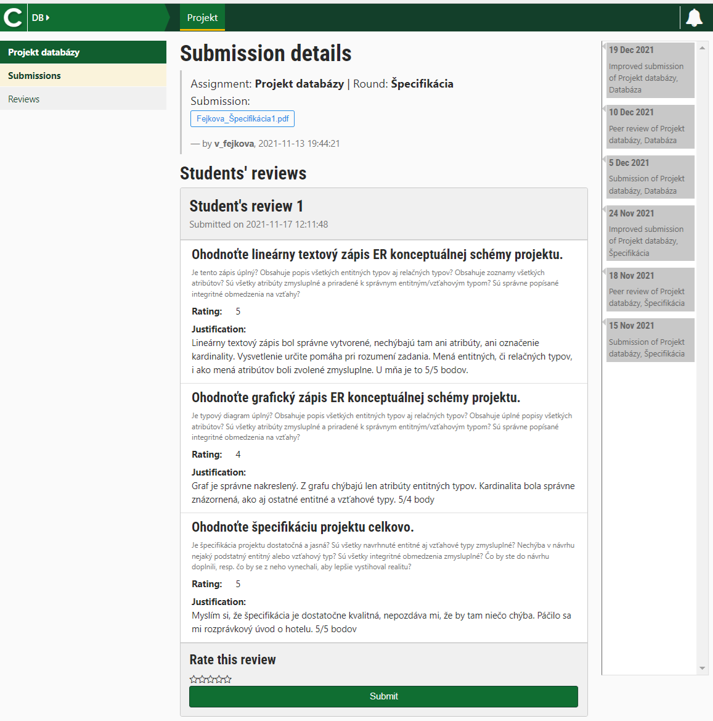
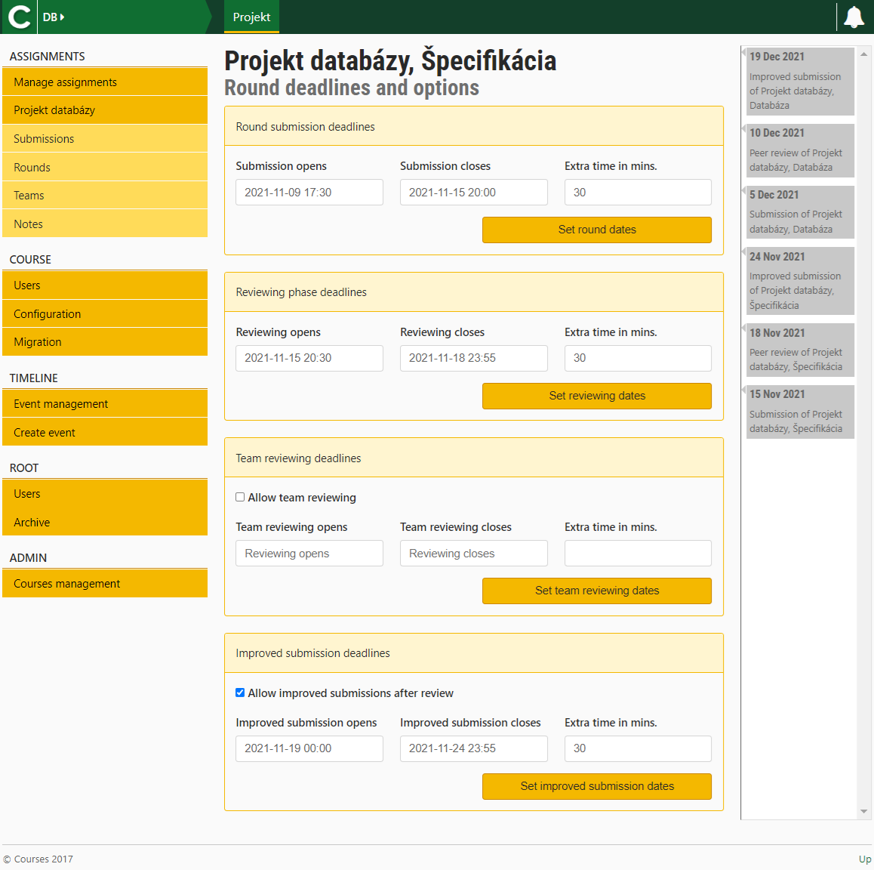
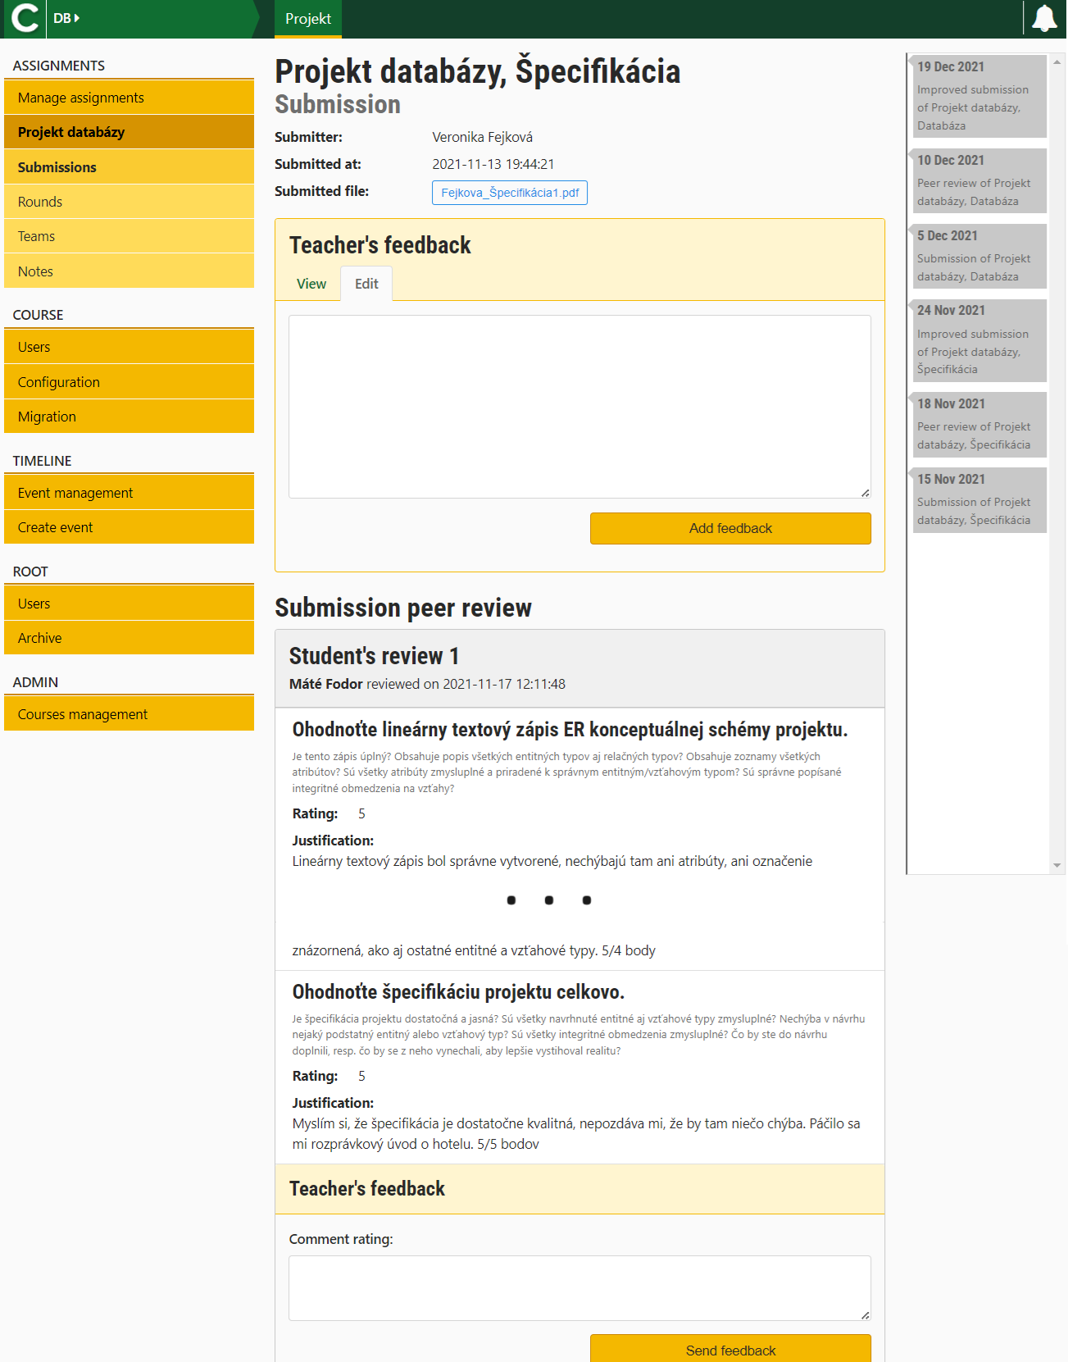
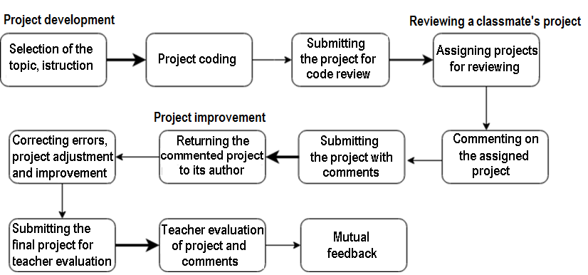
Peer assessment – our experience
Applied Informatics – professional blogging, projects
Teaching Informatics – projects
Results
Methodology
Tool
Long-term research (Web technologies and methodologies)
Increased student activity
Improved study results
Research into the reliability of student assessment
Fairness of assessment (friends vs. non-friends)
Comparison of student and teacher assessment
Kubincová, Z., Homola, M., Bejdová, V.: Motivational effect of peer review in blog-based activities. ICWL 2013. Springer,LNCS, vol. 8167, pp.194–203.
Dropčová, V., Homola, M., Kubincová, Z. Students' acceptance of peer review. eLEOT 2015, Springer, LNICSSITE, 2016, pp. 52-59.
Dropčová, V., Kubincová, Z., Homola, M. Can blogging activities and peer-reviewing improve learning outcomes? ICTE 2013, Ostrava, 2013, pp. 37-46.
Dropčová, V., Kubincová, Z. Evaluation of peer-review quality in comparison to teacher's grading. ICTE 2014, University of Ostrava, 2014, pp. 61-68
Dropčová, V., Kubincová, Z., Homola, M. Are students reliable peer-reviewers? In: ICALT 2014, Los Alamitos, IEEE, 2014, pp. 270-272
Dropčová, V., Homola, M., Kubincová, Z. May I peer-review your web design project? State-of-the-Art and Future Directions of Smart Learning. Springer, 2015, pp.241-248
Homola, M. et al. Peer review support in a virtual learning environment. In: State-of-the-Art and Future Directions of Smart Learning. Springer, 2015, pp. 349-353

Slide 23
Team assessment (background)
Intention to fairly evaluate teamwork (Levine, 2008)
Within the team – evaluation of the contribution of individual team members
Implementation of the method (Michaelsen & Fink, 2004)
Must be suitable for teams of different sizes
Must accurately reflect the work of team members
Must influence the evaluation of the team's work results
Web tools (Rosenman, 2015)
Levine, R. E. Peer evaluation in team-based learning. In: Team-Based Learning for Health Professions Education: A Guide to Using Small Groups to Improve Learning. Sterling, Va: Stylus Publishing, 2008, pp. 103–116
Michaelsen, L. K., Fink, L. D. Calculating peer evaluation scores. In: Team-Based Learning: A Transformative Use of Small Groups in College Teaching. Sterling, Va, Stylus Publishing (2004), pp. 241–248
Rosenman, E.D., Ilgen, J.S., Shandro, J.R., Harper, A.L. and Fernandez, R., A systematic review of tools used to assess team leadership in health care action teams. Academic Medicine, 2015, 90(10), pp.1408-1422.

Slide 24
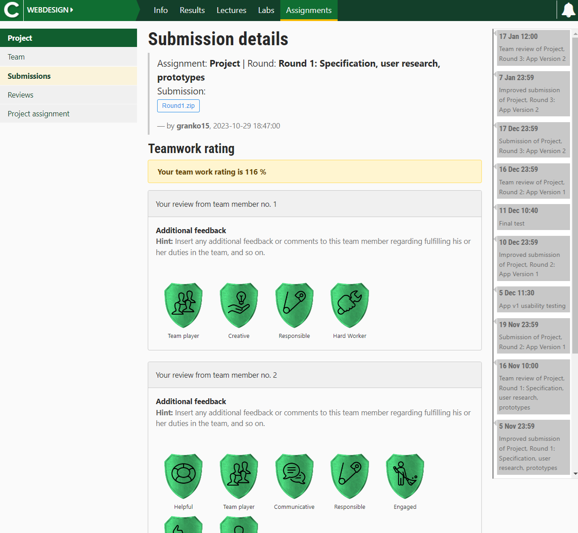
Team assessment – our experience
Collaborative learning: team projects + team assessment
(Web applications, Programming)
Results
Methodology
Team building tool
Team assessment tool
Gamification
Greater acceptance of the activity
Reliability of student assessment
Fairness of assessment
Student vs. teacher evaluation
Kubincová, Z. et al. Peer reviews in a web design course: Now students like them too. In: Emerging Technologies for Education. Springer, 2017, pp. 624-634
Kubincová, Z., Dropčová, V., Homola, M. Students' acceptance of peer review in Computer Science course, EAI Endorsed Transactions on e-Learning, 3(10), 2016
Homola, M. et al. Team workflow and peer review in avirtual learning environment. ITHET 20017, Los Alamitos: IEEE, 2017, pp. 1-6
Šuníková, D., Kubincová, Z., Navrátil, M. How to use open badges? ICTE 2015, University of Ostrava, 2015, pp. 222-230
Šuníková, D. et al. Peer assessment augmented with digital badges: A first experience report . ITHET 2017, IEEE, 2017, pp. 1-5
Kubincová, Z. et al. Badges for peer assessment of teamwork in organized education, Journal of Universal Computer Science, 25(12), 2019, pp. 1589-1607
Šuníková, D., Kubincová, Z., Homola, M. A badge for reducing open answers in peer assessment. ICWL 2018, Springer LNCS, 2018, pp. 14-24
Kubincová, Z. Negative Badges in Teamwork Evaluation Preliminary Results. Mis4TEL 2021, Springer Nature, 2021, pp. 47-55

Slide 25
Code review (background)
Feedback for the program author from fellow programmers → improvement of code quality
"Best practice" in software product development
Suitable for use in education (Li&Prasad 2005, Wang et al. 2012)
Educational code review (Trytten, 2005, Hundhausen et al., 2009)
New methodologies
Customized web tools
Li, X. and C. Prasad, “Effectively teaching coding standards in programming,” in Proceedings of the 6th conference on Information technology education. ACM, 2005, pp. 239–244.
Wang, Y., H. Li, Y. Feng, Y. Jiang, and Y. Liu, “Assessment of programming language learning based on peer code review model: Implementation and experience report,” Computers & Education, vol. 59, no. 2, pp. 412–422, 2012.
Hundhausen, C., Agrawal, A., Fairbrother, D., Trevisan, M.: Integrating pedagogical code reviews into a CS1 course: An empirical study. ACM SIGCSE Bulletin 41(1), pp. 291–295, 2009.
Trytten, D. A.: A design for team peer code review. ACM SIGCSE Bulletin 37(1), 455–459, 2005

Slide 26
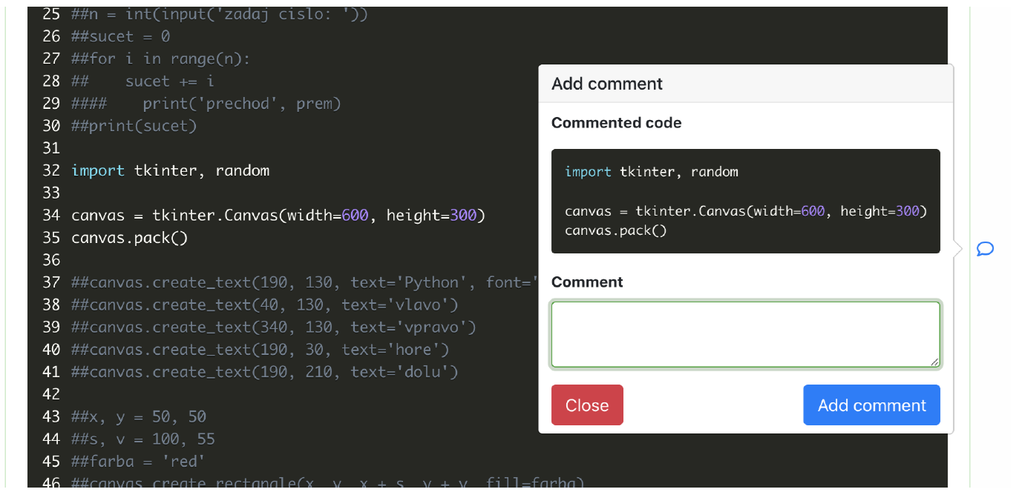
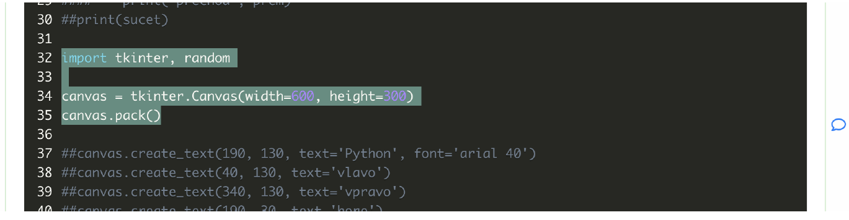

Code review – university
Experiment in Web Programming and Database Systems courses (Applied Informatics)
Comparison of two different tools
Results
Acceptance of the activity by students – satisfaction
Help with debugging errors in their program
Useful skill for their future employment
Specification of requirements for a tool suitable for educational code review + implementation of the tool
Regular use in Programming and Algorithms courses for future informatics teachers
Kubincová, Z., Homola, M. Code review in computer science courses: Take one. In ICWL 2017. Springer, LNCS, 2017, pp. 125–135.
Kubincová, Z., Kľuka, J., Homola, M., Marušák, A. Educational Code-Review Tool: A First Glimpse , Mis4TEL 2022, Springer Nature, 2023, pp. 113-122

Slide 27
Code review – high school
Results
Our own methodology
Short reviews + Project reviews
Student perspective:
A useful way to learn programming
Reflecting on programming problems they had not encountered before
Teacher perspective:
Students learned to find and fix errors and even prevent errors
They gained self-sufficiency in reading code
They were able to find alternative solutions
They were asking for help less often
Resarch on team assessment vs. self-assessment
The suitability of code review in teaching already at high school
Kubincová, Z., Csicsolová, I. Code Review in High School Programming. In ITHET 2018,IEEE, pp. 1-4, 2018.
Kubincová, Z., Demková, I. Integrating code review into high school programming projects. In: EDULEARN19, IATED, 2019, pp.1612-1621
Kubincová, Z., Demková, I. Using Code Review at School and at the Programming Club. ICPEC, Dagstuhl Publishing, 2020, pp. 1-8
Kubincová, Z., Demková, I. Code review at high school? Yes! MIS4TEL 2019, Springer Nature, 2020, pp. 115-123
Kubincová, Z., Kolčák, K. Acceptance of Team Assessment and Self-Assessment by High School Students. EDULEARN22, IATED, 2022, pp. 5225-5231
Kubincová, Z., Kolčák, K. Team Assessment and Self-Assessment Can High School Students Do It? In: ITHET 2022, IEEE, 2022, pp. 1-7.
Kubincová, Z., Kolčák, K. Team Assessment and Self Assessment in High School - Preliminary Results. ITHET 2021, IEEE, 2022, pp. 1-5

Slide 28
Collaborative creation of quiz questions (background)
Quizzes
Effective learning tool
Promote active and self-regulated learning
Motivating
Stimulate critical thinking
Help to identify gaps in understanding of the subject matter and better retain newly acquired knowledge (Yang, 2021)
Quizzes created by students
Even more beneficial
Yang, C., Luo, L., Vadillo, M., Yu, R., Shanks, D.: Testing (quizzing) boosts classroom learning: A systematic and meta-analytic review. Psychological Bulletin 147(3), 2021
Stelovsky, J., Ogawa, M.B., Ogata, B., Stelovska, U.: Constructive learning by teaching: Flip-flop, peer evaluation, and agile tooltip: Making and taking peer quizzes synchronized with lecture screencasts. In: Designing for the user experience in learning systems, pp. 177–200 (2018)

Slide 29
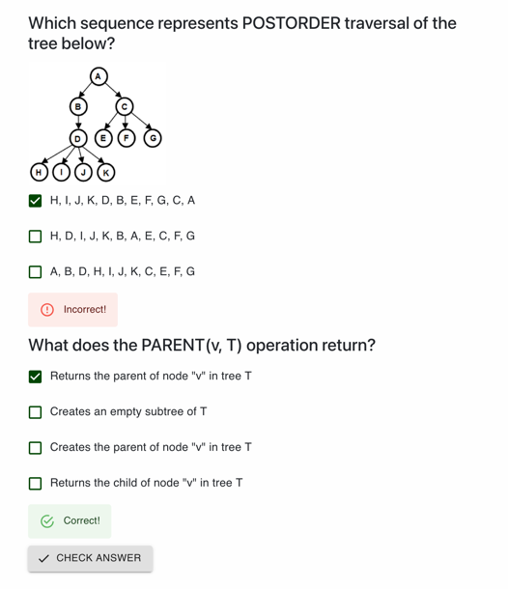
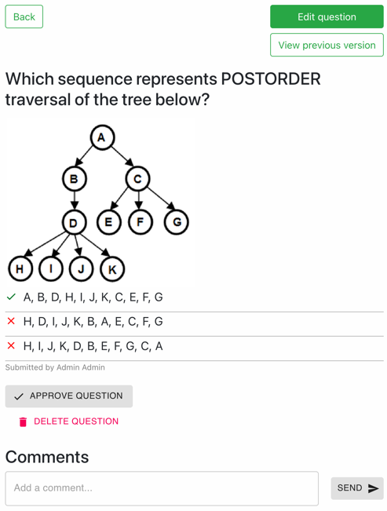
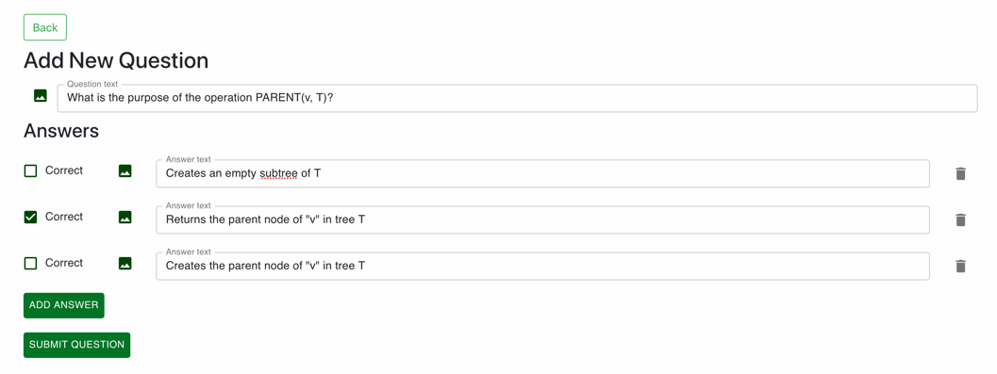
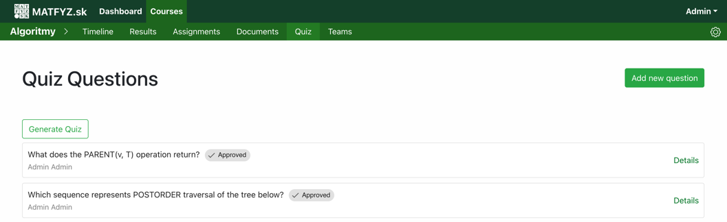
Collaborative creation of quiz questions
Results
Tool
Student’s role
Creating questions
Editing/deleting them
Mutual commenting on questions
Teacher’s role
Editing/deleting/commenting on questions
Approving questions
Generating quizzes for self-assessment and/or tests as part of the course assessment
Experience from one course
Optional activity
Students participated only to a limited extent
Kubincová, Z. and Krupková, K.: First Experiences with a Tool for Collaborative Creation of Quiz Questions by Students, In: New Perspectives in Informatics Education, International Proceedings on Teaching Informatics, Banská Bystrica, pp. 32-40, DOI 10.24040/2025.9788055722498 .
Kubincová, Z. and Krupková, K.: First Experiences with a Tool for Collaborative Creation of Quiz Questions by Students, Proc. of The 24th International Conference on Web-Based Learning (ICWL 2025), Springer, In press.

Slide 30
Peer collaboration (background)
Examining ways of mutual communication and collaboration among students
Evaluating student success
Information about approaches to learning
Course curriculum development
Analysis of student networks
Identifying key figures among students
candidates for academic development
Detecting loneliness and isolation among students
poor academic performance (dropping out?)

Slide 31
Peer collaboration & student succes *
Students nominate cooperative classmates → network
Identification of
Central figures in the student network
Relationship between peer collaboration and student success
Predicting students' achievement levels
Creating clusters
Providing student groups with suitable study materials
*University of St. Cyril and Methodius, Skopje

Slide 32
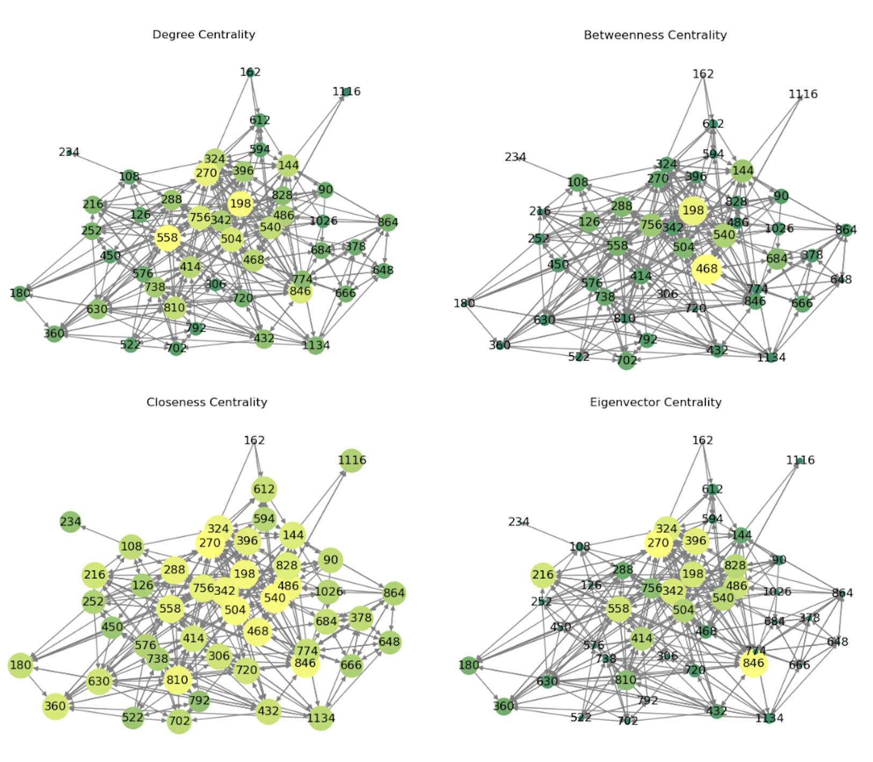
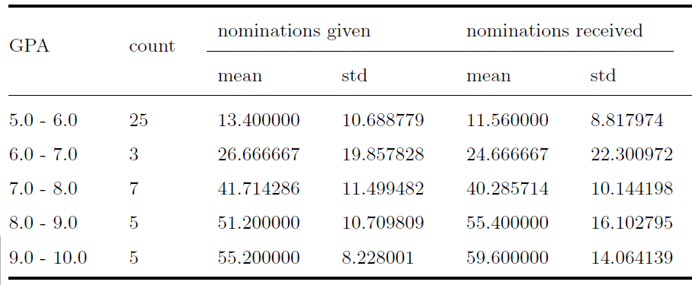
Peer collaboration – Results I.
Linear relationship between grade point average (GPA) and nominations received and awarded
Centrality analysis
Degree centrality
Betweennes centrality
Closeness centrality Eigenvector centrality
Student network centrality graphs
Pesovski, I., Jolakoski, P., Kubincová, Z., Herzog, M., Trajkovik, V.: Digital Learning Platforms and Peer Influence: Analysis of Performance and Collaboration, In: International Symposium on Emerging Technologies for Education, pp. 195-209. Singapore: Springer Nature Singapore, 2023

Slide 33
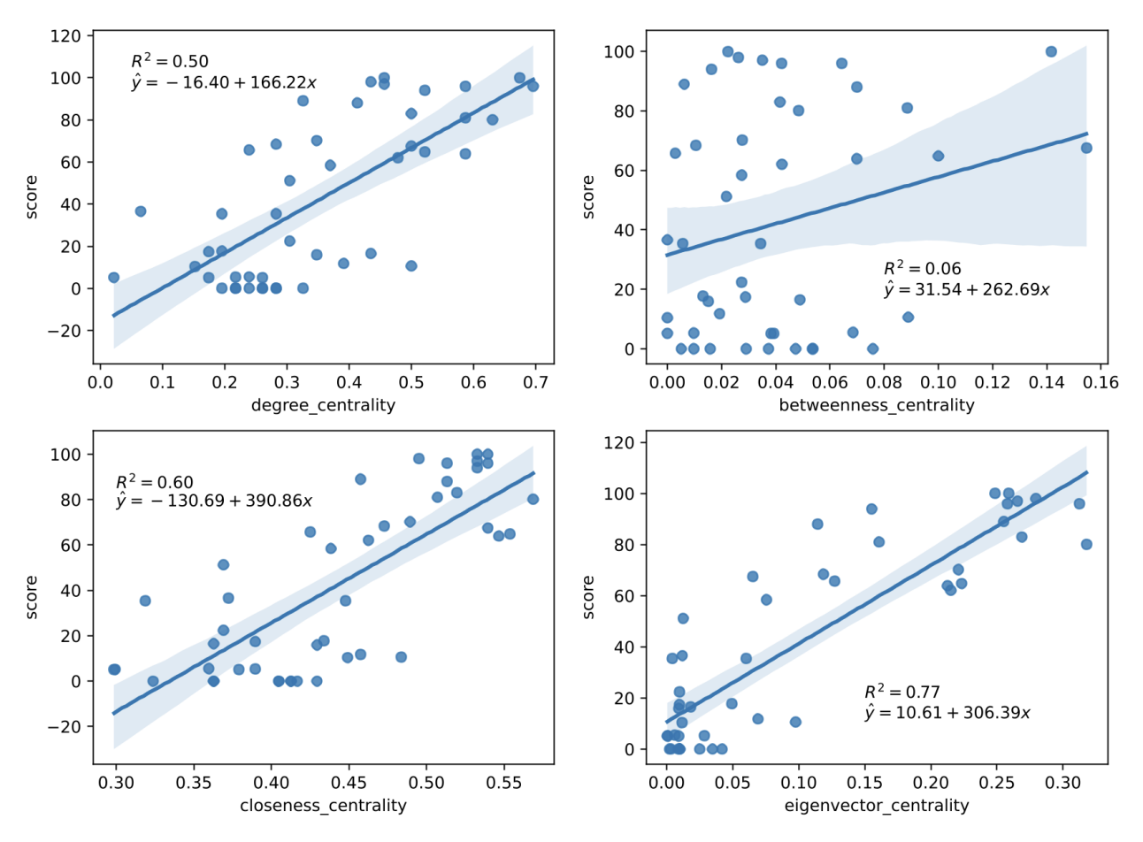
Peer collaboration – Results II.
Correlation between individual measures and student success
Betweenness centrality – unsuitable for predicting GPA
Eigenvector centrality – the best predictor
Powerful tool for predicting academic outcomes
Linear regression results
Pesovski, I., Jolakoski, P., Kubincová, Z., Herzog, M., Trajkovik, V.: Digital Learning Platforms and Peer Influence: Analysis of Performance and Collaboration, In: International Symposium on Emerging Technologies for Education, pp. 195-209. Singapore: Springer Nature Singapore, 2023

Slide 34
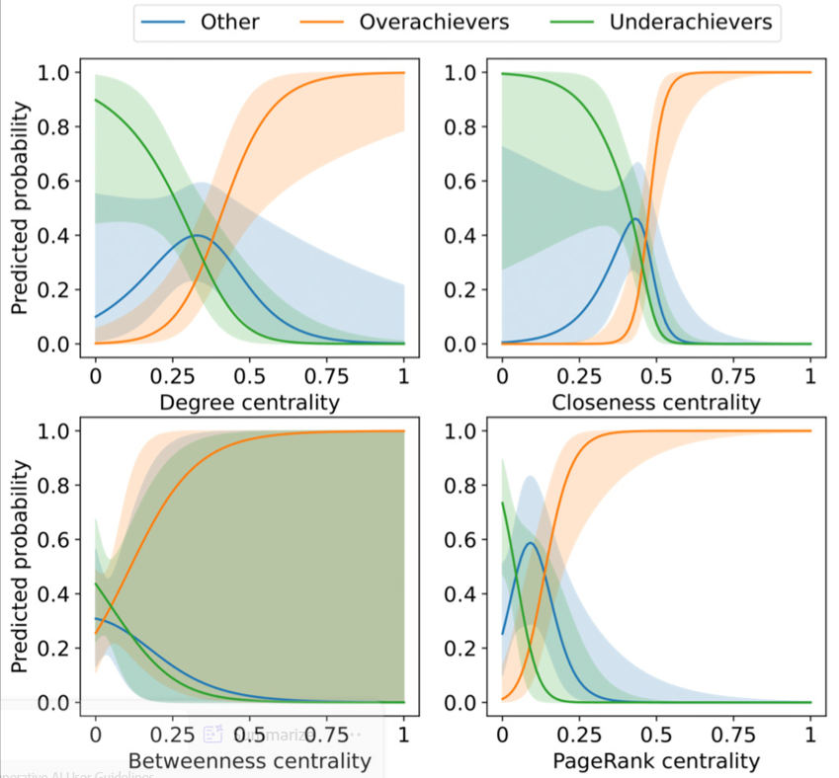
Peer collaboration – Results III.
Classifying students into low-achieving, high-achieving, and neutral groups
Creating tailored learning scenarios for each student cluster using generative AI
Questionnair survey
Students’ acceptance of AI-driven personalization
Multinomial logistic regression results
Pesovski, I., Jolakoski, P., Kubincová, Z., Herzog, M., Trajkovik, V.: Digital Learning Platforms and Peer Influence: Analysis of Performance and Collaboration, In: International Symposium on Emerging Technologies for Education, pp. 195-209. Singapore: Springer Nature Singapore, 2023
Pesovski, I., Jolakoski, P., Trajkovik, V., Kubincova, Z., Herzog, M. A.: Predicting student achievement through peer network analysis for timely personalization via generative AI, Computers and Education: Artificial Intelligence, Volume 8, 2025, 100430, DOI 10.1016/j.caeai.2025.100430

Slide 35
Findings and benefits

Slide 36
Findings and benefits
Observations
Greater student interest in selected educational activities
Acceptance of the course and activities
Better academic performance
Benefits for students
☺ Professional knowledge + soft skills
Benefits for teachers
☺ Teacher's workload reduction
☺ Better overview of student abilities and group dynamics
☺ Fairer assessment of teamwork
☹ Time-consuming and overwhelming
Benefits for Theory of Informatics Education
Research findings
Peer and team assessment, code review, peer collaboration, …
Achievement of educational goals in both the cognitive and affective domains
Methodologies
Tools

Slide 37
.
Thank you for your attention

