Slide 1
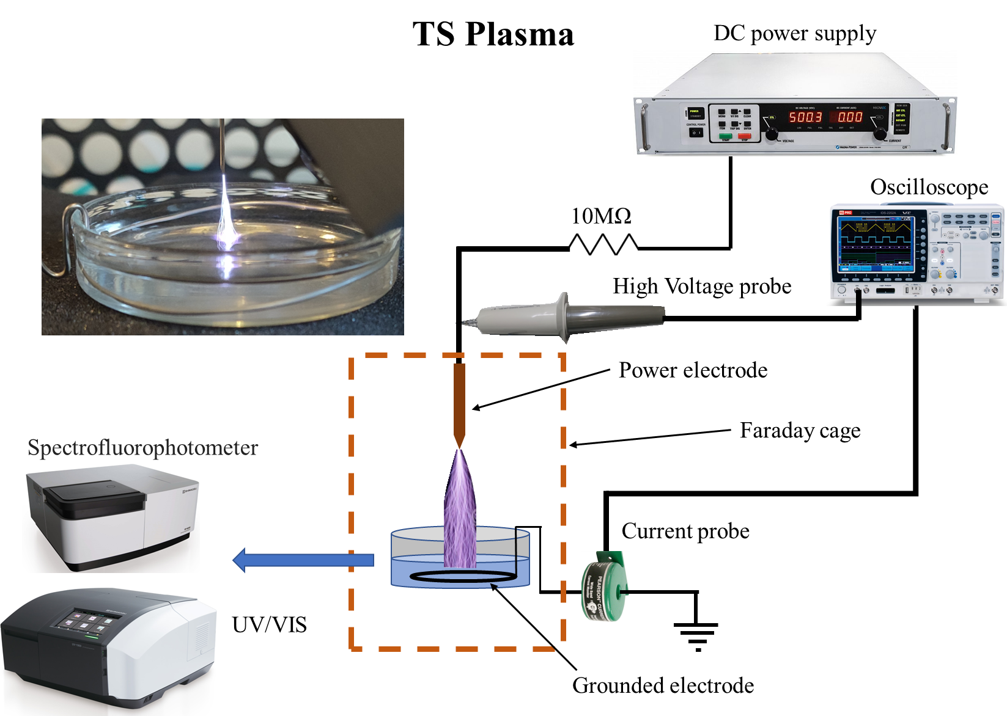
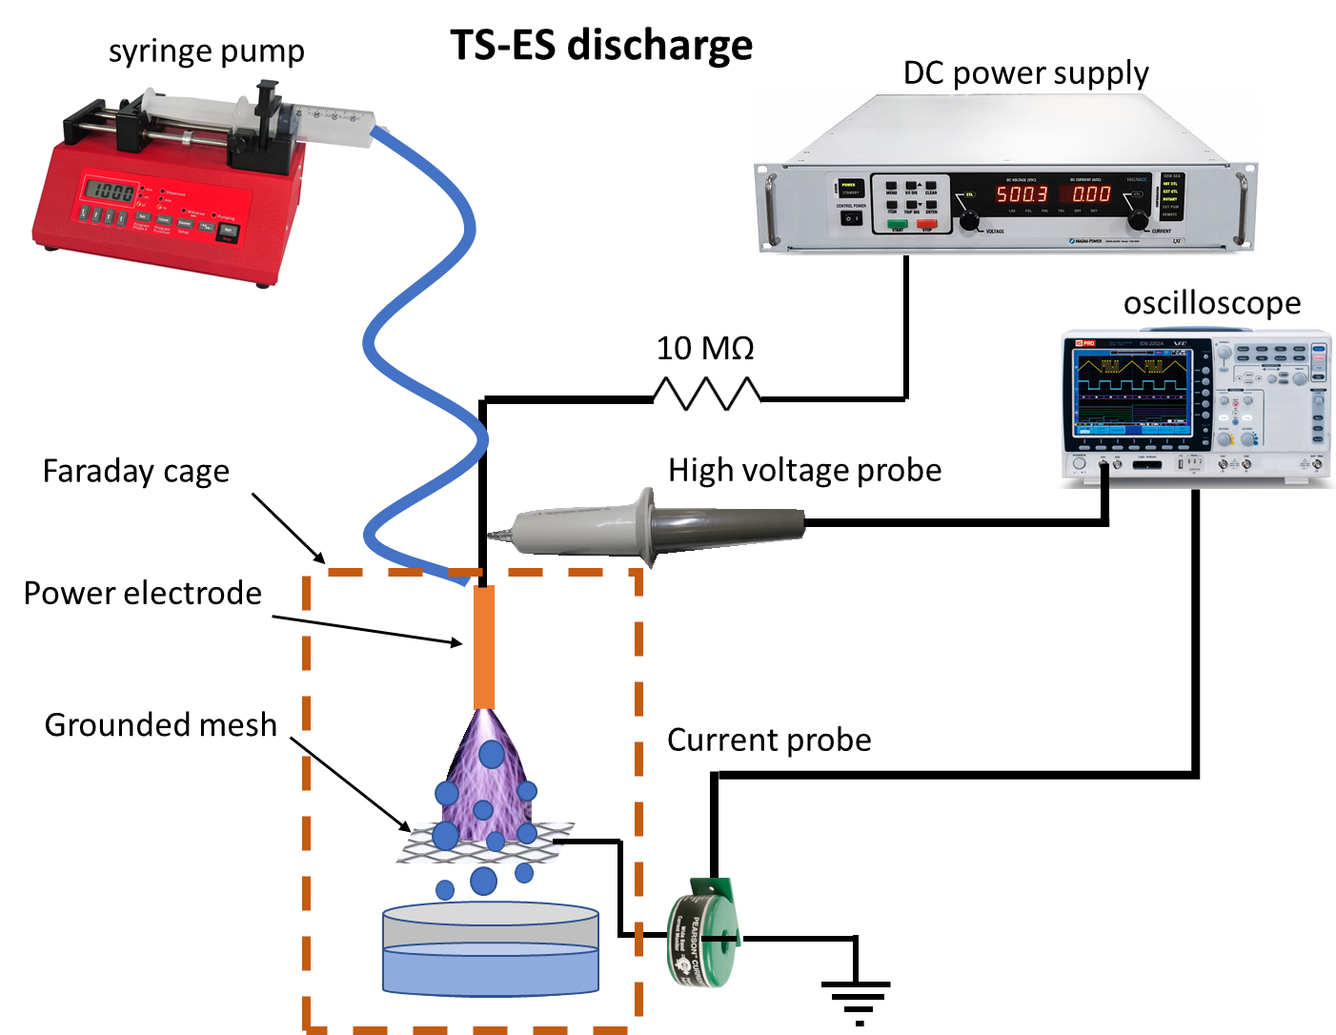
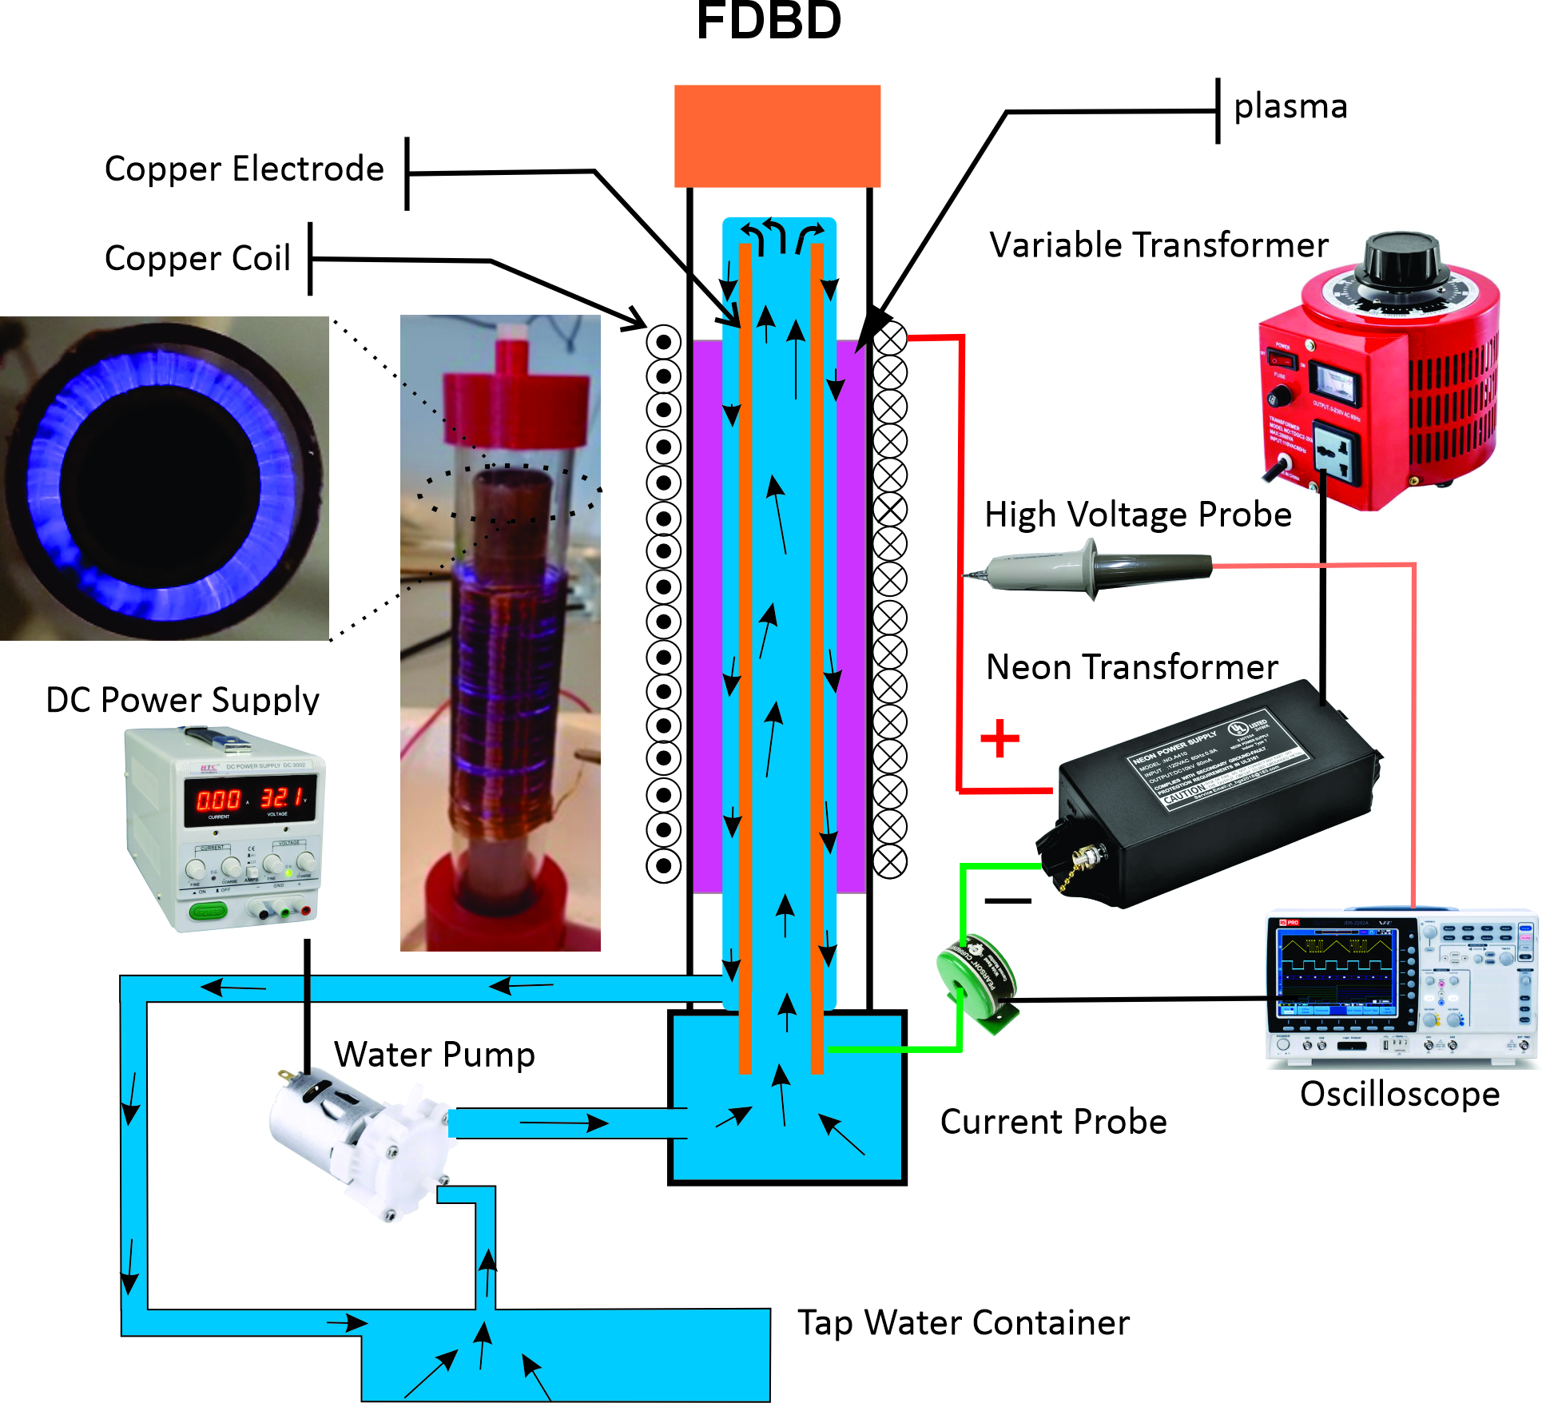
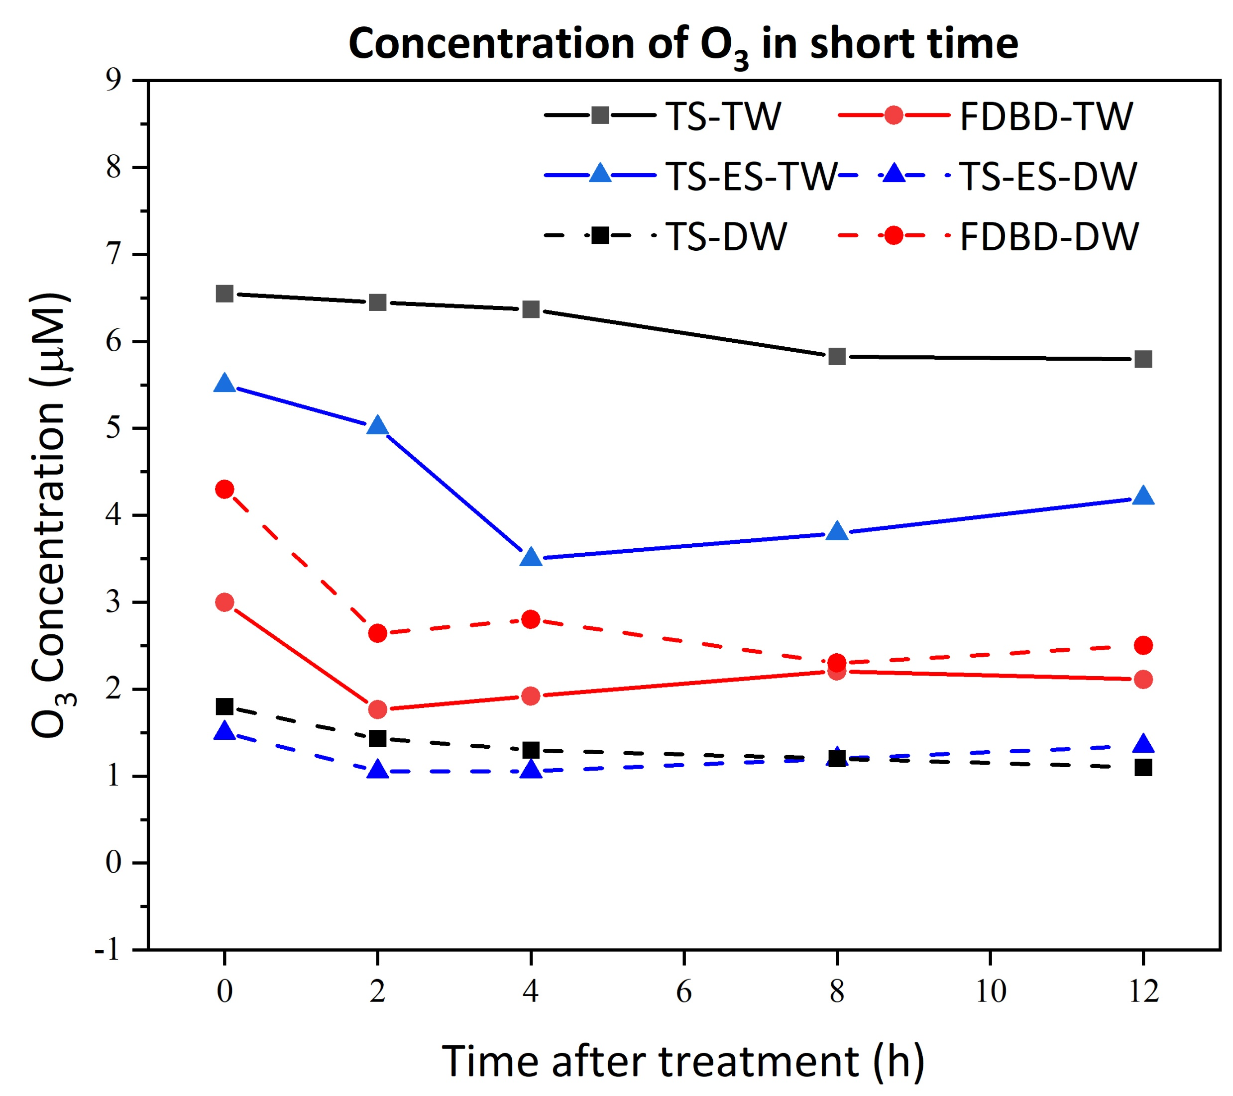
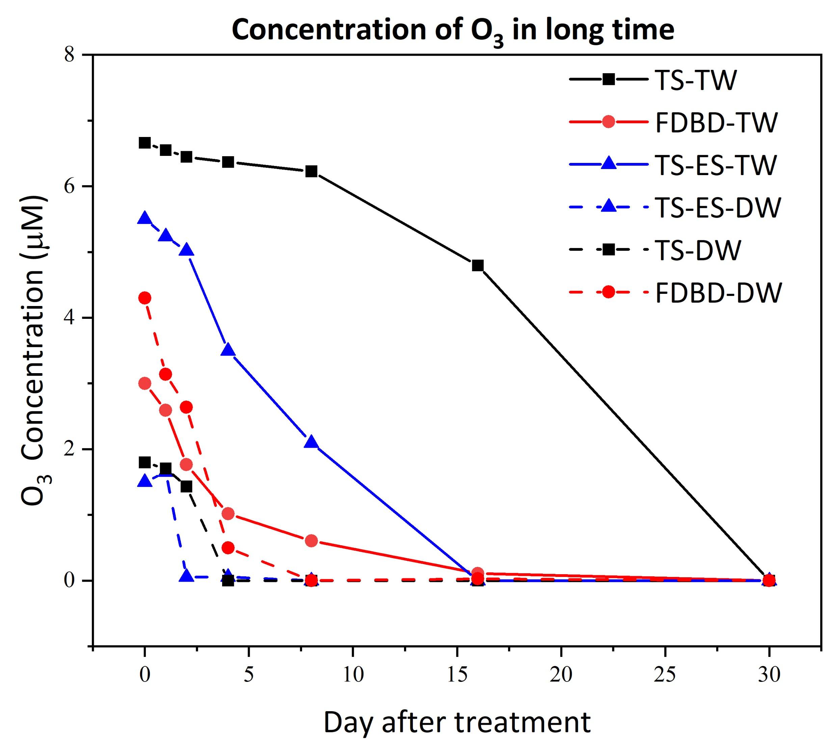
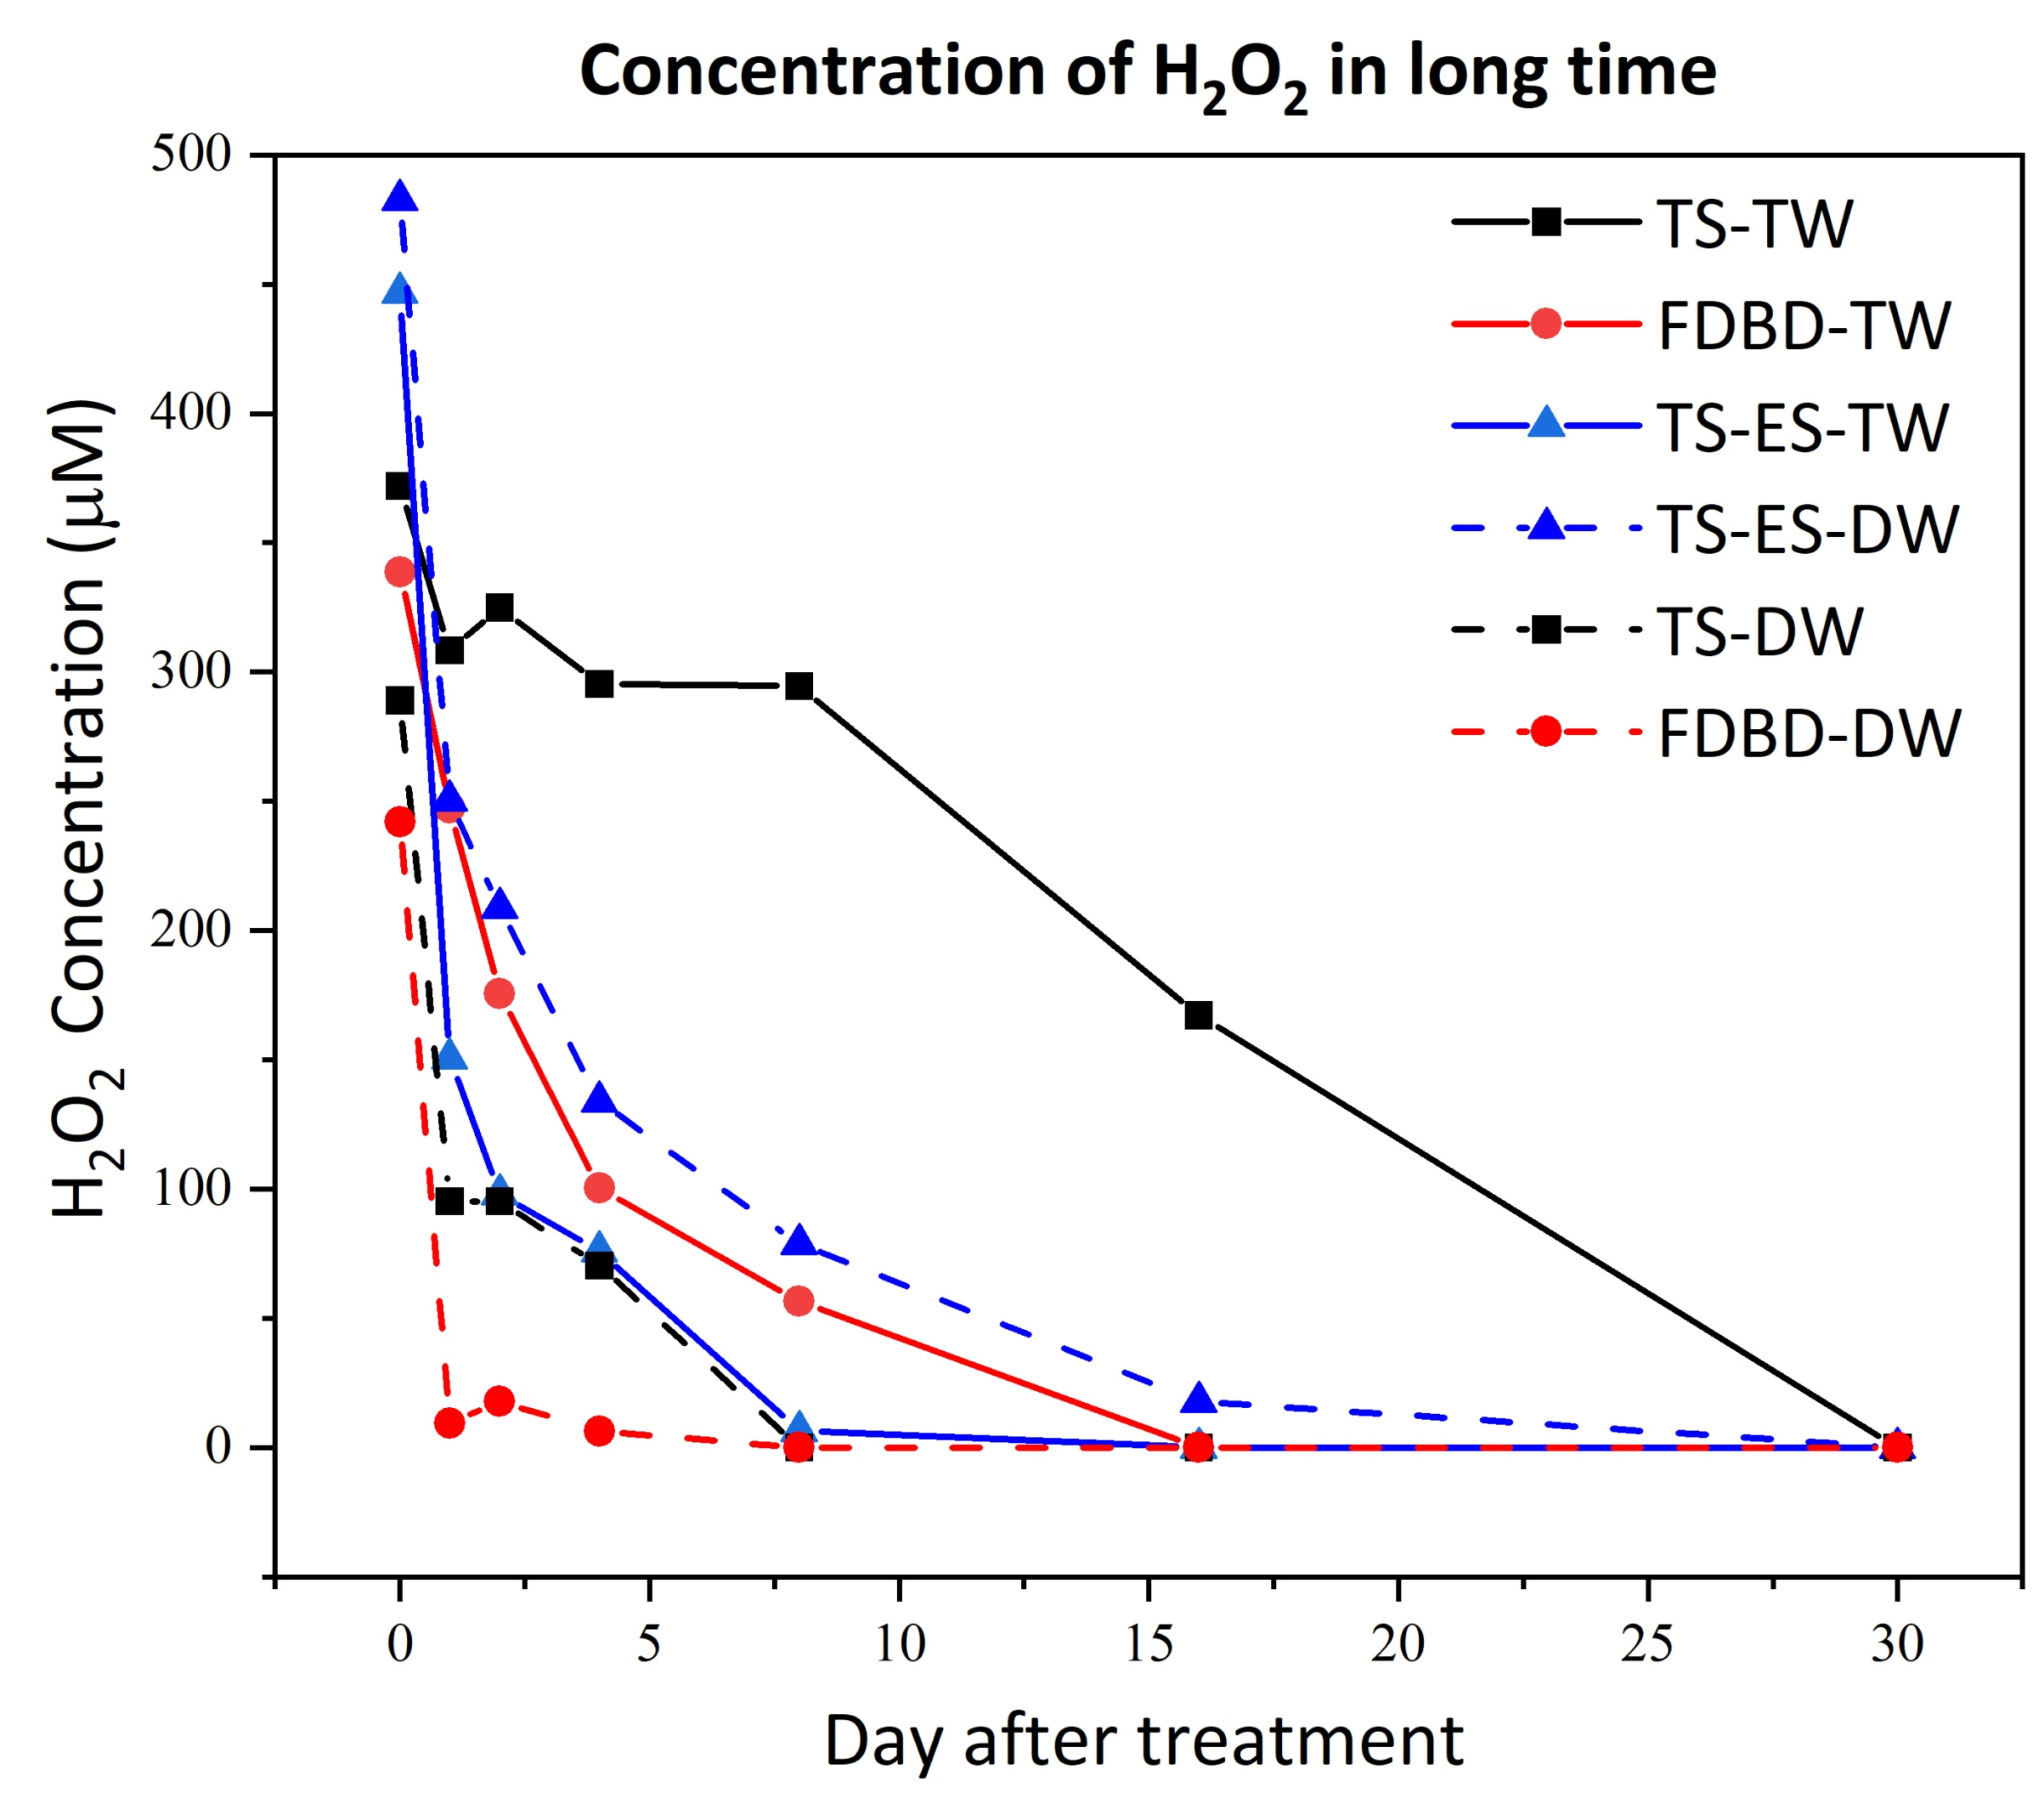
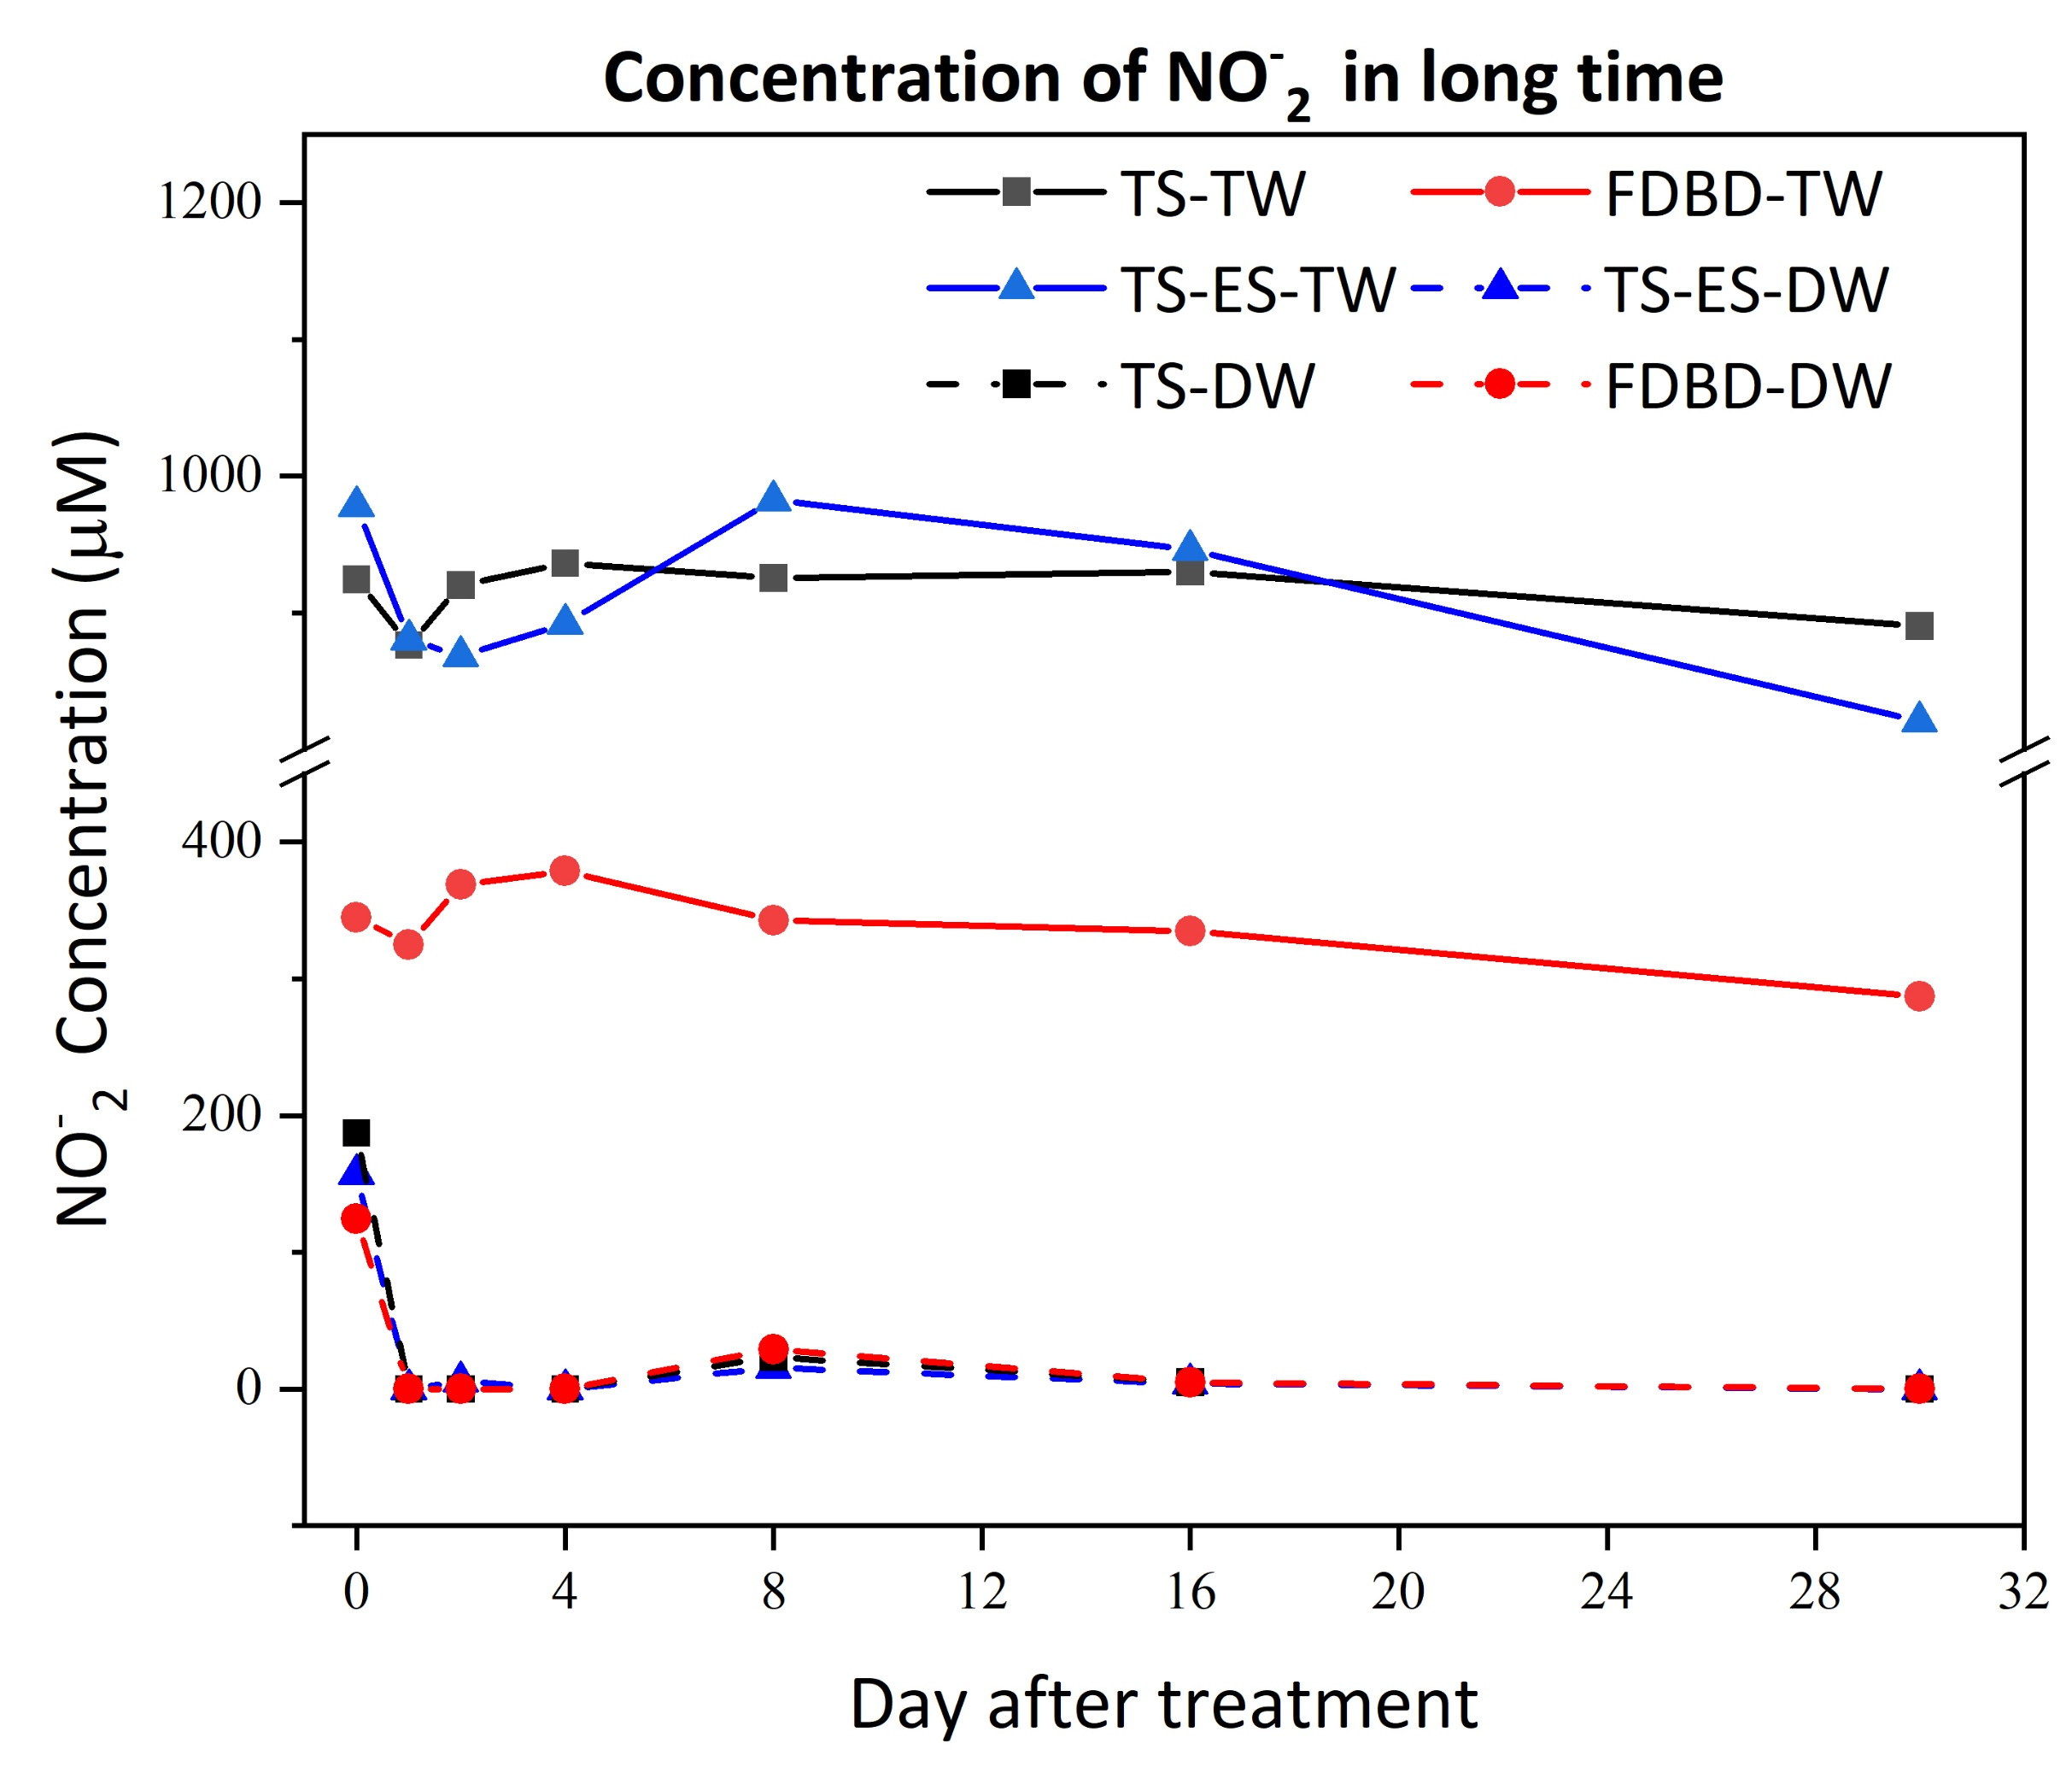
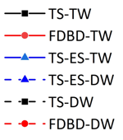
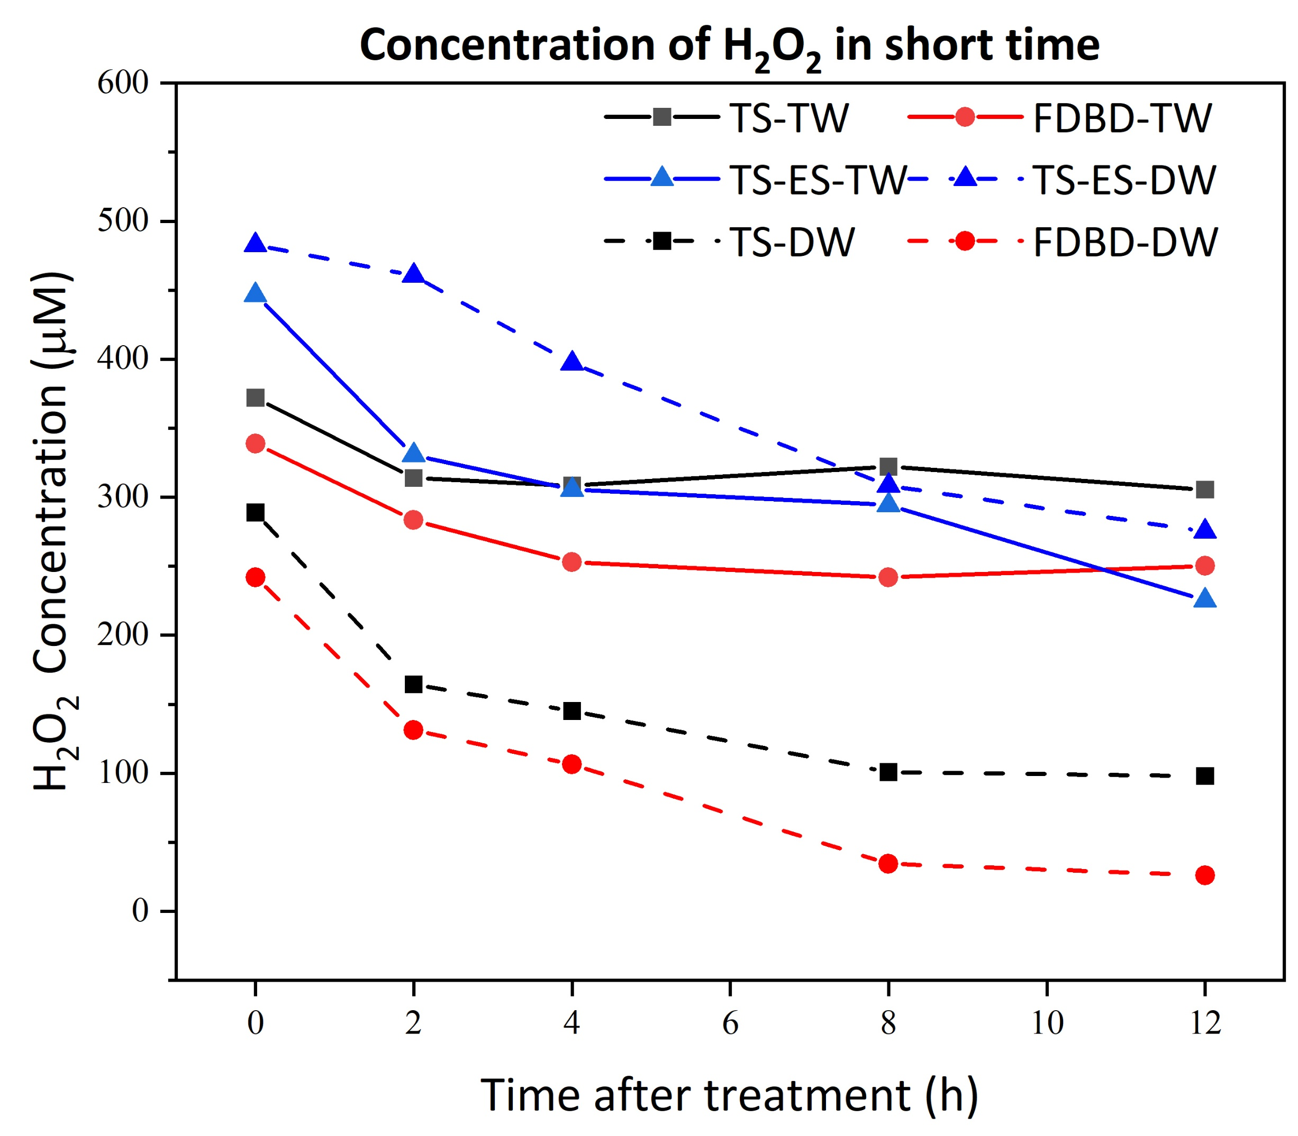
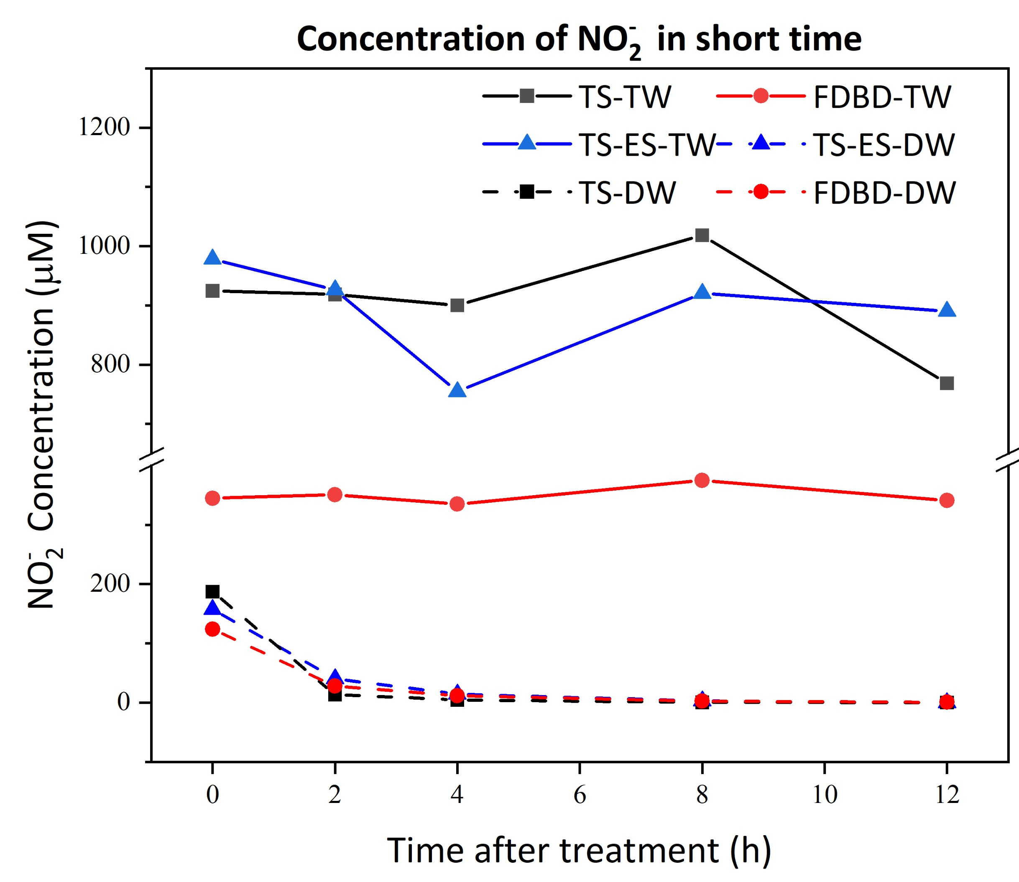
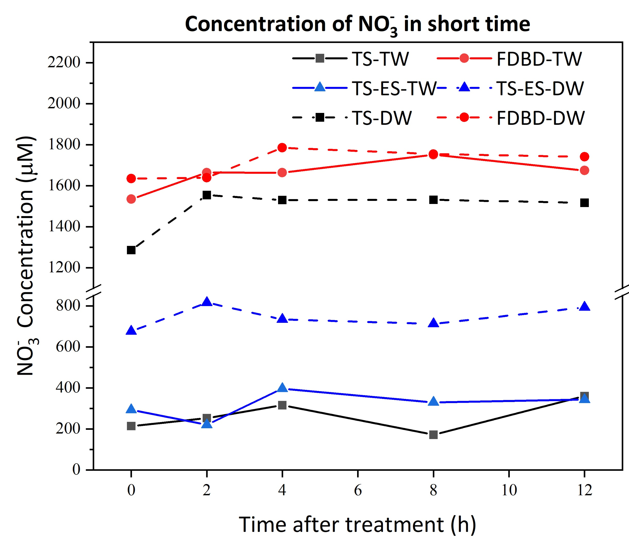
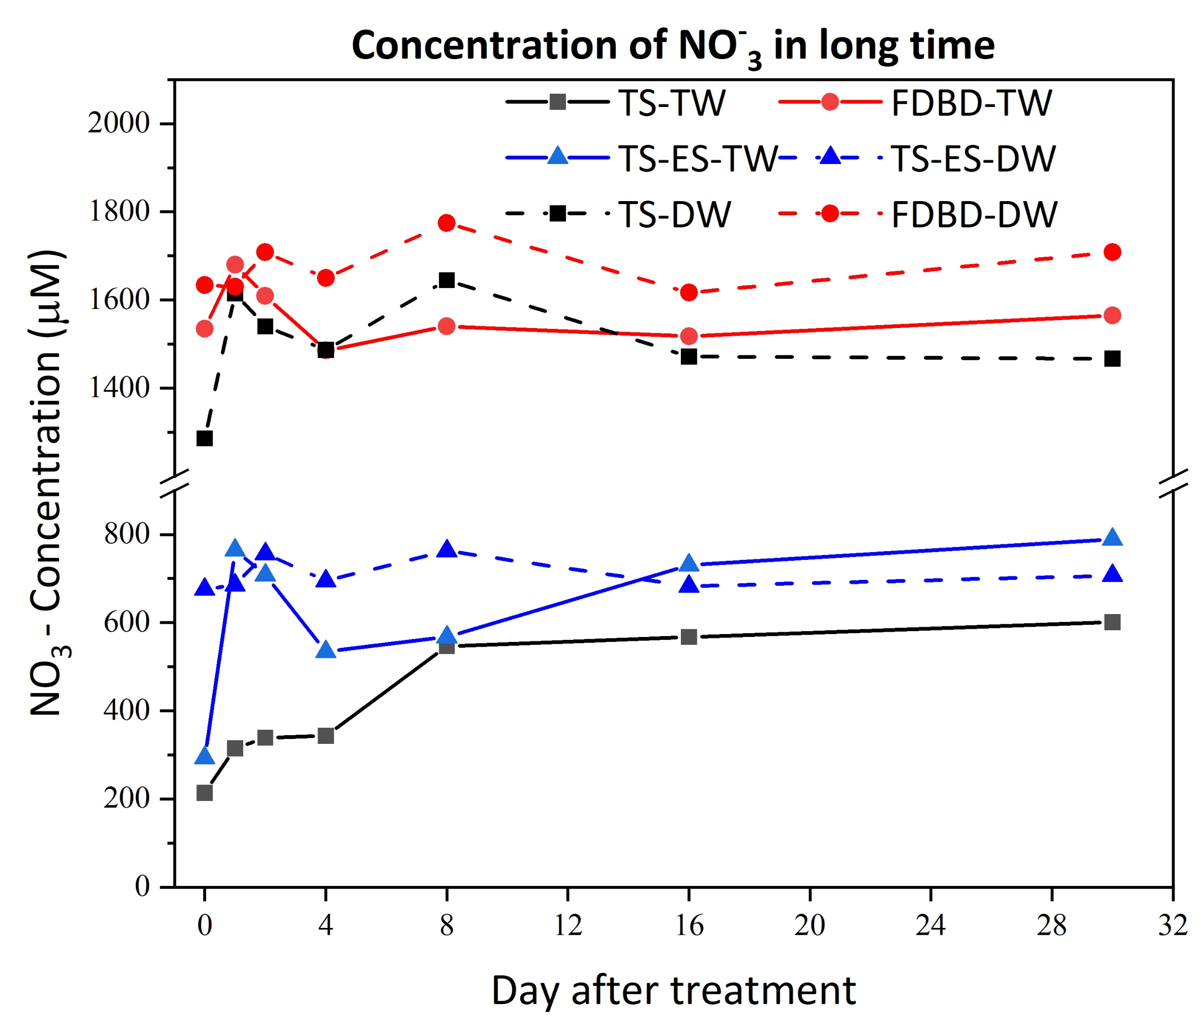


Reactive species stability in plasma-activated water generated by different atmospheric pressure plasmas
Introduction: Because of their unique components, particularly reactive oxygen and nitrogen species (RONS), non-thermal plasma and plasma-activated water (PAW) are used in a wide range of applications. PAW is mostly used in food safety [1] and biomedical applications [2], agriculture and, surface treatment [3]. In this work, three distinct plasma setups—Transient Spark (TS) batch water treatment, Transient Spark-Electrospray (TS-ES), and Fountain Dielectric Barrier Discharge (FDBD)—are employed
To generate PAW using both tap and deionized (DI) water. TS and TS-ES use DC high voltage and operate in pin-to-plane geometries. For each, the spark pulse frequency and gap distance are set at 1 kHz and 1 cm, respectively. For TS-ES, a flow rate of 0.5 ml/min was established, while batch TS treated 10 ml for 10 minutes. We utilized a neon-sign AC high voltage power source with 15 kV pk-to-pk and 20 kHz for FDBD, and we cycled 1 L of water for 20 minutes.
Plasma Set-ups
Figure 1. Schematic diagram of the PAW production by (A) transient spark (TS) with UV-A/UV-C irradiation, (B) transient spark electro spray (TS-ES), (C) fountain dielectric barrier discharge (FDBD)
Result
References
[1] Machala Z. et al. Plasma Process. Polym., 10, 649–659 (2013)
[2] Pavlovich M. J. et al. Plasma Process. Polym. 10, 1051–1060 (2013)
[3] Mehrabifard R. et al. “Combined Antimicrobial Properties of Ultraviolet Radiation and Plasma-Activated Water,” (2024), doi: 10.2139/SSRN.4961388.
Acknowledgment
This work was supported by the EU NextGenerationEU through the Recovery and Resilience Plan for Slovakia under the project No. 09I03-03-V03-00033 EnvAdwice, and Slovak Research and Development Agency APVV-22-0247.
Ramin Mehrabifard, Akshara Chithran, Bernard Gitura Kimani, Zdenko Machala
Division of Environmental Physics, Faculty of Mathematics, Physics and Informatics, Comenius University, Mlynská dolina, 842 48 Bratislava, Slovakia
Ramin.mehrabifard@fmph.uniba.sk

