Slide 1
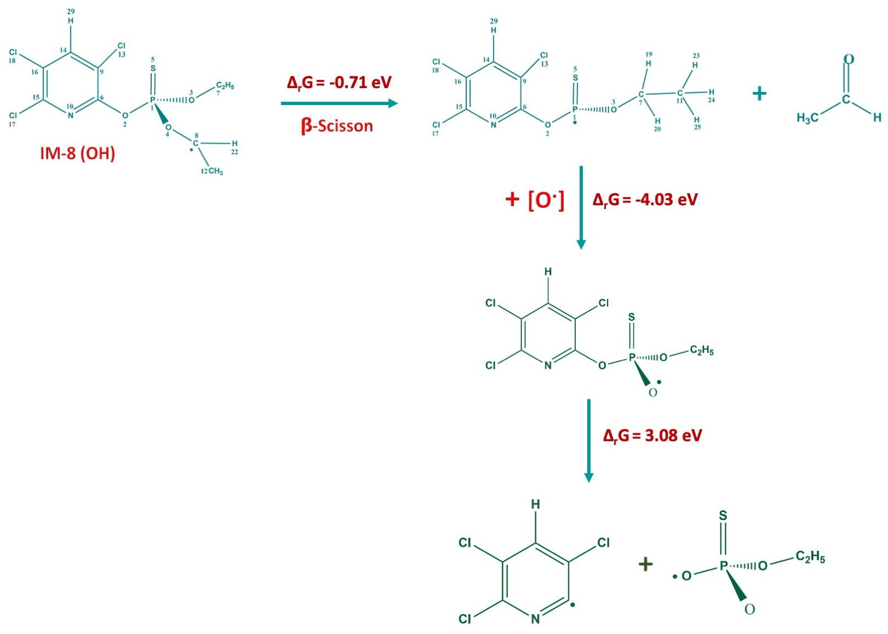
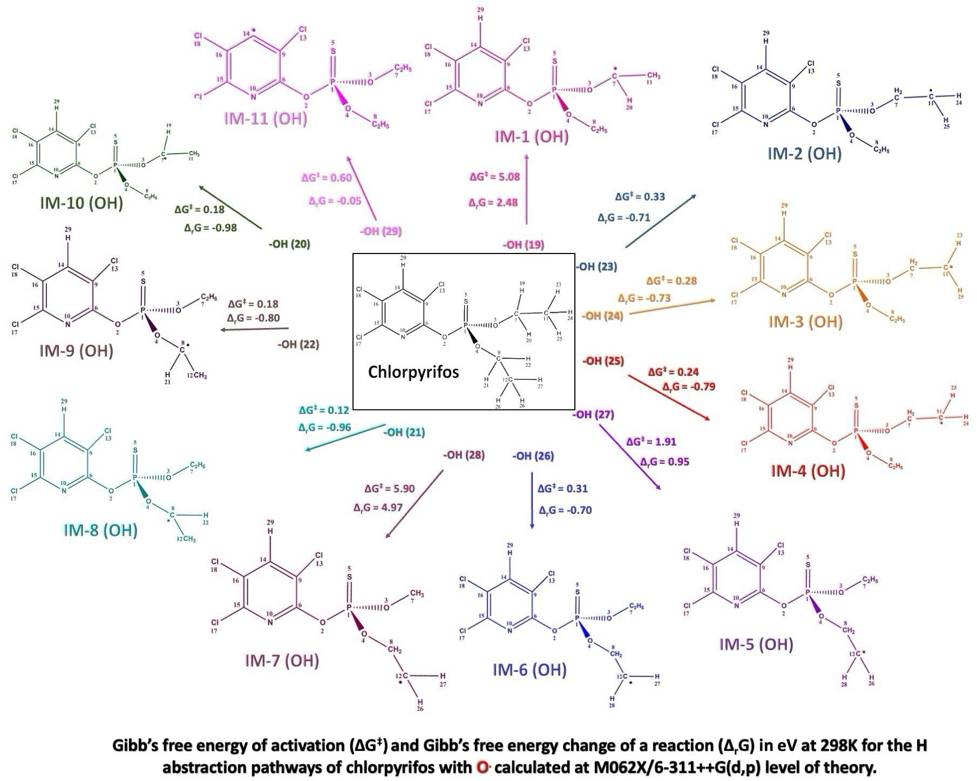
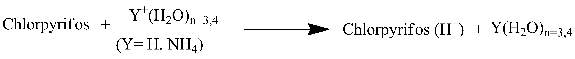
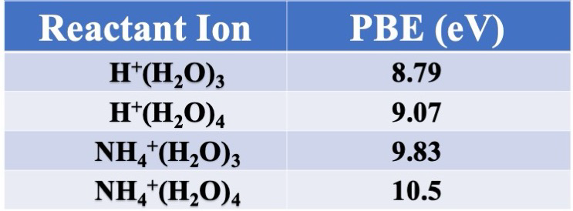
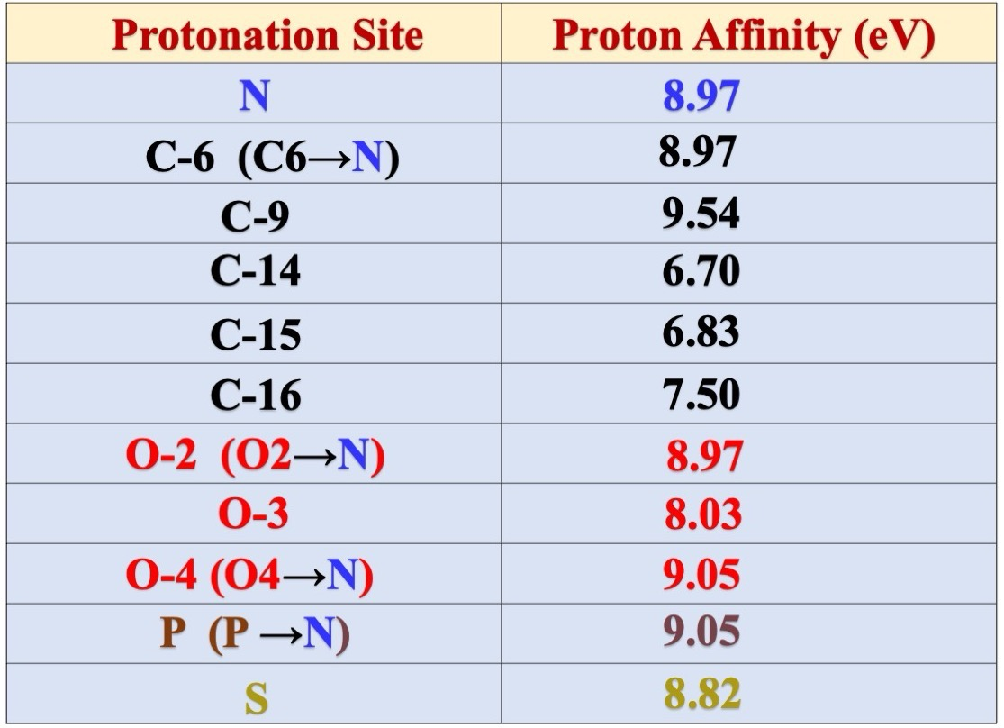
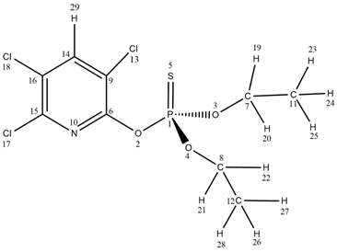
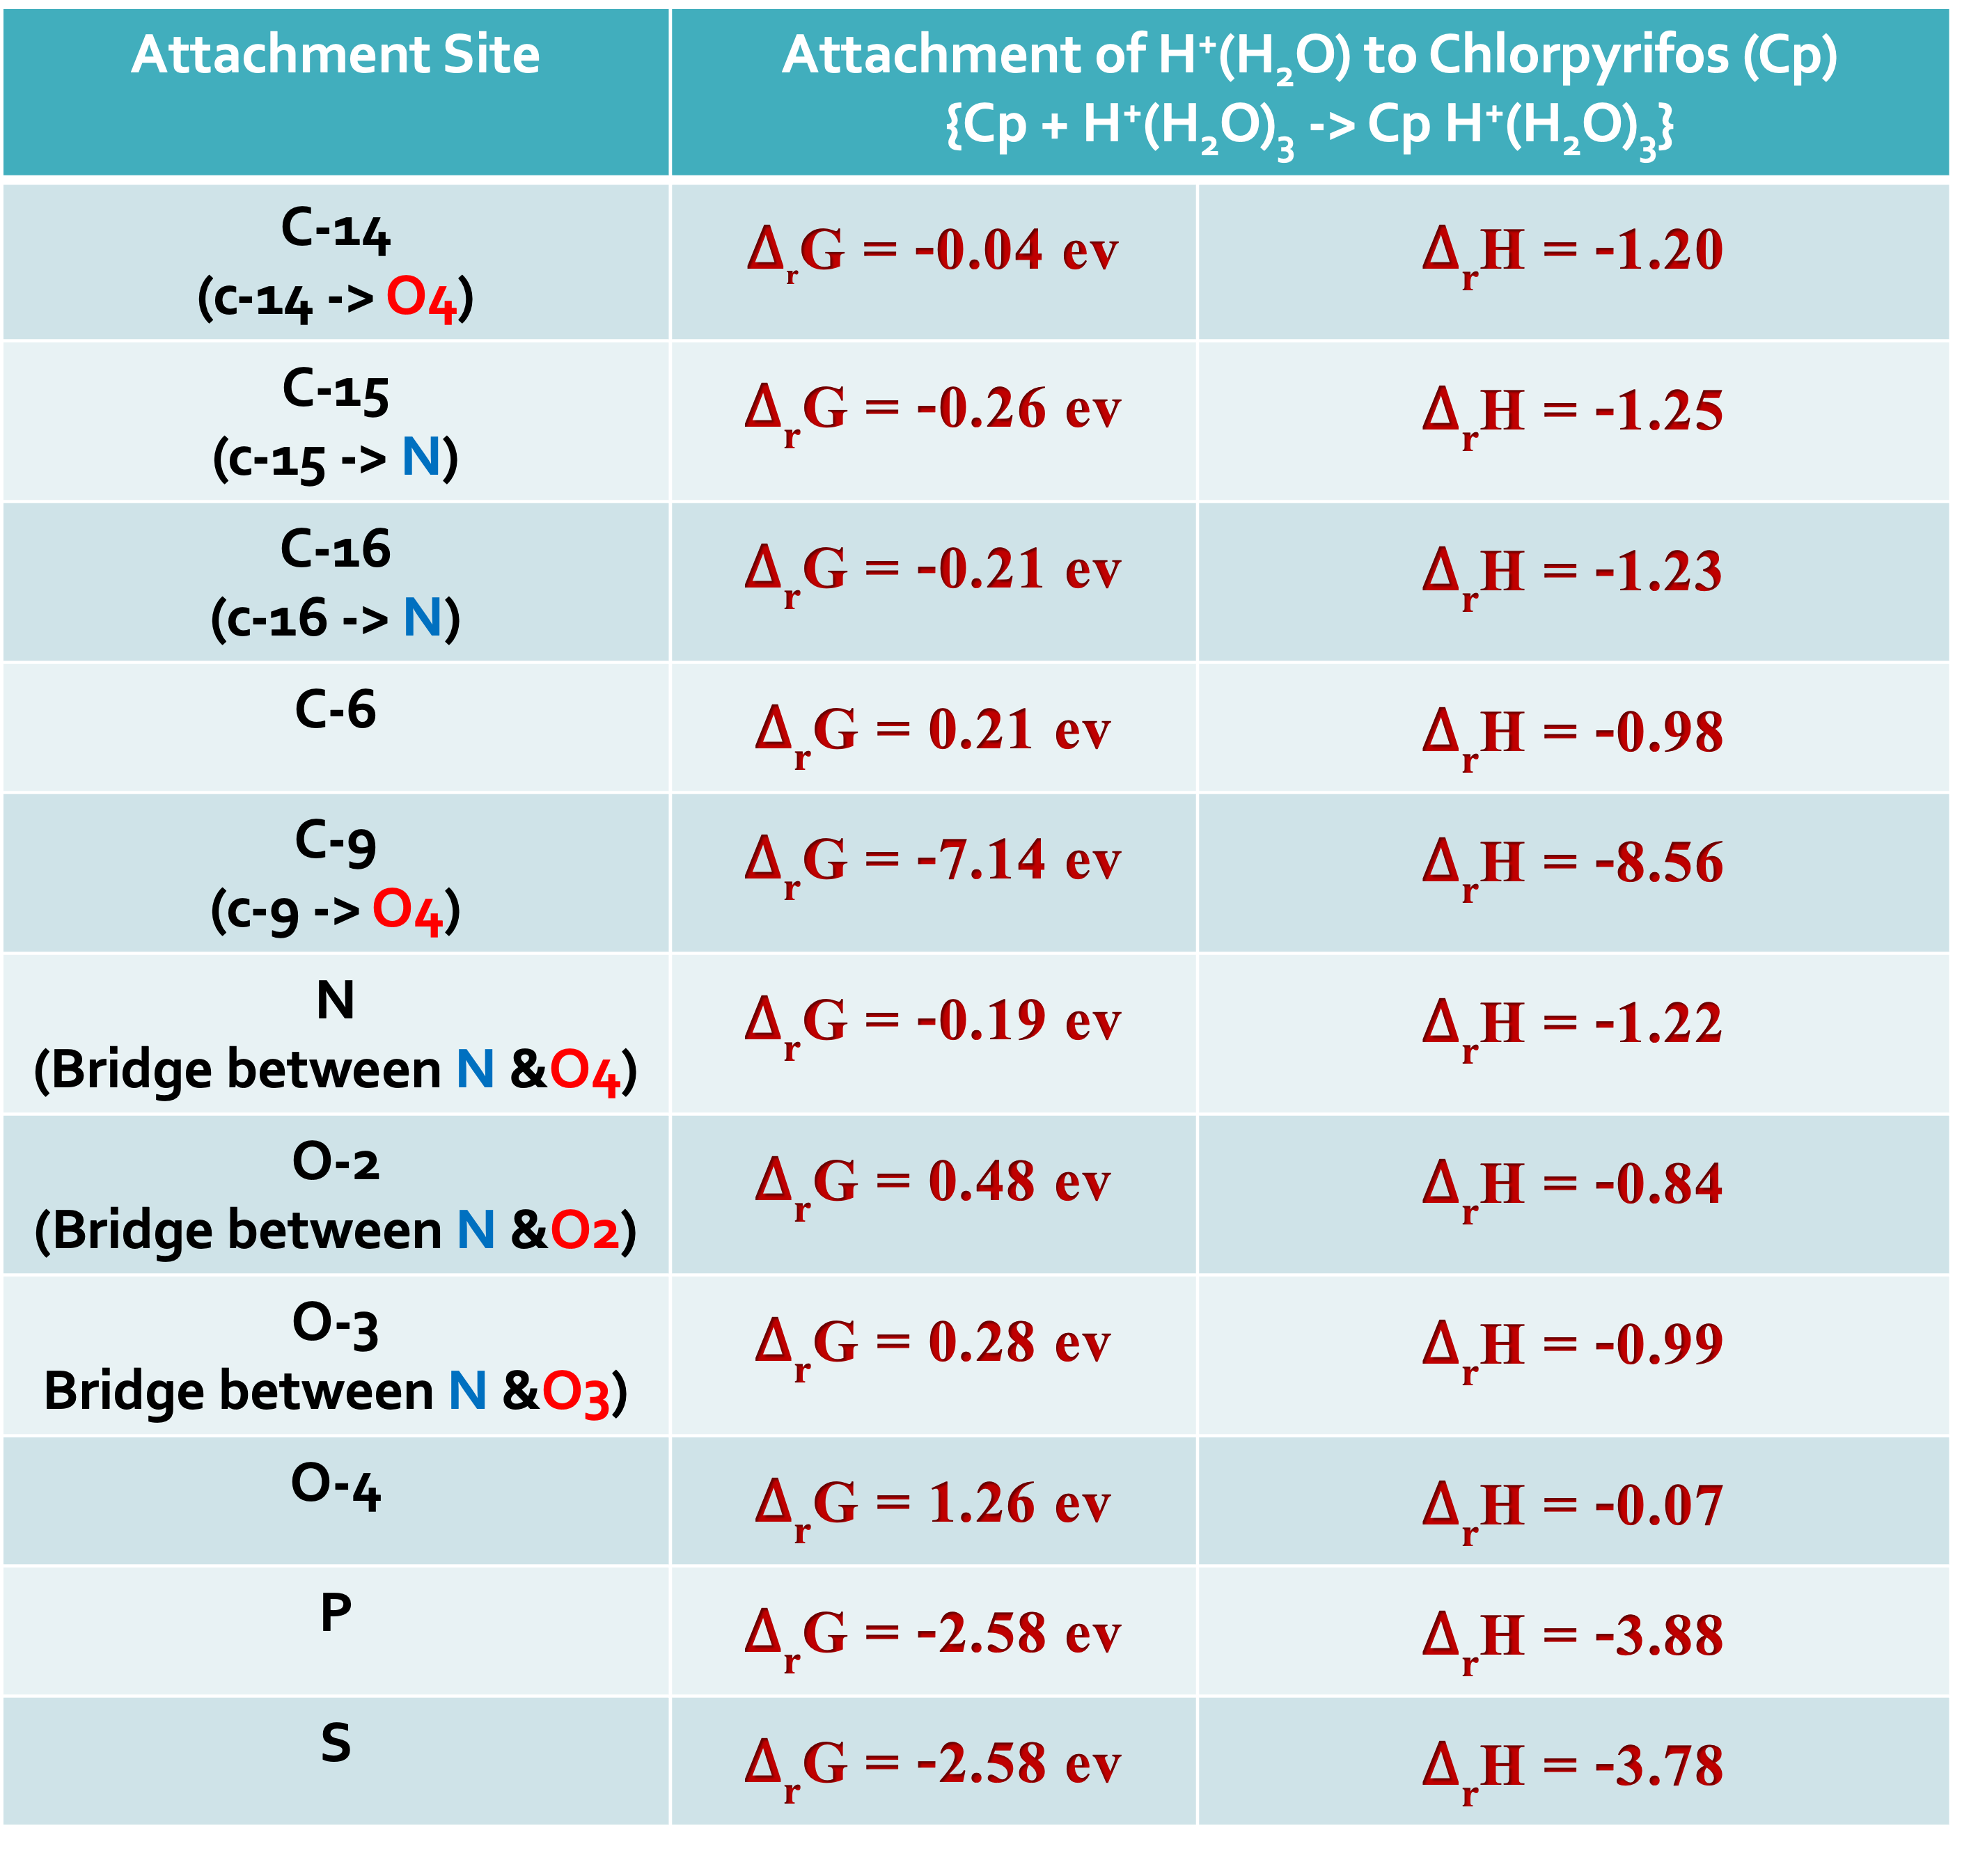
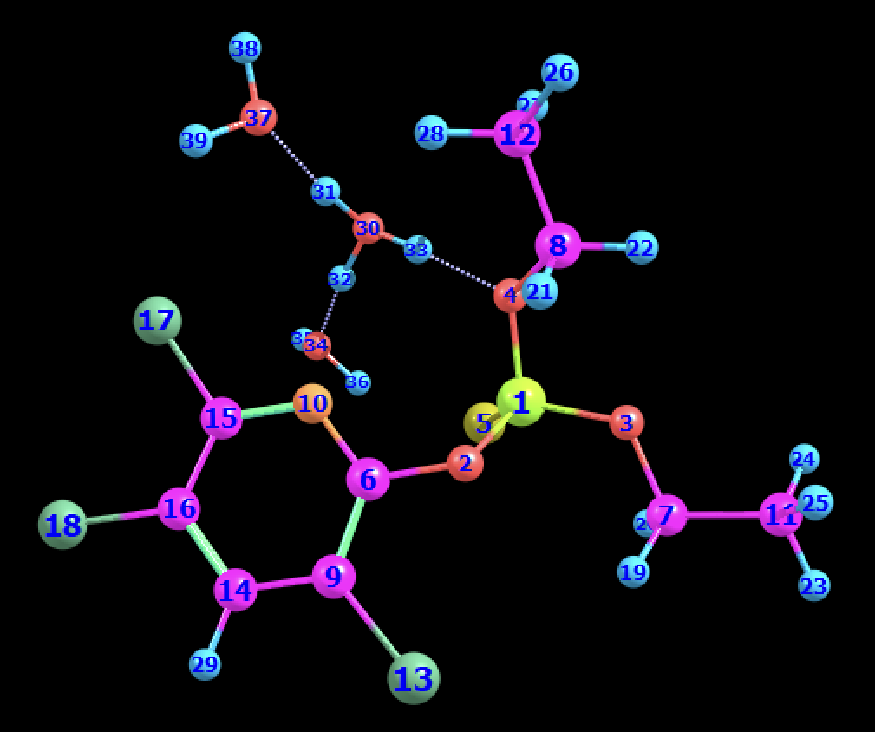
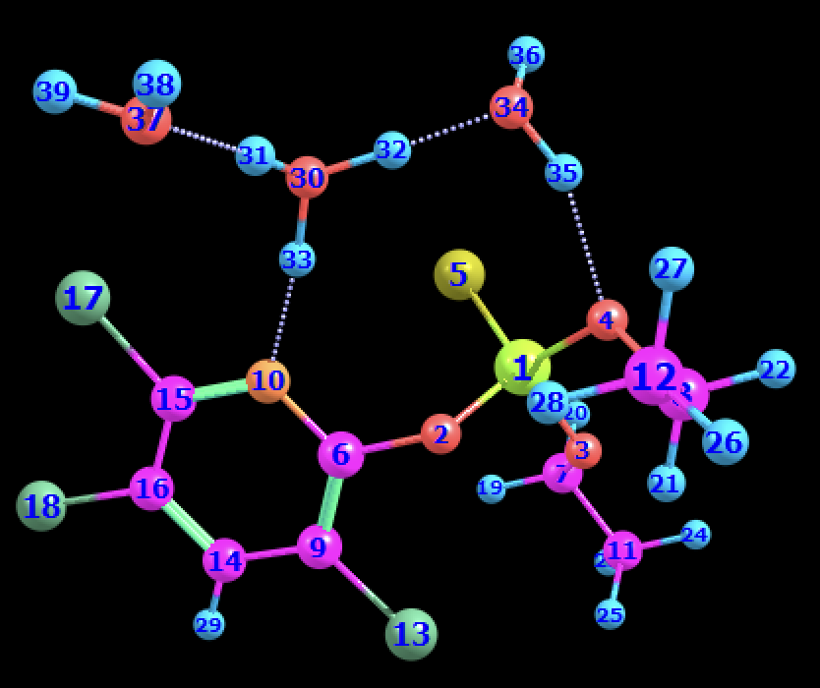



Theoretical Investigation of Plasma Induced Degradation of Chlorpyrifos
Introduction
Further Degradation of Chlorpyrifos after H abstraction by O.
Chlorpyrifos, a commonly used pesticide, poses serious health risks to humans, animals and the environment.
To reduce the toxic impact of chlorpyrifos, its degradation into less harmful substances is of high importance.
Plasma assisted degradation is a promising, eco-friendly method that effectively breaks down chlorpyrifos using reactive species
(O.,N.,OH.,H⁺(H₂O)_{n=3,4},…).
Quantum chemical calculations of all the reactions involved in this work were performed using Density Functional Theory (DFT) with Gaussian 16 software package.
Degradation of Chlorpyrifos by O.
Degradation of Chlorpyrifos by H⁺(H₂O)_{n=3,4} & NH₄⁺(H₂O)_{n=3,4}
PBE – Proton Binding Energy
References
Acknowledgement
Bose, S.; Kumar, P.S.; Dai-Viet, N.V. A review on the microbial degradation of chlorpyrifos and its metabolite TCP. Chemosphere 2021, 283, 131447.
John, E. M., & Shaike, J. M. (2015). Chlorpyrifos: pollution and remediation. In Environmental Chemistry Letters (Vol. 13, Issue 3, pp. 269–291).
This work was supported by the Slovak Research and Development Agency under the Contract no. APVV-22-0522 and the Slovak Grant Agency for Science (contract no. VEGA 1/0553/22).
Funded by the EU Next Generation EU through the Recovery and Resilience Plan for Slovakia under the project No. 09I01-03-V04-00047.
This work was supported in part through the Comenius University in Bratislava CLARA@UNIBA.SK high-performance computing facilities, services and staff expertise of Centre for Information Technology (https://uniba.sk/en/HPC-Clara).
Navya Arepalli, Alexandra Jančišinová,
Štefan Matejčík, Peter Papp
Department of Experimental Physics, Comenius University in Bratislava, Mlynská dolina F2, 842 48 Bratislava, Slovakia.

