Slide 1
Sensitivity training
@ SuperNEMO collaboration meeting Bratislava 2026
Maros Petro

Slide 2
Outline
Software set-up
Quick introduction to Sensitivity
  What is sensitivity
  Bayesian
  Frequentist – Feldman-Cousins
Worked examples
  Background model
  Bayesian sensitivity
  1D frequentist
  ND frequentist
  Sensitivity per data-phase

Slide 3
Software setup
Go to https://github.com/Shoram444/SN_Sensitivity_training and clone directory to your sps
The repository shows 5 examples of how to use the SNSensitivityEstimate.jl package to calculate sensitivity
README.md shows how to setup all dependencies

Slide 4
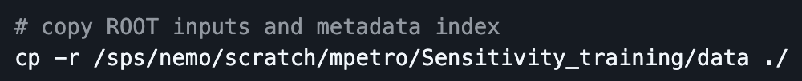
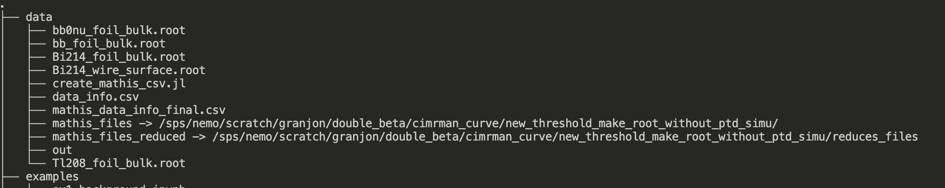
Software setup (when working on CC)
1. Clone repo
2. Copy example data to your directory
Files used for examples 1-4. Contain ideal detector simulations/reco data. Simple 4 component bkg + 1 signal.

Slide 5
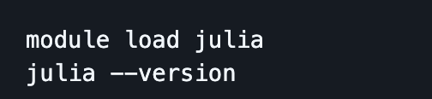

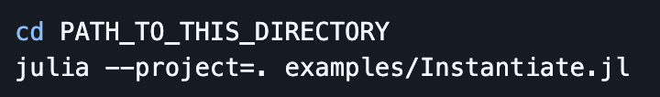
Software setup (when working on CC)
1. Clone repo
2. Copy example data to your directory
3. Load Julia module and setup ”generic” CPU target
Into ~/.profile + source ~/.profile
4. Install dependencies and precompile with

Slide 6
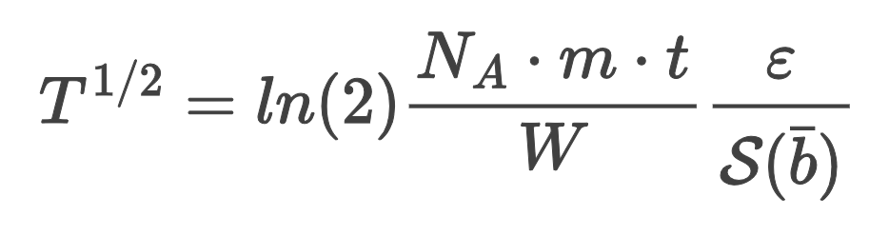
Quick introduction to Sensitivity
What is sensitivity?
  Depends on whether you ask a Bayesian or a frequentist
Bayesian asks about signal
Frequentist asks about background
Bayesian: How how much of the signal is allowed by our data?
Frequentist: Given the expected background level, how much signal is measurable with our detector?

Slide 7
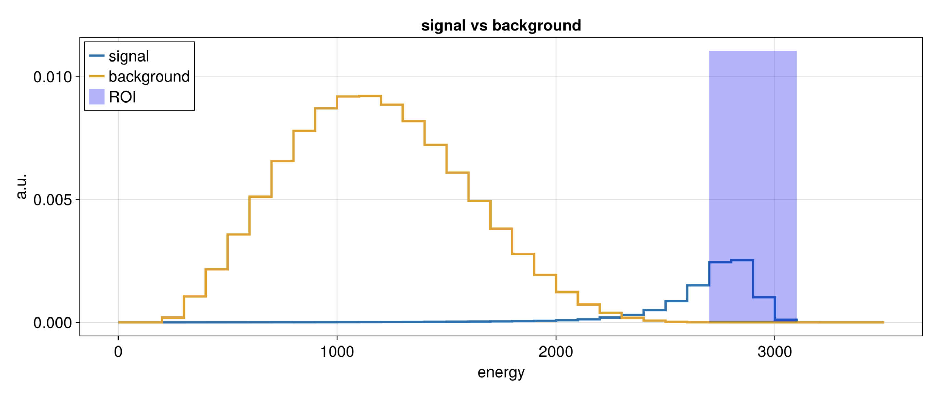
Quick introduction to Sensitivity
How big does the signal “peak” have to be to observe?

Slide 8
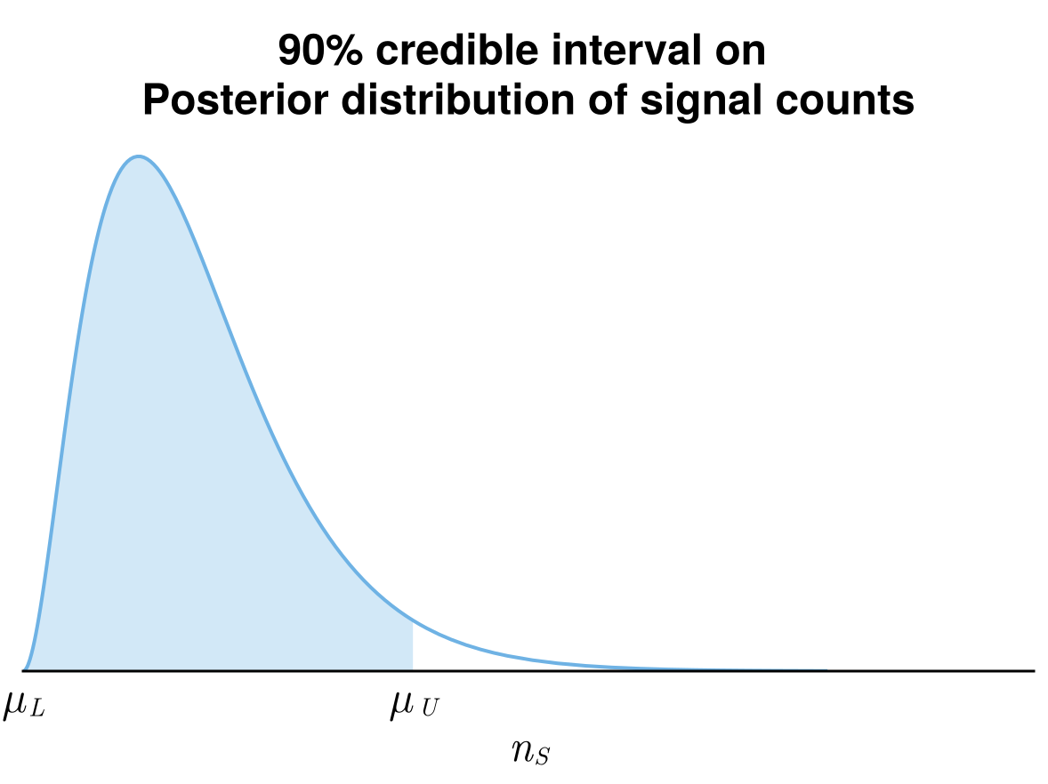
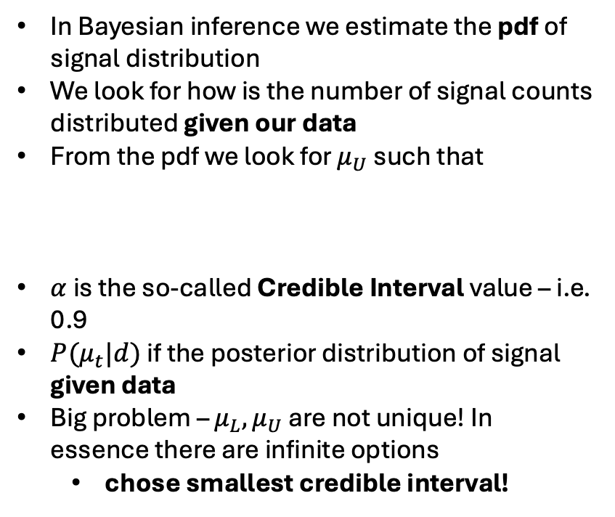

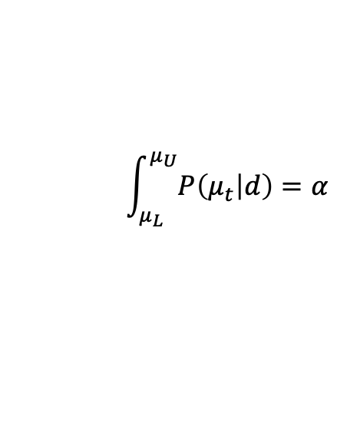
Quick introduction to Sensitivity - Bayesian
In Bayesian inference we estimate the pdf of signal distribution
We look for how is the number of signal counts distributed given our data
From the pdf we look for $μ_{U}$ such that
$α$ is the so-called Credible Interval value – i.e. 0.9
$P(μ_{t}|d)$ if the posterior distribution of signal given data
Big problem – $μ_{L}, μ_{U}$ are not unique! In essence there are infinite options
  chose smallest credible interval!
$$\int_{μ_{L}}^{μ_{U}}{P\left(μ_{t} | d\right)=α}$$
$$μ_{t}$$

Slide 9

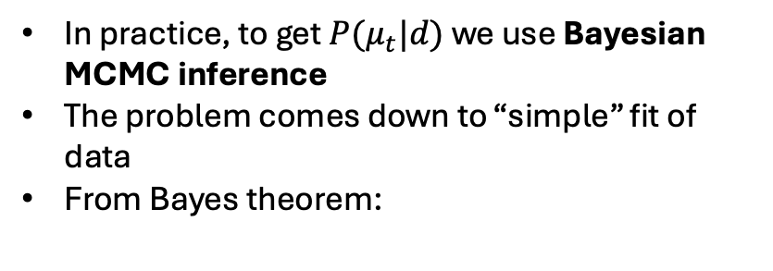
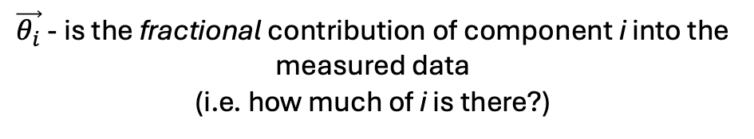
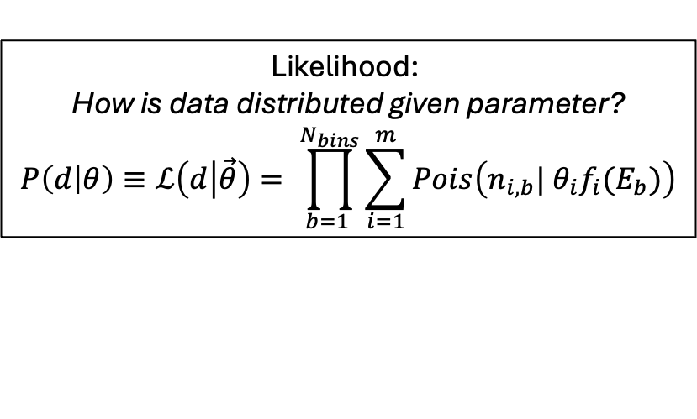
Quick introduction to Sensitivity - Bayesian
In practice, to get $P(μ_{t}|d)$ we use Bayesian MCMC inference
The problem comes down to “simple” fit of data
From Bayes theorem:
$$P\left(θ | d\right)∝P\left(d | θ\right)×P(θ)$$
Likelihood:
How is data distributed given parameter?
$$P\left(d | θ\right)≡ℒ\left(d | \vec{θ}\right)= \prod_{b=1 }^{N_{bins}}{\sum_{i=1}^{m}{Pois\left(n_{i,b}| θ_{i}f_{i}(E_{b})\right)}}$$
$\vec{θ_{i}}$ - is the fractional contribution of component i into the measured data
(i.e. how much of i is there?)

Slide 10
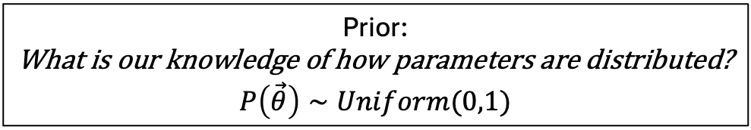
Quick introduction to Sensitivity - Bayesian
In practice, to get $P(μ_{t}|d)$ we use Bayesian MCMC inference
The problem comes down to “simple” fit of data
From Bayes theorem:
$$P\left(θ | d\right)∝P\left(d | θ\right)×P(θ)$$
Prior:
What is our knowledge of how parameters are distributed?
$$P\left(\vec{θ}\right)∼Uniform(0,1)$$

Slide 11
Quick introduction to Sensitivity - Bayesian
In practice, to get $P(μ_{t}|d)$ we use Bayesian MCMC inference
The problem comes down to “simple” fit of data
From Bayes theorem:
$$P\left(θ | d\right)∝P\left(d | θ\right)×P(θ)$$
Posterior:
How is parameter distributed given data?
This is what we are trying to find out!
It’s not a single number (MLE would give you maximum!)

Slide 12
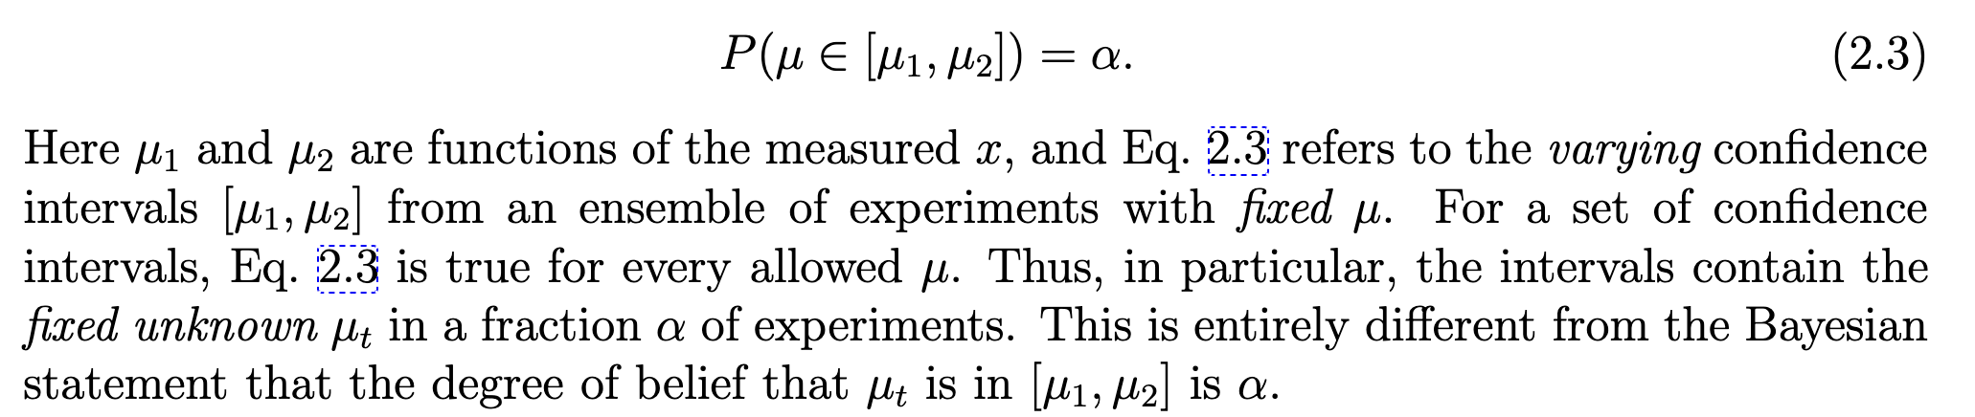
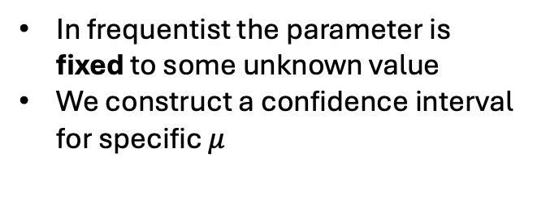
Quick introduction to Sensitivity - Frequentist
In frequentist the parameter is fixed to some unknown value
We construct a confidence interval for specific $μ$
From: https://arxiv.org/pdf/physics/9711021

Slide 13
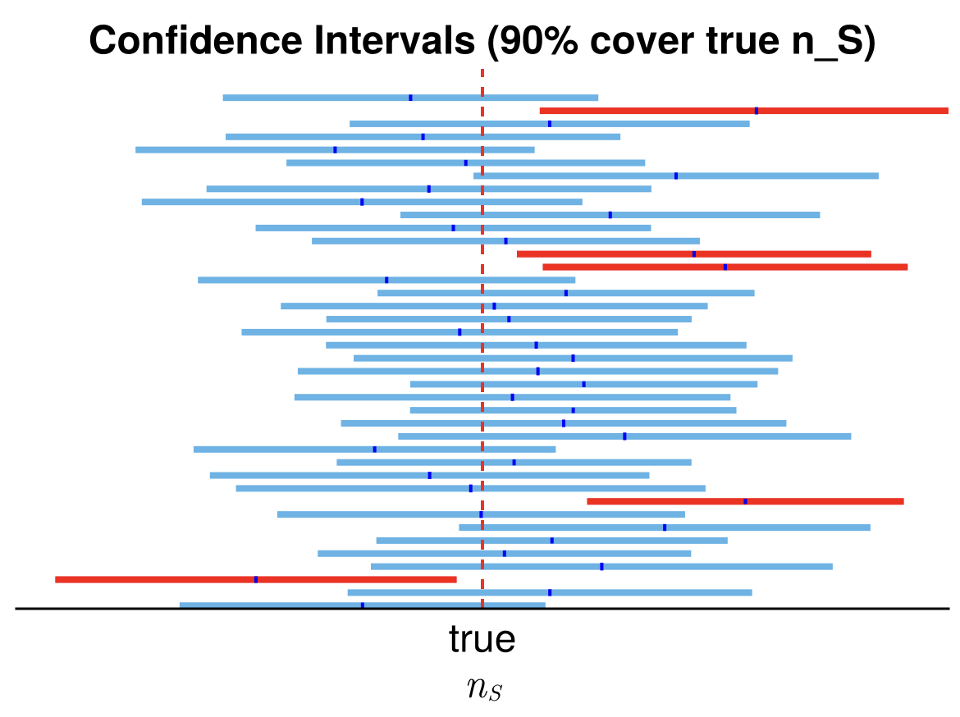
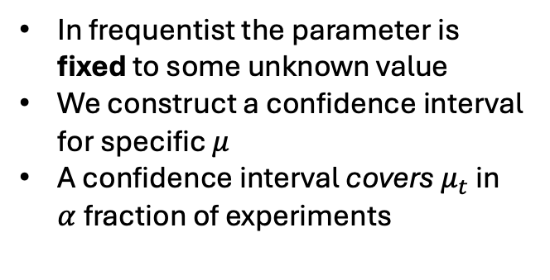


Quick introduction to Sensitivity - Frequentist
$$μ_{t}$$
In frequentist the parameter is fixed to some unknown value
We construct a confidence interval for specific $μ$
A confidence interval covers $μ_{t}$ in $α$ fraction of experiments
$$μ_{t}$$

Slide 14
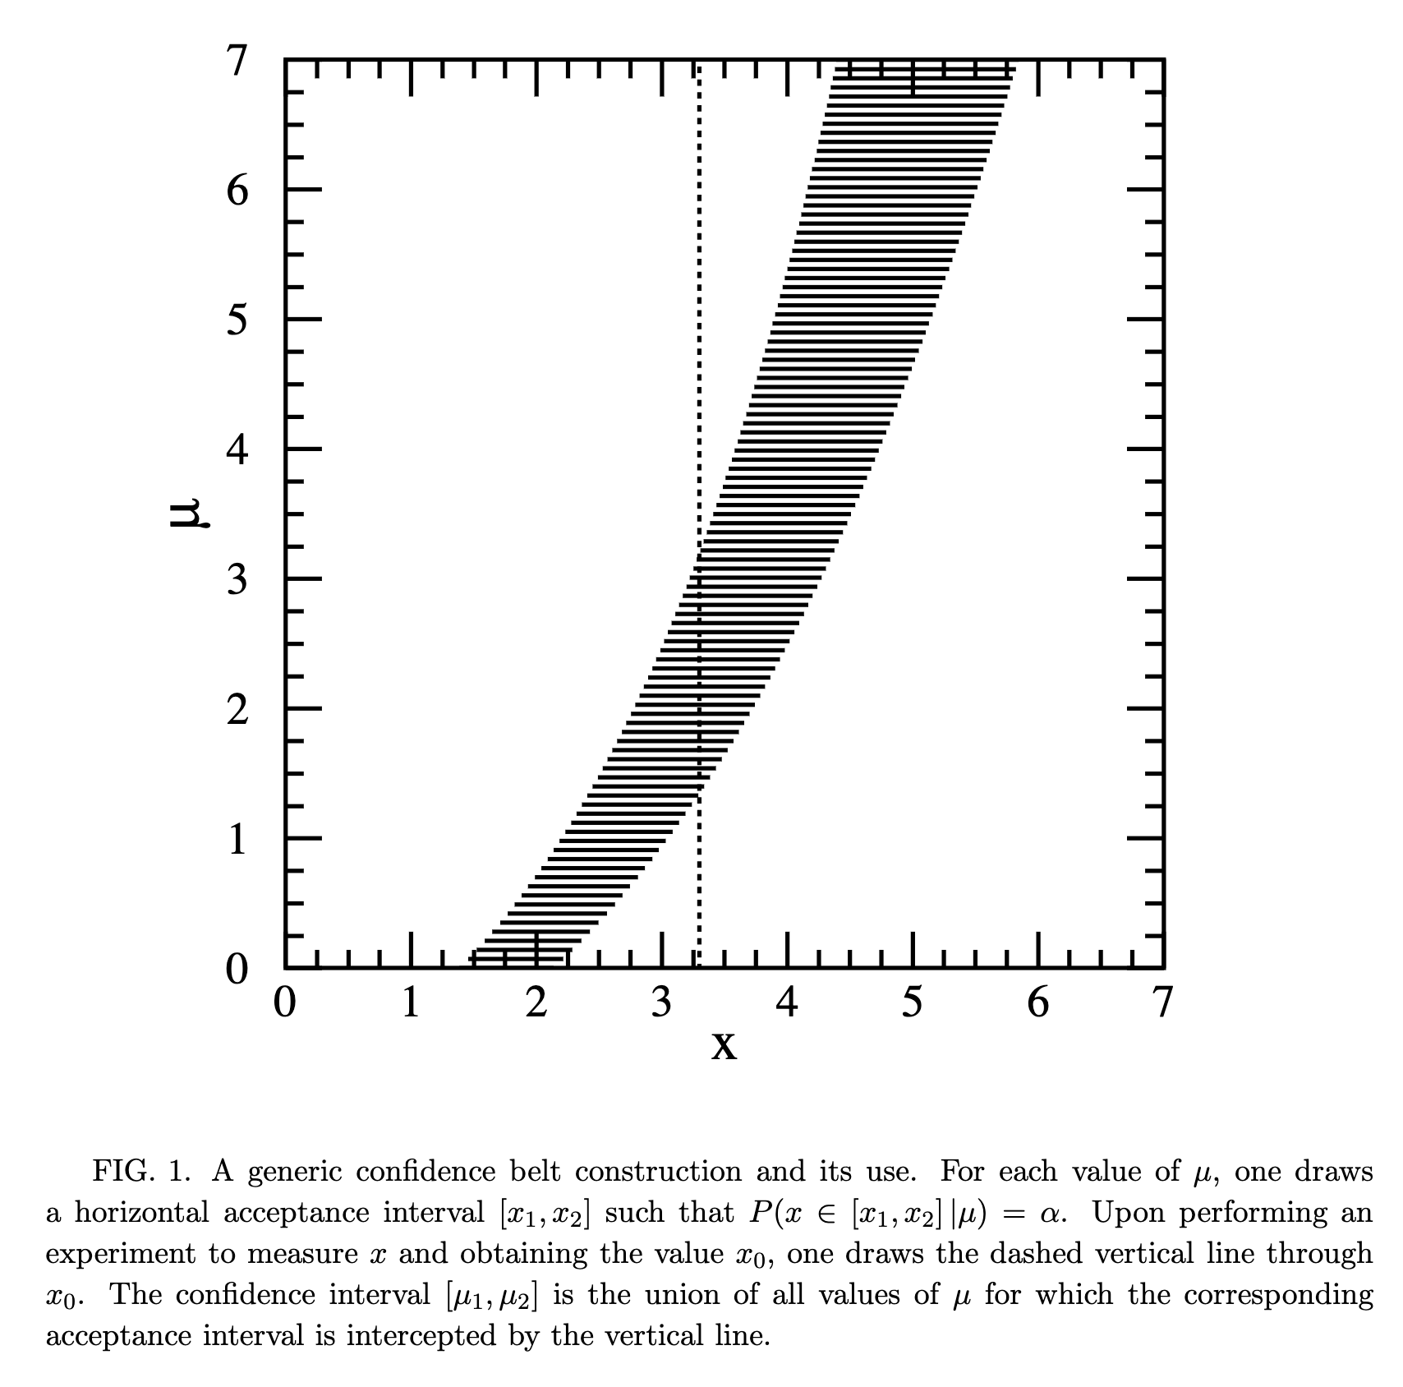
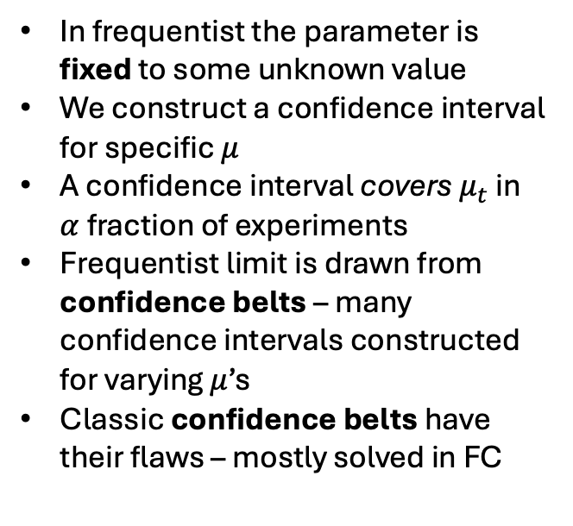
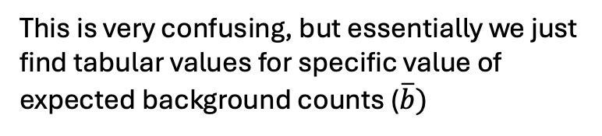
Quick introduction to Sensitivity - Frequentist
In frequentist the parameter is fixed to some unknown value
We construct a confidence interval for specific $μ$
A confidence interval covers $μ_{t}$ in $α$ fraction of experiments
Frequentist limit is drawn from confidence belts – many confidence intervals constructed for varying $μ$’s
Classic confidence belts have their flaws – mostly solved in FC
This is very confusing, but essentially we just find tabular values for specific value of expected background counts ($\overline{b})$
From: https://arxiv.org/pdf/physics/9711021

Slide 15
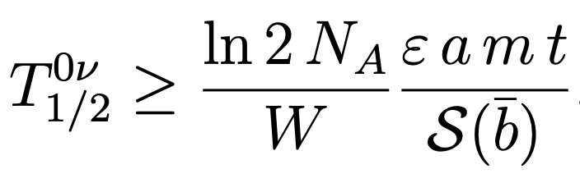
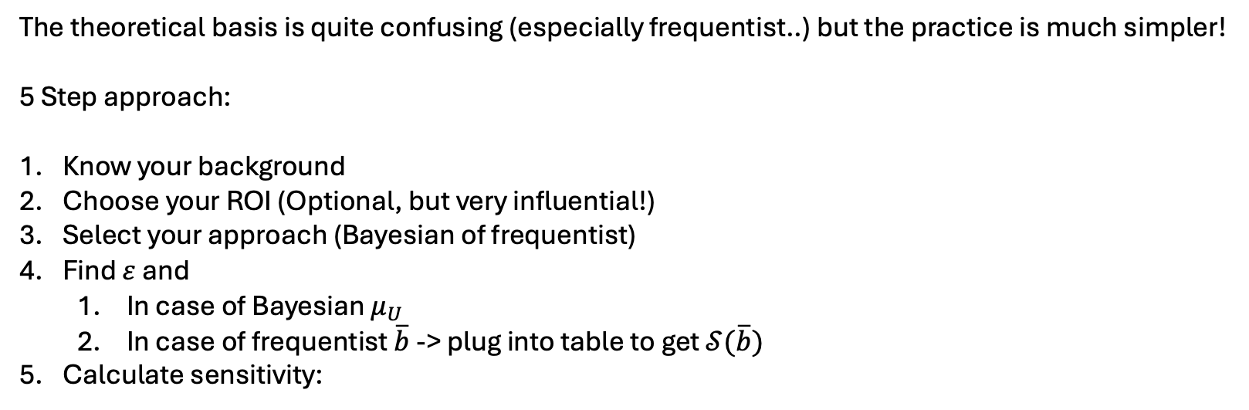

Quick introduction to Sensitivity – in practice
The theoretical basis is quite confusing (especially frequentist..) but the practice is much simpler!
5 Step approach:
Know your background
Choose your ROI (Optional, but very influential!)
Select your approach (Bayesian of frequentist)
Find $ε$ and
  In case of Bayesian $μ_{U}$
  In case of frequentist $\overline{b}$ -> plug into table to get $𝒮(\overline{b})$
Calculate sensitivity:
Bayesian
Frequentist
$$μ_{U}$$

Slide 16
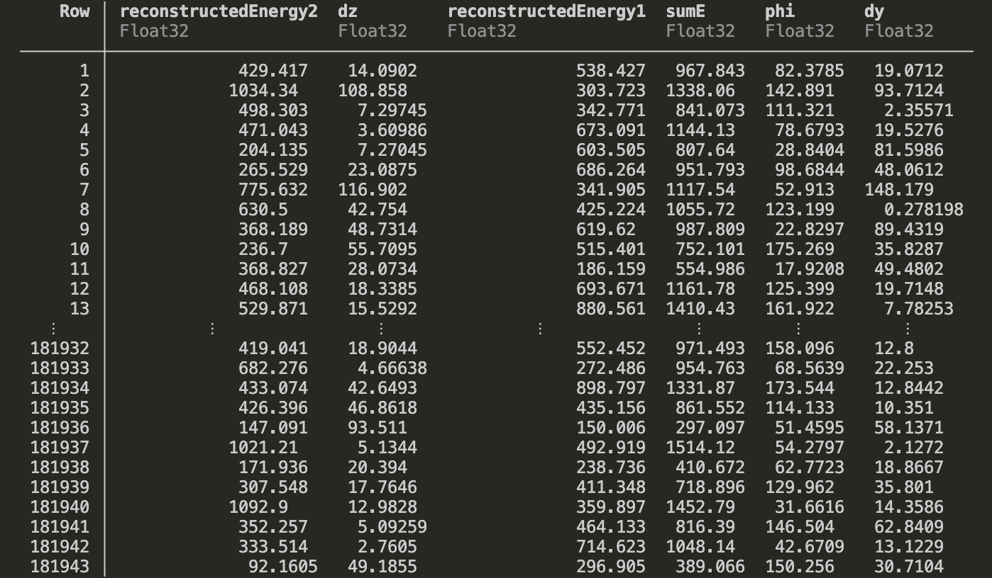
Worked examples - data
Data structure - each process has a ROOT file with per Event data

Slide 17
Worked examples - data
There are 2 “types” of data in the repository:
  In path “data/*.root” the files contain old simulations – flat foils, 12% FWHM all OMs, golden event topology cuts
  In path “data/mathis_files/X/phase_p/*.root” there are files produced by Mathis with the official reco pipeline and selection (richer data)

Slide 18
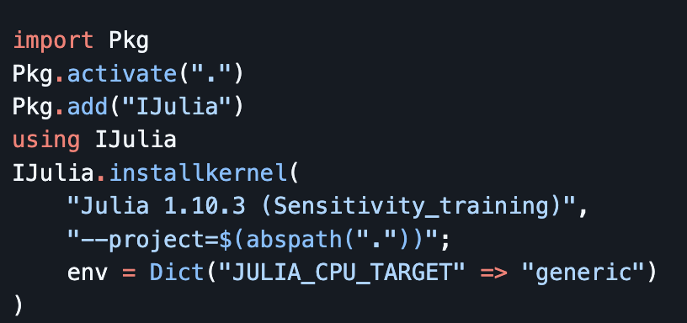
Worked examples – Setup
For training purposes I suggest using the CC-provided notebooks server:
  https://notebook.cc.in2p3.fr/
To setup a Julia kernel simply: (can copy-paste from README.md)

Slide 19
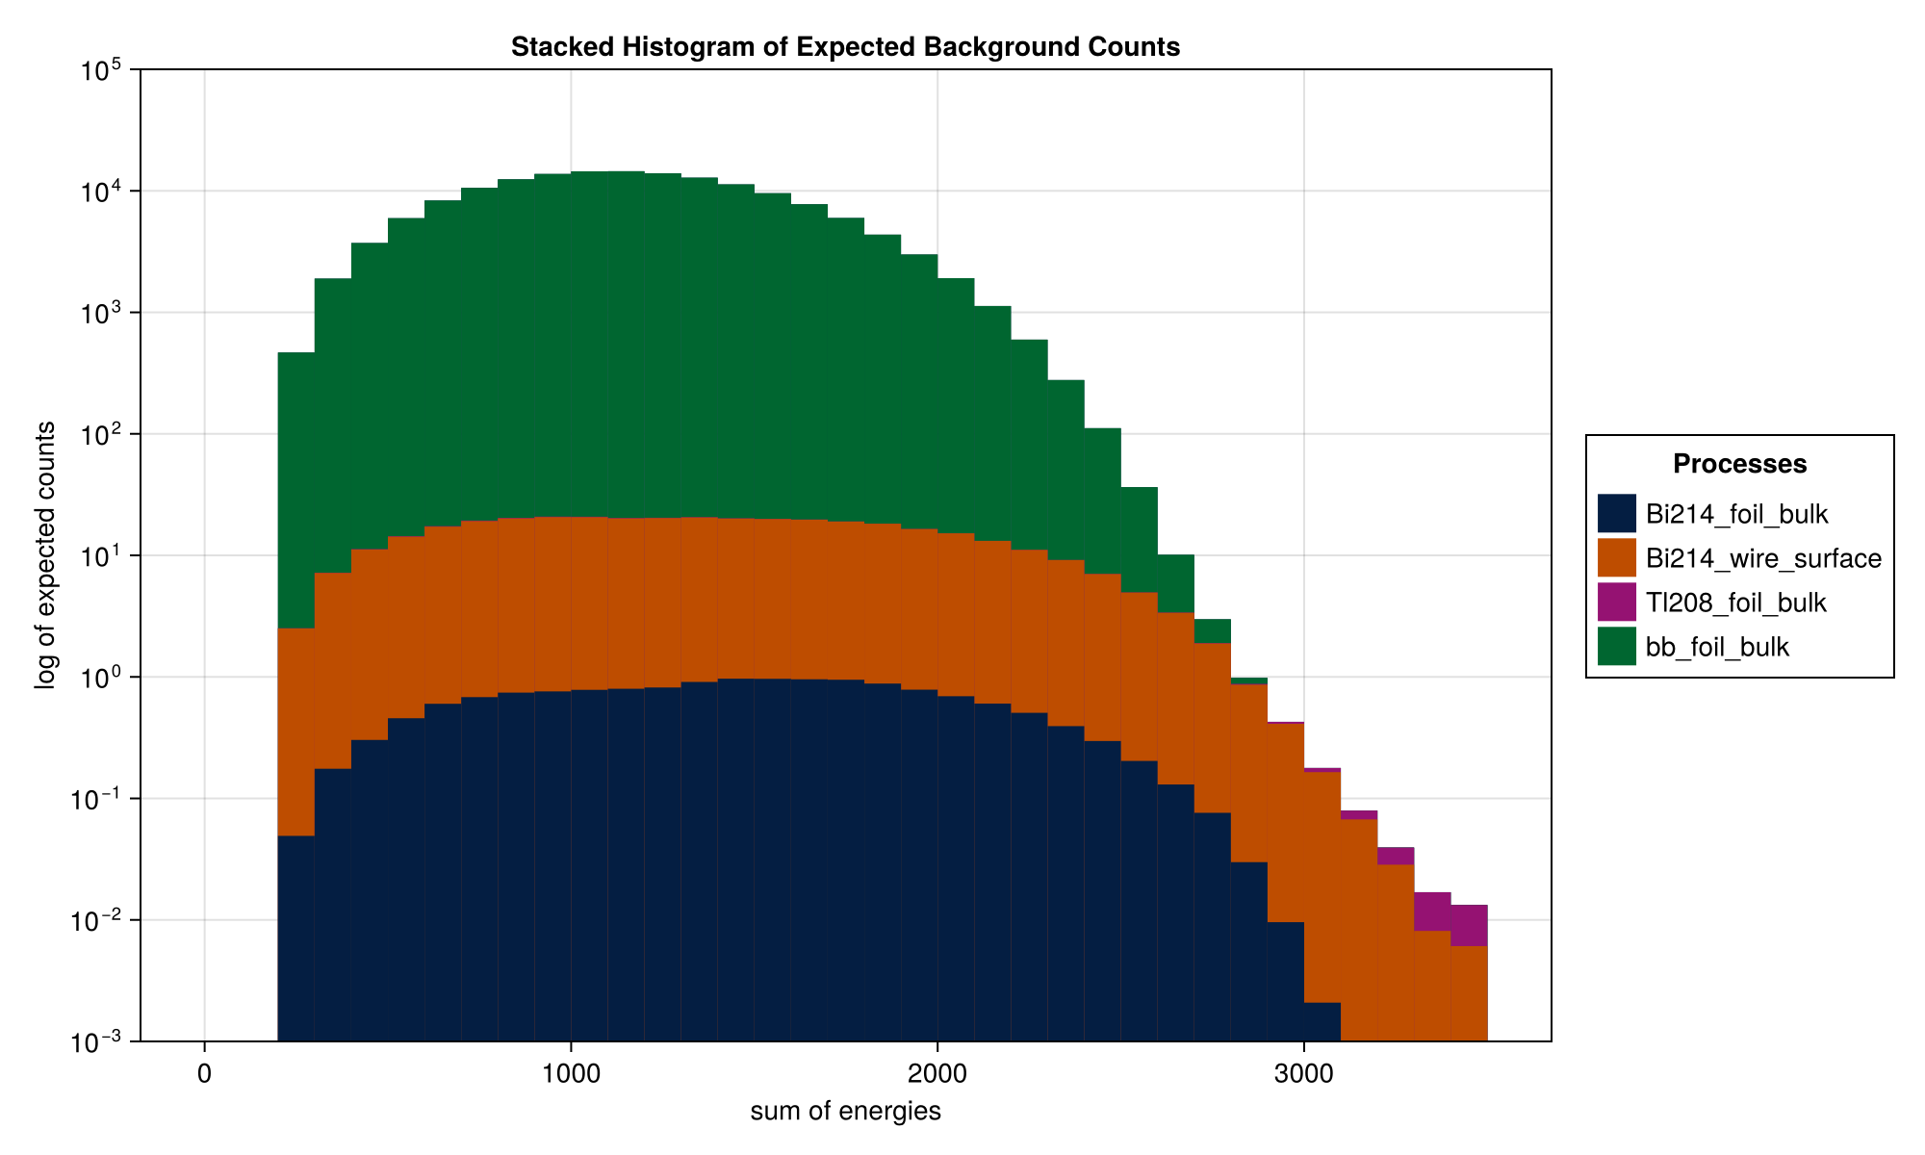

Worked examples – Example 1
Script examples/ex1_background.jl or .ipynb (notebook)
Goal:
  Given simple data-set estimate background model and find $\overline{b}$.

Slide 20
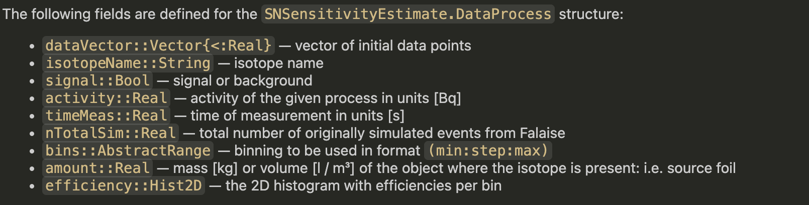

Worked examples – Example 1
Script examples/ex1_background.jl or .ipynb (notebook)
Goal:
  Given simple data-set estimate background model and find $\overline{b}$.
Important functionality:
  Load all data based on simple CSV which holds relevant information
  Build DataProcess struct – holds process information

Slide 21
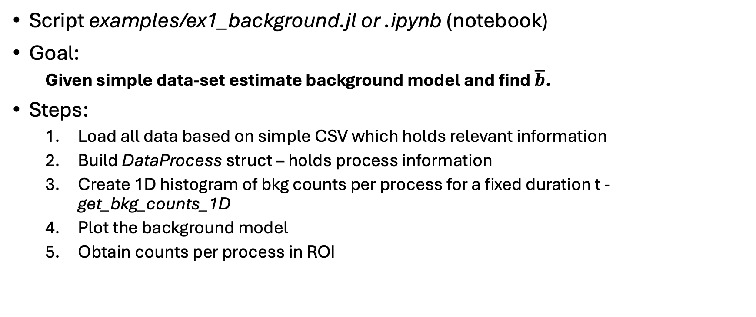
Worked examples – Example 1
Script examples/ex1_background.jl or .ipynb (notebook)
Goal:
  Given simple data-set estimate background model and find $\overline{b}$.
Steps:
  Load all data based on simple CSV which holds relevant information
  Build DataProcess struct – holds process information
  Create 1D histogram of bkg counts per process for a fixed duration t - get_bkg_counts_1D
  Plot the background model
  Obtain counts per process in ROI

Slide 22
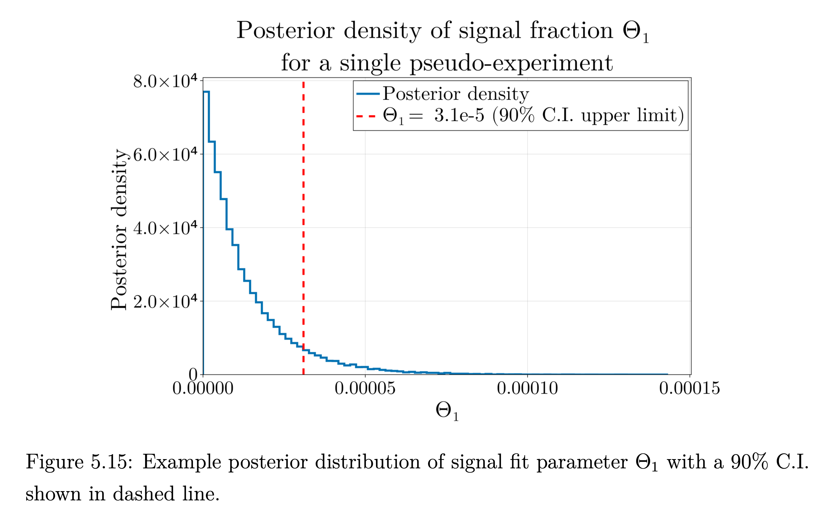
Worked examples – Example 2
Script examples/ex2_bayes.jl or .ipynb (notebook)
Uses BAT.jl – developed by guys from LEGEND
Goal:
  Create pseudo experiment from the background model and find Bayesian sensitivity.
From my phd thesis

Slide 23
Worked examples – Example 2
Script examples/ex2_bayes.jl or .ipynb (notebook)
Uses BAT.jl – developed by guys from LEGEND
Goal:
  Create pseudo experiment from the background model and find Bayesian sensitivity.
Steps:
  Load data as in Ex1
  Implement “basic” data-cuts with filter_data
  Create DataProcess
  Create bkg and signal templates
  Sample single pseudo-experiment from background model
  Fit using Uniform priors on A_i (relative amplitude of process i) with BAT.jl
  Extract fit parameters – pdfs
  Plot best fit
  Extract sensitivity @ 90%
  Repeat steps 4.-8. to obtain median sensitivity

Slide 24
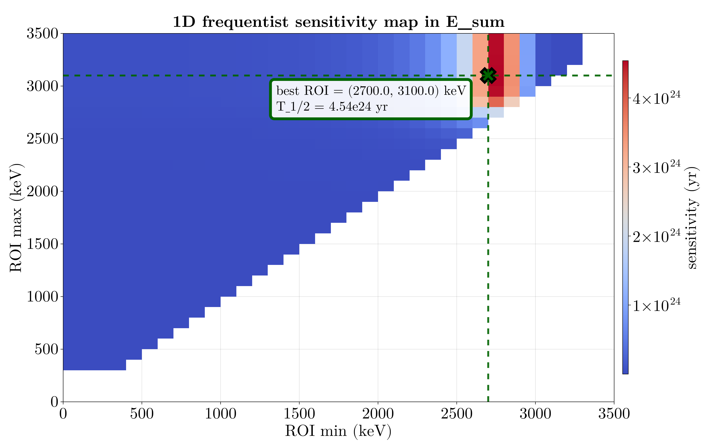

Worked examples – Example 3
Script examples/ex3_freq1D.jl or .ipynb (notebook)
Goal:
  For a single variable X find the best $ROI ≡x∈\left(x_{min},x_{max}\right)$ such that frequentist $T^{1/2}$is maximized.
From my phd thesis

Slide 25
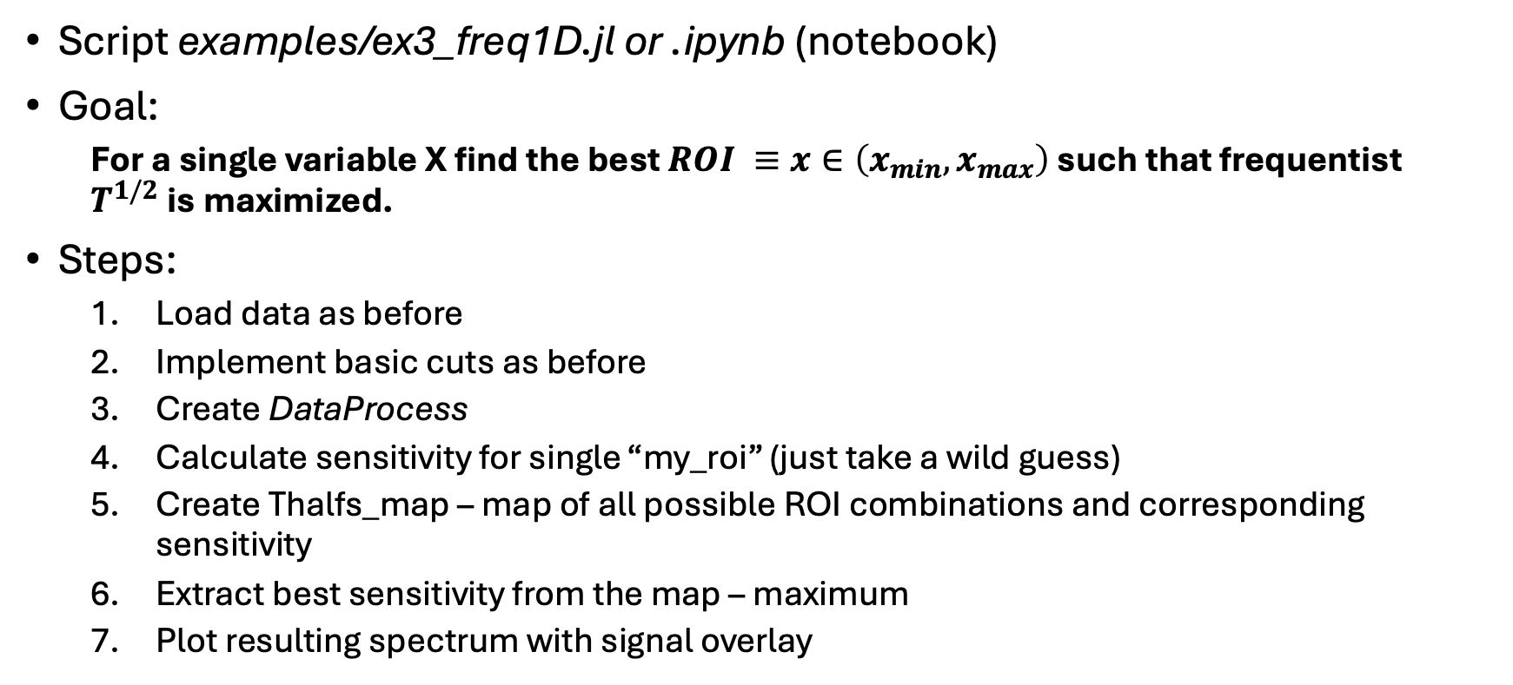
Worked examples – Example 3
Script examples/ex3_freq1D.jl or .ipynb (notebook)
Goal:
  For a single variable X find the best $ROI ≡x∈\left(x_{min},x_{max}\right)$ such that frequentist $T^{1/2}$is maximized.
Steps:
  Load data as before
  Implement basic cuts as before
  Create DataProcess
  Calculate sensitivity for single “my_roi” (just take a wild guess)
  Create Thalfs_map – map of all possible ROI combinations and corresponding sensitivity
  Extract best sensitivity from the map – maximum
  Plot resulting spectrum with signal overlay

Slide 26
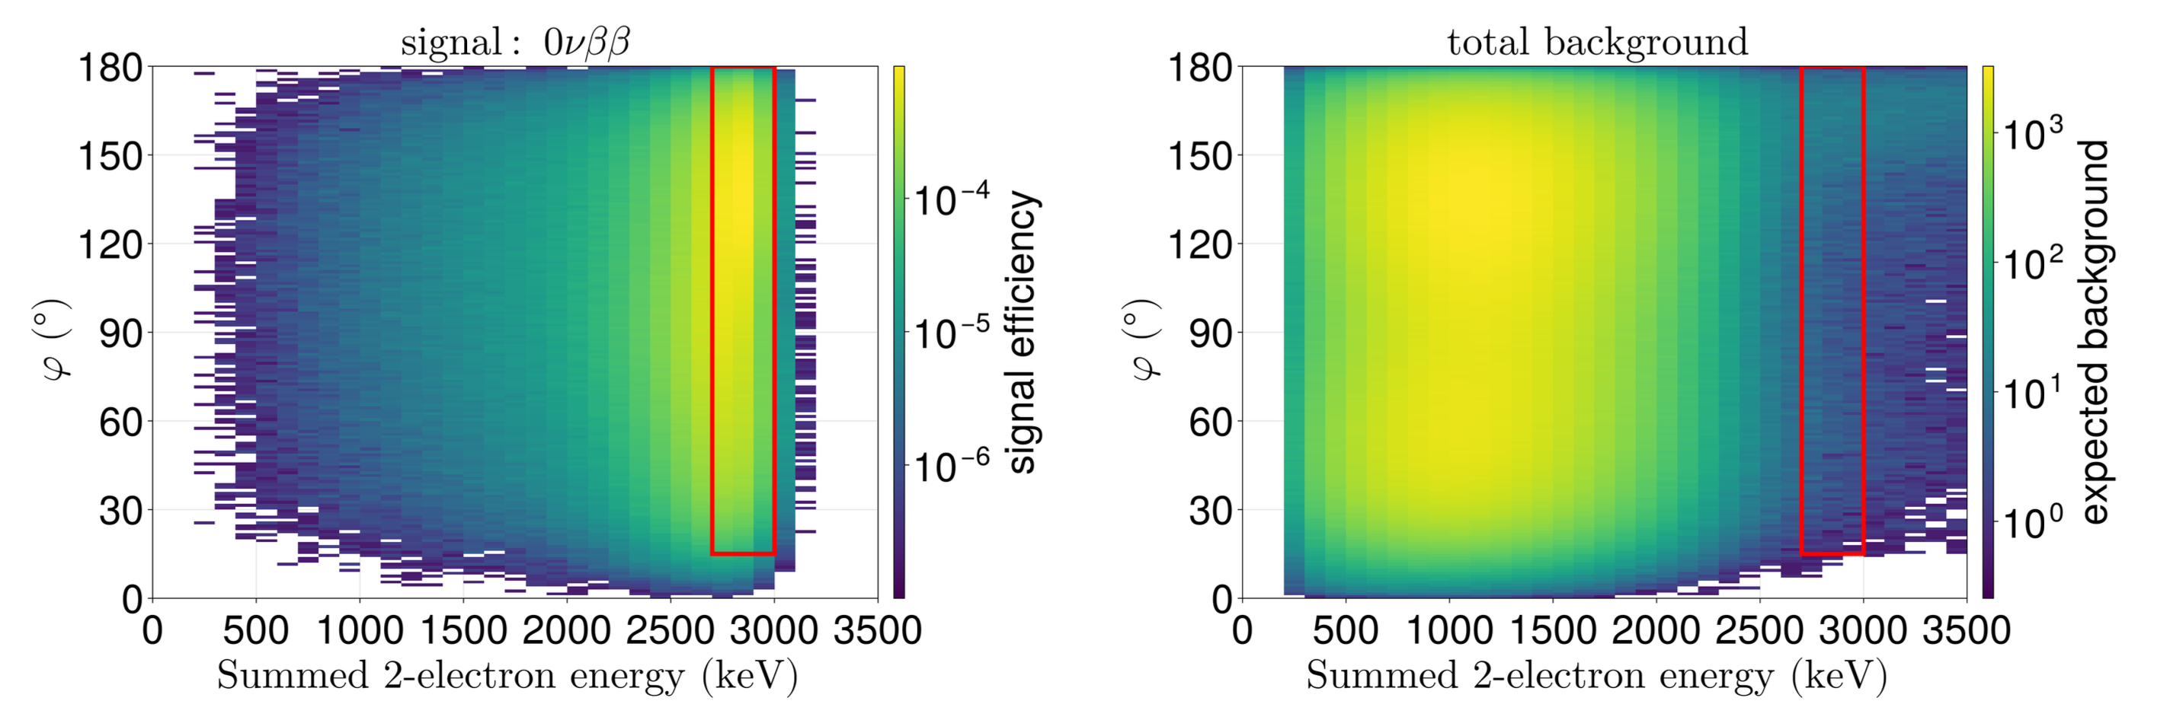

Worked examples – Example 4
Script examples/ex4_freqND.jl or .ipynb (notebook)
Goal:
  For a collection of variables find the best $ROI$which maximizes $T^{1/2}$.
From my phd thesis

Slide 27
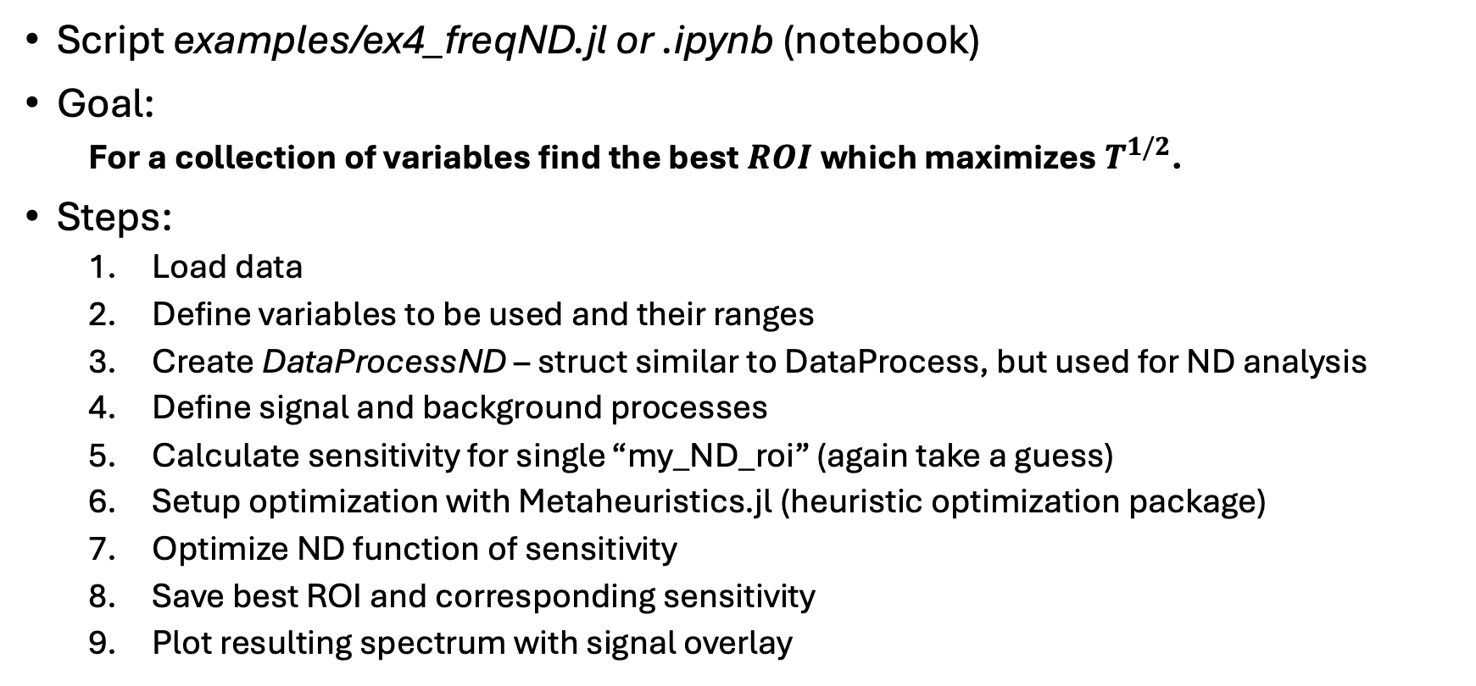
Worked examples – Example 4
Script examples/ex4_freqND.jl or .ipynb (notebook)
Goal:
  For a collection of variables find the best $ROI$which maximizes $T^{1/2}$.
Steps:
  Load data
  Define variables to be used and their ranges
  Create DataProcessND – struct similar to DataProcess, but used for ND analysis
  Define signal and background processes
  Calculate sensitivity for single “my_ND_roi” (again take a guess)
  Setup optimization with Metaheuristics.jl (heuristic optimization package)
  Optimize ND function of sensitivity
  Save best ROI and corresponding sensitivity
  Plot resulting spectrum with signal overlay
From my phd thesis

Slide 28
Worked examples – Example 5
Script examples/ex5_realistic_detector.jl or .ipynb (notebook)
Goal:
  Find sensitivity per phase using official simulation.
From my phd thesis

